Slide 1
CHAPTER 2 The Nature of Matter
Chapter 2 Section 1

Slide 2
What is an atom?
Basic building blocks of matter
Extremely small
Composition

Slide 3
An Element in the Periodic Table
1
6
C
Carbon
12.011

Slide 4
What is an element?
Pure substance that contains only 1 type of atom
24 occur in living organisms
Chemical symbol
Isotopes

Slide 5
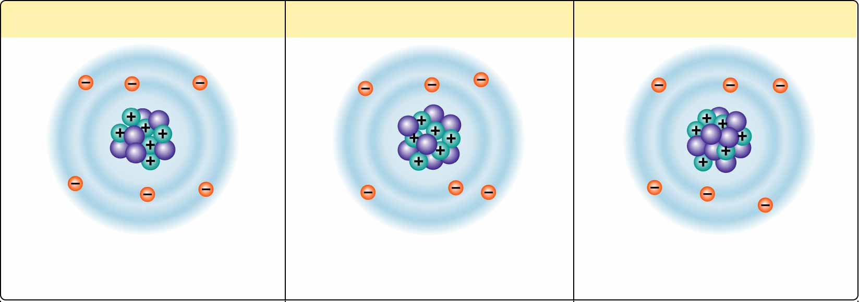
Figure 2-2 Isotopes of Carbon
Nonradioactive carbon-12
Nonradioactive carbon-13
Radioactive carbon-14
6 electrons
6 protons
6 neutrons
6 electrons
6 protons
7 neutrons
6 electrons
6 protons
8 neutrons

Slide 6
What is an element?
Pure substance that contains only 1 type of atom
24 occur in living organisms
Chemical symbol
Isotopes
Atoms that have varying number of neutrons
Atomic mass is a weighted average
Since they have same # of electrons, have same chemical properties
Radioactive isotopes
Nucleus is unstable
Breaks down at constant rate
Uses

Slide 7
What is a compound?
Compound
Two or more elements in definite proportions
Chemical formula
Ex. C₂H₄, H₂O
Chemical properties change when atoms combine
NaCl

Slide 8
My name is Bond…Chemical Bond
Chemical Bonds
Based on valence e- configuration
Ionic Bonds
Created by transfer of e- creating ions

Slide 9
Figure 2-3 Ionic Bonding
Section 2-1
Sodium atom (Na)
Chlorine atom (Cl)
Sodium ion (Na⁺)
Chloride ion (Cl⁻)
Transfer
of electron
Protons +11
Electrons -11
Charge 0
Protons +17
Electrons -17
Charge 0
Protons +11
Electrons -10
Charge +1
Protons +17
Electrons -18
Charge -1

Slide 10
Figure 2-3 Ionic Bonding
Section 2-1
Sodium atom (Na)
Chlorine atom (Cl)
Sodium ion (Na⁺)
Chloride ion (Cl⁻)
Transfer
of electron
Protons +11
Electrons -11
Charge 0
Protons +17
Electrons -17
Charge 0
Protons +11
Electrons -10
Charge +1
Protons +17
Electrons -18
Charge -1

Slide 11
My name is Bond…Chemical Bond
Chemical Bonds
Based on valence e- configuration
Ionic Bonds
Created by transfer of e- creating ions
Oppositely charged ions are attracted to one another
Ex. NaCl, MgCl₂

Slide 12
Chemical Bonds continued…
Covalent Bonds
Created when atoms share e-
Single, double, triple bonds
Non-polar
Equal sharing
Polar
Unequal sharing, results in partial charges

Slide 13
Intermolecular Attraction
Van der Waal forces
Nonpolar covalent
Rapid movement of e- can create brief charges
Opposites attract
Ex. Gecko

Slide 14
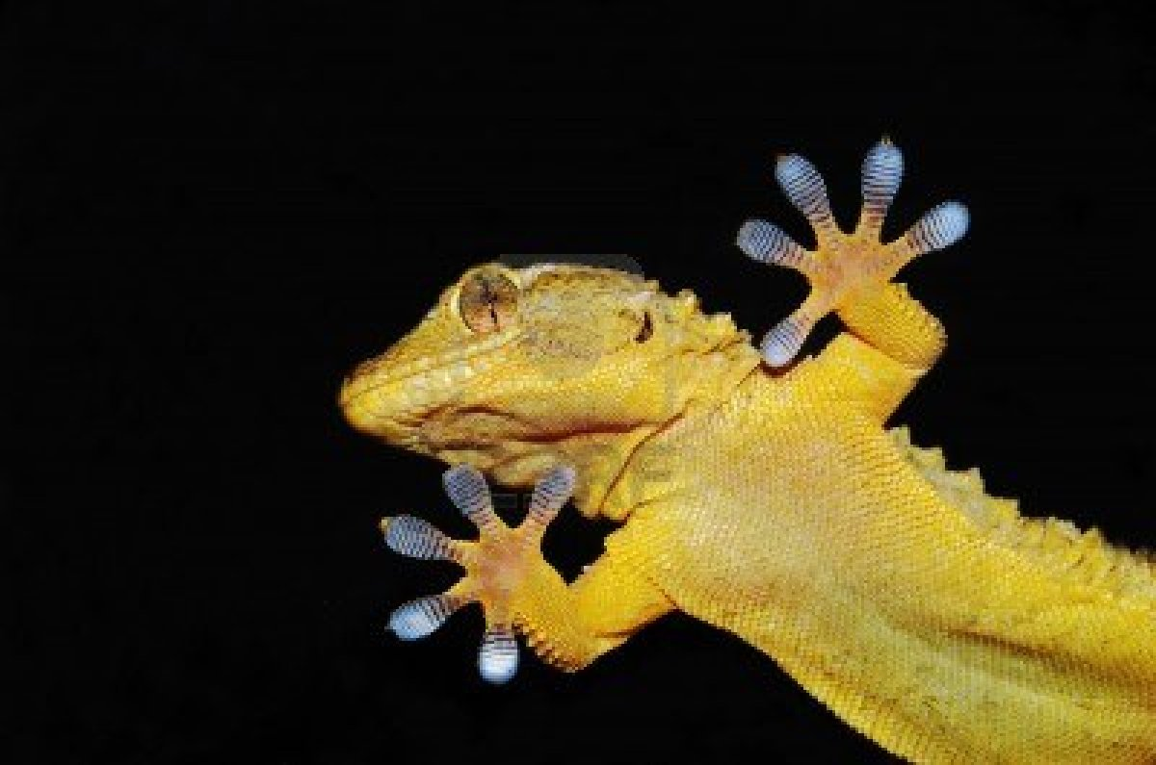

Slide 15
The Properties of Water
Chapter 2 Section 2

Slide 16
Chemistry of Water
Polar
Uneven sharing of e- creates partial charges
Hydrogen bonds
Weak attractions between opposite charges on polar molecules
Constantly breaking and reforming

Slide 17
Properties of Water
Due to hydrogen bonds
Cohesion
Water’s ability to stick to itself
Surface tension
Adhesion
Water’s ability to stick to other things
Capillary action
Excellent solvent
Dissolves substances

Slide 18
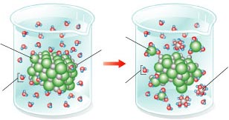
Figure 2-9 NaCI Solution
Section 2-2
Cl⁻
Cl⁻
Na⁺
Na⁺
Water
Water

Slide 19
Figure 2-9 NaCI Solution
Section 2-2
Cl⁻
Cl⁻
Na⁺
Na⁺
Water
Water

Slide 20
Properties of Water
Due to hydrogen bonds
Cohesion
Water’s ability to stick to itself
Surface tension
Adhesion
Water’s ability to stick to other things
Capillary action
Excellent solvent
Dissolves substances
Solutions
Parts are evenly distributed
Solute, solvent
Suspension
Mixture of water and nondisolved particles that do not settle out
Ex.

Slide 21
Acids and Bases
pH Scale
Indicates the [H+]
Range 0 to 14
Log scale based on unit 10

Slide 22
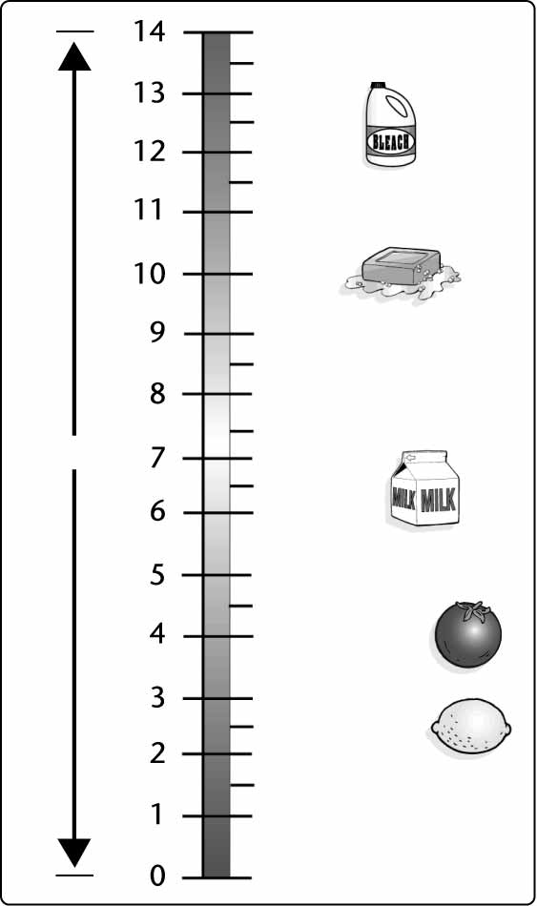
pH Scale
Section 2-2
Oven cleaner
Bleach
Ammonia solution
Increasingly Basic
Soap
Sea water
Neutral
Human blood
Pure water
Milk
Normal
rainfall
Acid rain
Increasingly Acidic
Tomato
juice
Lemon juice
Stomach acid

Slide 23
Acids and Bases
pH Scale
Indicates the [H+]
Range 0 to 14
Log scale based on unit 10
Acids
Compound that forms H+ ions
pH <7, sour taste
Bases
Produces OH- ions in solution
pH >7, bitter taste, slippery
Buffers
Substance that can act as acid or base
Minimize pH changes
Neutralization

Slide 24
Organic Compounds
Chapter 2 Section 3- The chemistry of carbon

Slide 25
Carbon Compounds
Organic chemistry
Compounds that contain C and are fairly complex
C has 4 valence e-
Can create 4 covalent bonds
Allows it to form chains
Double, triple bonds

Slide 26
Figure 2-11 Carbon Compounds
Methane
Acetylene
Butadiene
Benzene
Isooctane

Slide 27
Carbon Compounds
Organic chemistry
Compounds that contain C and are fairly complex
C has 4 valence e-
Can create 4 covalent bonds
Allows it to form chains
Double, triple bonds
C, H, O, N, P, S

Slide 28
Macromolecules
Macromolecules
Monomers → polymers
Dehydration synthesis
Putting together by the removal of water
Creates a covalent bond
Hydrolysis is used to reverse process (breakdown)
Breaking apart by adding water
Both require enzymes
4 major groups

Slide 29
Carbohydrates
(CH₂O)_{n}
Monosaccharides
Simple sugars
C₆H₁₂O₆ (glucose, fructose, galactose)
–ose=sugar
take on ringed structure
Polysaccharides
Formed by combing monomers by dehydration synthesis
Creates a covalent glycosidic bond
Forms of
Glycogen, starch, cellulose

Slide 30
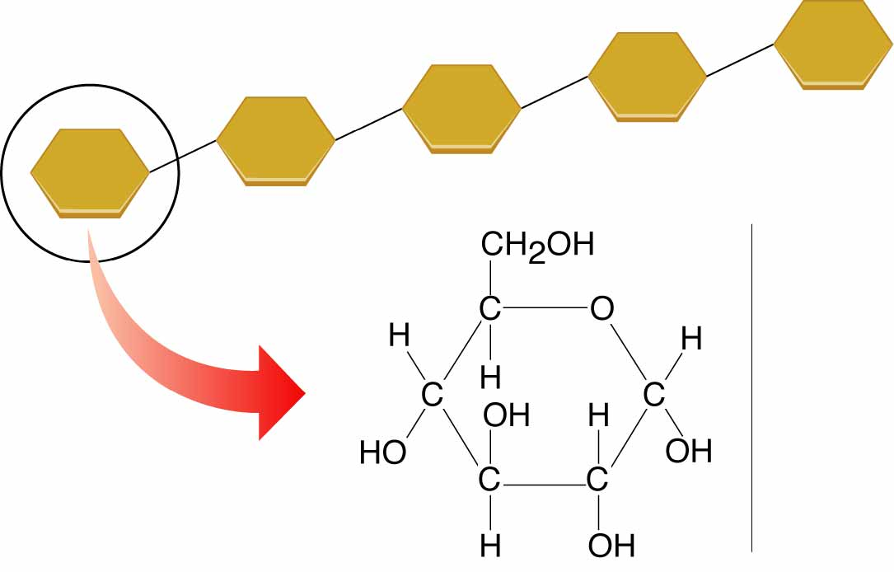
Figure 2-13 A Starch
Section 2-3
Starch
Glucose

Slide 31
Lipids
Fats, oils, waxes, steroids
C, H, O (O in less amounts than carbs)
Hydrophobic- insoluble in water
Function- energy, cell membrane( phospholipids)
Structure
Glycerol backbone
Fatty acids (1,2,3)
Long hydrocarbon chain
Dehydration synthesis between OH group on glycerol and H in carboxyl group

Slide 32
2 Major Types of Lipids
Two major groups
Saturated fats
No double bonds between C
Max # of C, H
Animal fats, solid at room temperature
Unsaturated fats
Double, even triple bonds between C
Plant and fish oils, liquid at room temperature
Hydrogenation-adding H to unsaturated fats to make them saturated.

Slide 33
Nucleic Acids
Contain Phosphorus and Nitrogen (C, H, O)
Base structure=Nucleotide
5 C sugar
Nitrogen base
Phosphate group
Three types
DNA, RNA and ATP

Slide 34
DNA-Deoxyribonucleic Acid
DNA
Deoxyribonucleic acid
Genetic material
Long double strand of repeating nucleotides
Four nitrogen bases
Chargraff’s pairing rules
A-T, C-G

Slide 35
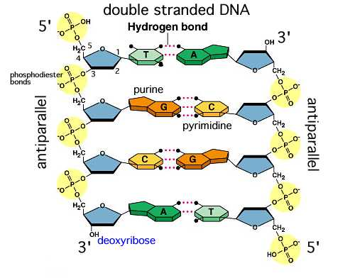

Slide 36
RNA-Ribonucleic Acid
RNA
Single strand
Ribose sugar
Uracil replaces Thymine (A-U)

Slide 37
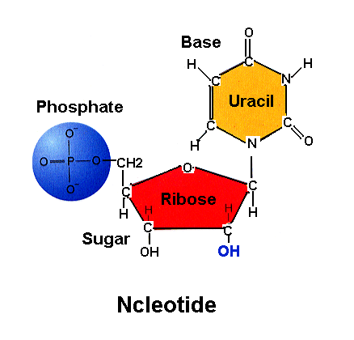

Slide 38
RNA-Ribonucleic Acid
RNA
Single strand
Ribose sugar
Uracil replaces Thymine (A-U)
Major role-protein synthesis
Three types
R-RNA
M-RNA
T-RNA

Slide 39
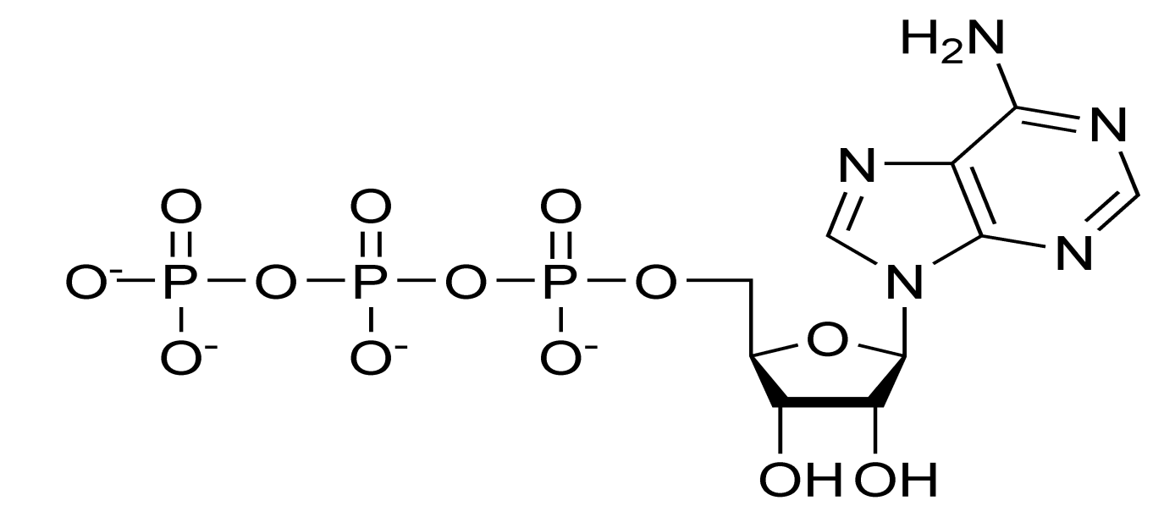
ATP
ATP (adenosine tri phosphate)
Energy currency

Slide 40
Proteins
Control just about every function in the cell including:
Rate of reaction
Form bones, muscle, hair, skin, and nails
Immune system
Composed of subunits called amino acids
20 common amino acids
Central carbon attached to :
Hydrogen, carboxyl, amino group, and R group

Slide 41
Figure 2-16 Amino Acids
Section 2-3
Amino group
Carboxyl group
General structure
Alanine
Serine

Slide 42
Figure 2-16 Amino Acids
Section 2-3
Amino group
Carboxyl group
General structure
Alanine
Serine

Slide 43
Figure 2-16 Amino Acids
Section 2-3
Amino group
Carboxyl group
General structure
Alanine
Serine

Slide 44
Proteins
Control just about every function in the cell including:
Rate of reaction
Form bones, muscle, hair, skin, and nails
Immune system
Composed of subunits called amino acids
20 common amino acids
Central carbon attached to :
Hydrogen, carboxyl, amino group, and R group
Created by dehydration synthesis between amino group of one and carboxyl group of another.
Peptide bond

Slide 45
Protein Structure- 4 Levels
Levels of structure
Primary-amino acid sequence
Secondary-twisting or folding
Tertiary- folding upon itself
Quaternary-two or more polypeptides twist together to form function protein
SHAPE DETERMINES FUNCTION

Slide 46
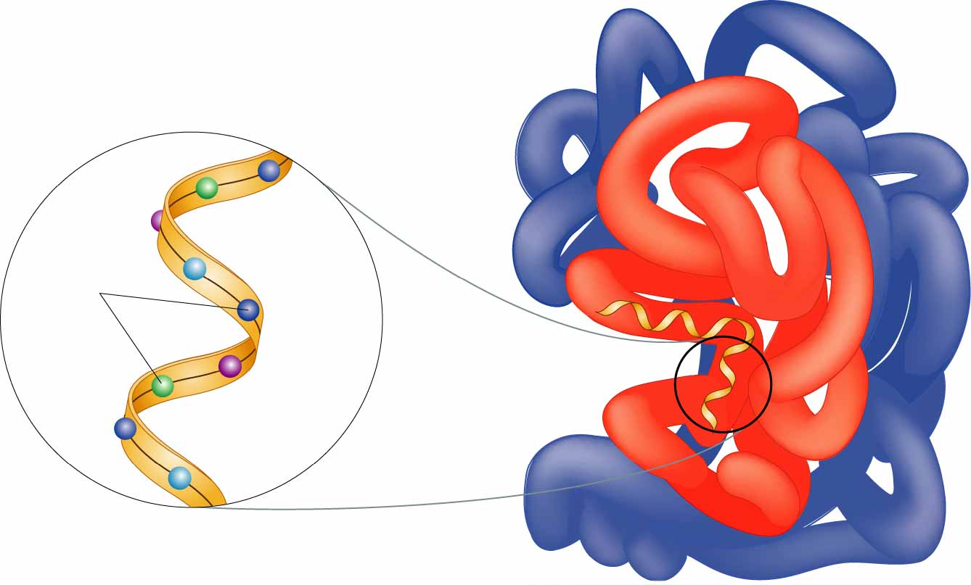
Figure 2-17 A Protein
Section 2-3
Amino
acids

Slide 47
Chemical Reaction and Enzymes
Chapter 2 Section 4

Slide 48
Chemical Reaction Overview
Chemical Reaction
Process that changes or transfers one set of chemicals into another
Reactants ⎯⎯→ Products
Involves changing the chemical bonds
Reversible
Ex. CO₂ + H₂O H₂CO₃

Slide 49
How energy is used determines the type of chemical reaction.
Energy in Reactions
Some chemical reactions absorb energy, some release energy
Endergonic- absorbs energy

Slide 50
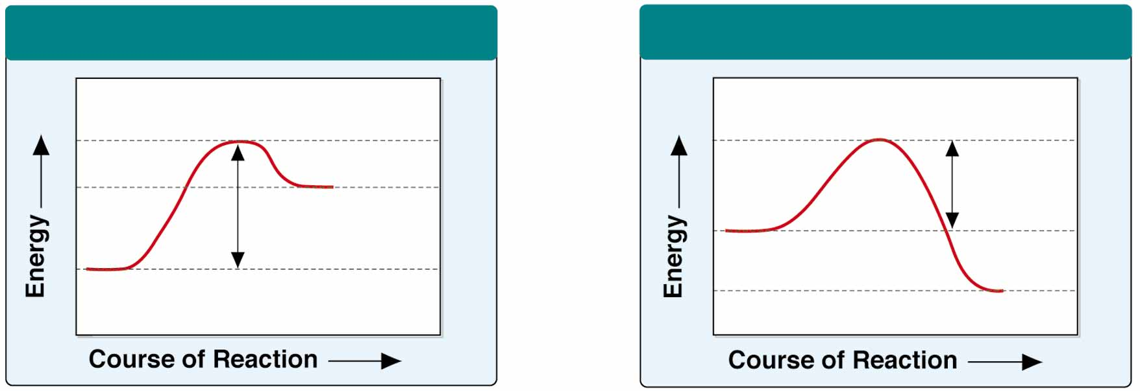
Figure 2-19 Chemical Reactions
Energy-Absorbing Reaction
Energy-Releasing Reaction
Products
Activation
energy
Activation energy
Reactants
Reactants
Products

Slide 51
How energy is used determines the type of chemical reaction.
Energy in Reactions
Some chemical reactions absorb energy, some release energy
Endergonic- absorbs energy
Exergonic- release energy

Slide 52
Figure 2-19 Chemical Reactions
Energy-Absorbing Reaction
Energy-Releasing Reaction
Products
Activation
energy
Activation energy
Reactants
Reactants
Products

Slide 53
How energy is used determines the type of chemical reaction.
Energy in Reactions
Some chemical reactions absorb energy, some release energy
Endergonic- absorbs energy
Exergonic- release energy
Regardless, all chemical reactions require activation energy
Energy needed to start chemical reaction

Slide 54
Enzymes
Enzymes
Proteins that are necessary for chemical reactions to take place
Reactions occur in series of small steps
Lowers activation energy

Slide 55
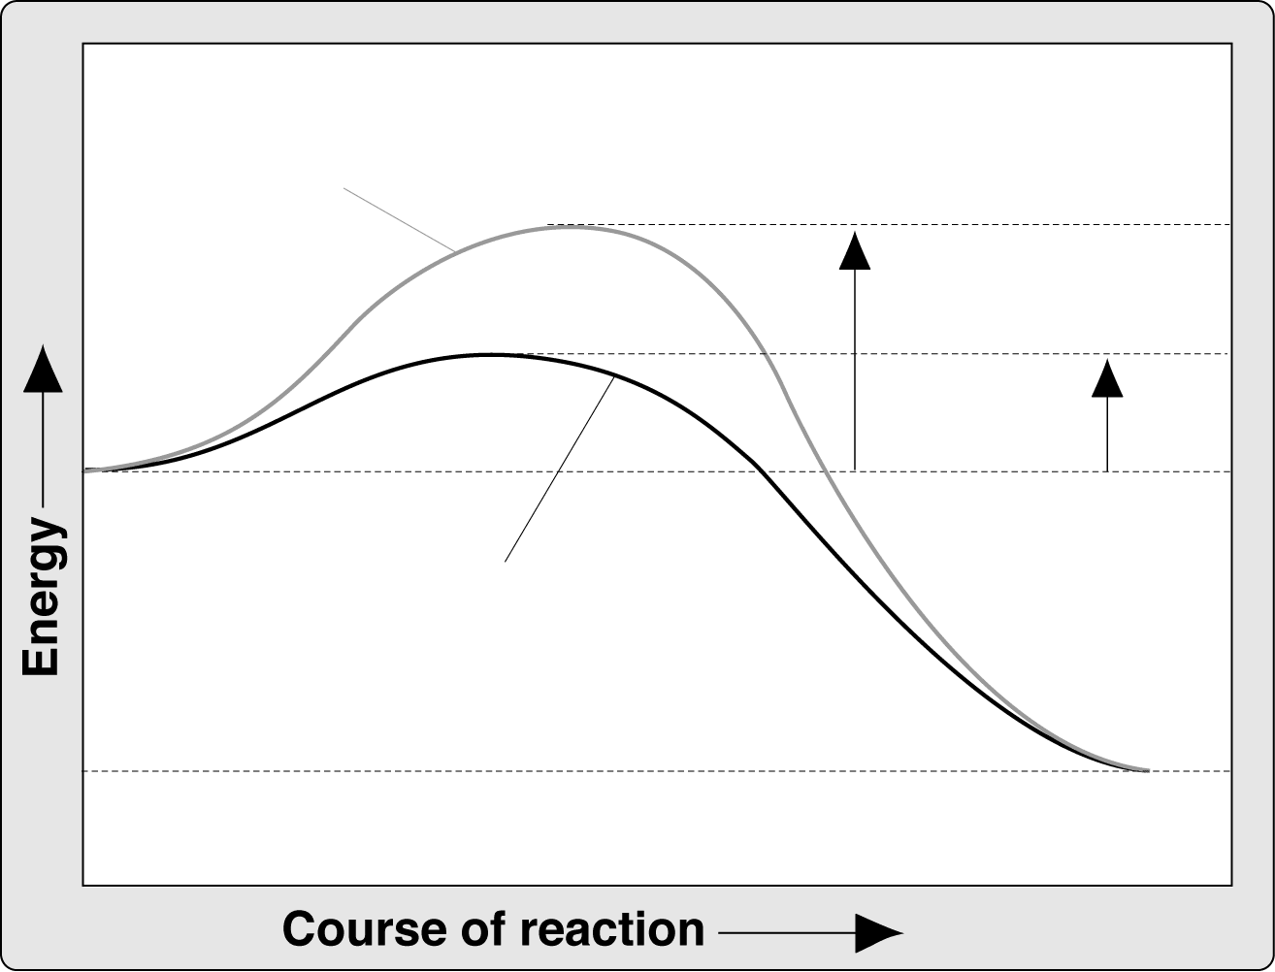
Effect of Enzymes
Section 2-4
Reaction pathway
without enzyme
Activation energy
without enzyme
Reactants
Activation
energy
with enzyme
Reaction pathway
with enzyme
Products

Slide 56
Enzymes
Enzymes
Proteins that are necessary for chemical reactions to take place
Reactions occur in series of small steps
Lowers activation energy
Enzyme for each step
Catalysts
Not changed during reaction
-ase=enzyme

Slide 57
How do enzymes work?
How enzymes work
Active site
Enzyme substrate complex
Physically bring reactants closer together
Lock and key fit

Slide 58
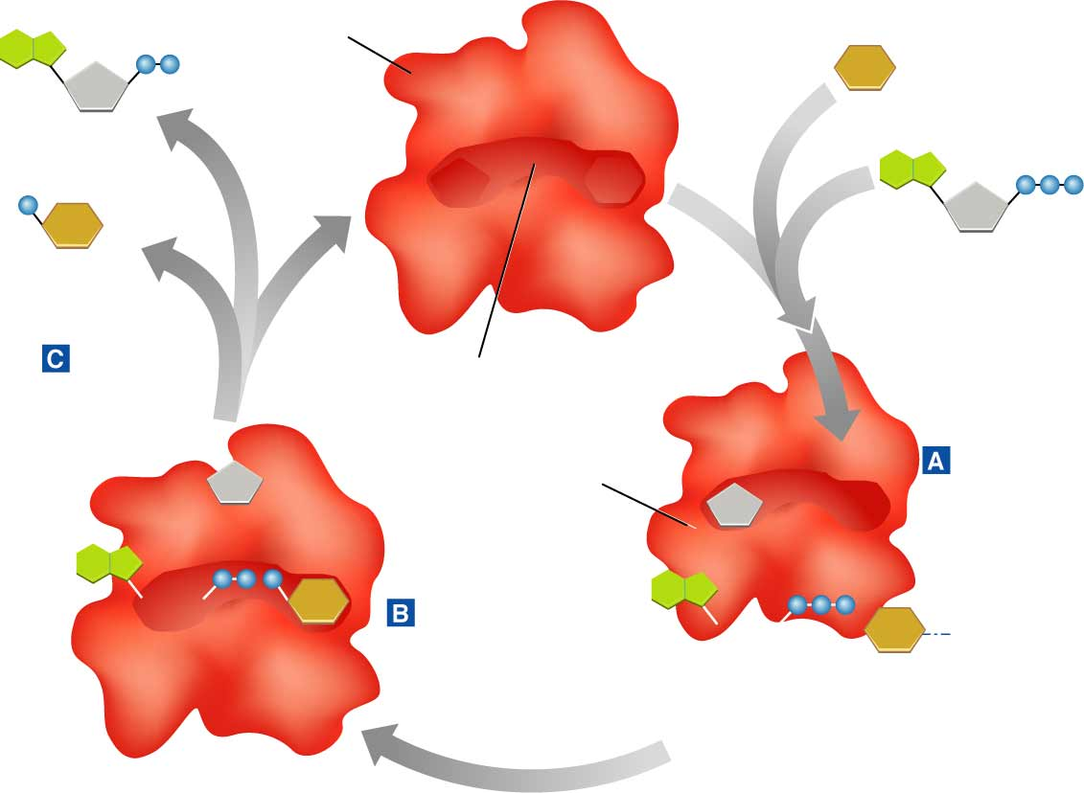
Figure 2-21 Enzyme Action
Section 2-4
Enzyme
(hexokinase)
Glucose
Substrates
ADP
Products
Glucose-6-
phosphate
ATP
Products
are released
Active site
Enzyme-substrate
complex
Substrates
bind to
enzyme
Substrates
are converted
into products

Slide 59
Figure 2-21 Enzyme Action
Section 2-4
Enzyme
(hexokinase)
Glucose
Substrates
ADP
Products
Glucose-6-
phosphate
ATP
Products
are released
Active site
Enzyme-substrate
complex
Substrates
bind to
enzyme
Substrates
are converted
into products

Slide 60
Figure 2-21 Enzyme Action
Section 2-4
Enzyme
(hexokinase)
Glucose
Substrates
ADP
Products
Glucose-6-
phosphate
ATP
Products
are released
Active site
Enzyme-substrate
complex
Substrates
bind to
enzyme
Substrates
are converted
into products

Slide 61
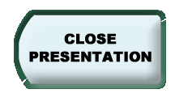
Figure 2-21 Enzyme Action
Section 2-4
Enzyme
(hexokinase)
Glucose
Substrates
ADP
Products
Glucose-6-
phosphate
ATP
Products
are released
Active site
Enzyme-substrate
complex
Substrates
bind to
enzyme
Substrates
are converted
into products

Slide 62
How do enzymes work?
How enzymes work
Active site
Enzyme substrate complex
Physically bring reactants closer together
Lock and key fit
Factors affecting enzyme function
Temperature
pH level
Enzyme concentration
Substrate concentration

