Slide 1
Chapter 15
Section 1

Slide 2
Charles Darwin
1832 HMS Beagle
5 year voyage
Charted coastlines of S. America

Slide 3
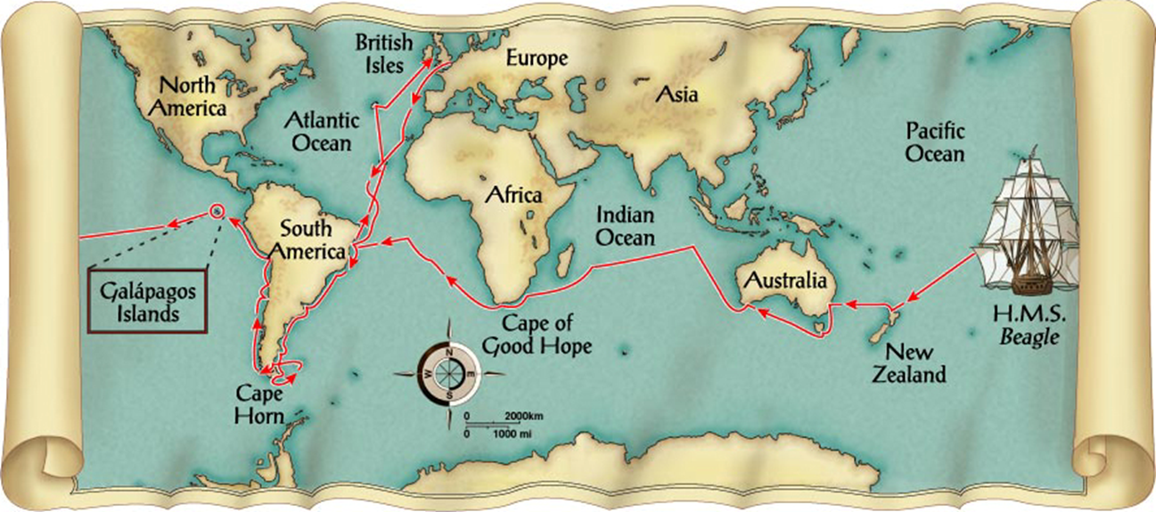

Slide 4
Charles Darwin
1832 HMS Beagle
5 year voyage
Charted coastlines of S. America
Galapagos Islands
Volcanic island chain
Noticed that organisms varied from island to island
Did not match mainland

Slide 5
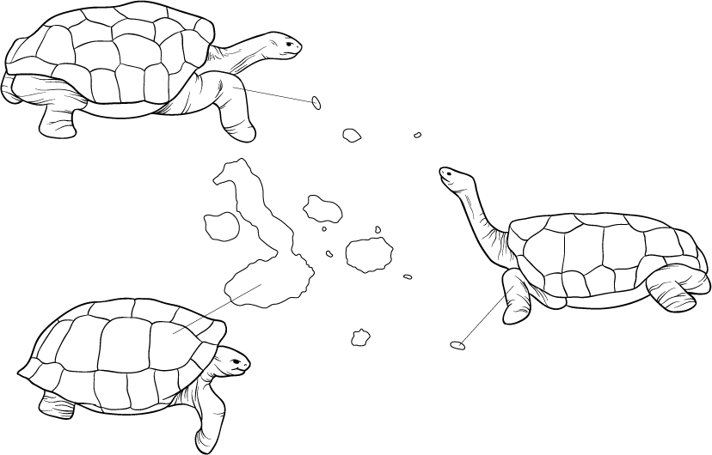
Giant Tortoises of the Galápagos Islands
Section 15-1
Pinta
Marchena
Tower
Pinta Island Intermediate shell
Fernandina
James
Santa Cruz
Isabela
Santa Fe
Hood Island
Saddle-backed shell
Floreana
Hood
Isabela Island
Dome-shaped shell

Slide 6
Charles Darwin
1832 HMS Beagle
5 year voyage
Charted coastlines of S. America
Galapagos Islands
Volcanic island chain
Noticed that organisms varied from island to island
Did not match mainland
Darwin’s finches
Due to isolation, species appeared to develop changes that made them better fit for their environment
Descent with modification
Also noted how continental crust changed during earthquake activity

Slide 7
Chapter 15
Section 2: Scientists that influenced Darwin’s Thinking

Slide 8
James Hutton- Geologist
Described the geologic forces the shape the Earth
Mountain building
Processes are very slow

Slide 9
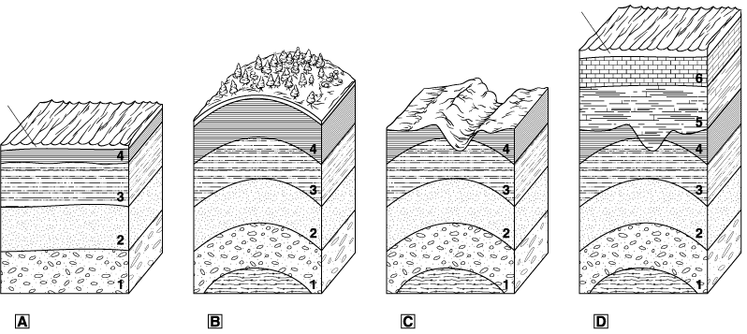
Movement of Earth’s Crust
Section 15-2
Sea level
Sea level
Sedimentary rocks form in horizontal layers.
When part of Earth’s crust is compressed, a bend in a rock forms, tilting the rock layers.
As the surface erodes due to water, wind, waves, or glaciers, the older rock surface is exposed.
New sediment is then deposited above the exposed older rock surface.

Slide 10
James Hutton- Geologist
Described the geologic forces the shape the Earth
Mountain building
Processes are very slow
Earth had to be much older than the few thousand years old that was currently believed

Slide 11
Charles Lyell- Geologist
The principles of Geology
Published many ideas, but one was of particular importance
The principle of uniformitarianism
Idea the geologic events that shape the Earth today, must have been operating in the past
Earth was extremely old and had changed slowly
Darwin wondered if you could say the same about life

Slide 12
Jean Baptist Lamarck- 1809
Realized that living things changed over time
Organisms of today were descended from past
However, the mechanism he described was wrong
Three principles
Organisms move toward a perfect state
Law of use and disuse
The more a particular part of an individual is used, the stronger it becomes

Slide 13
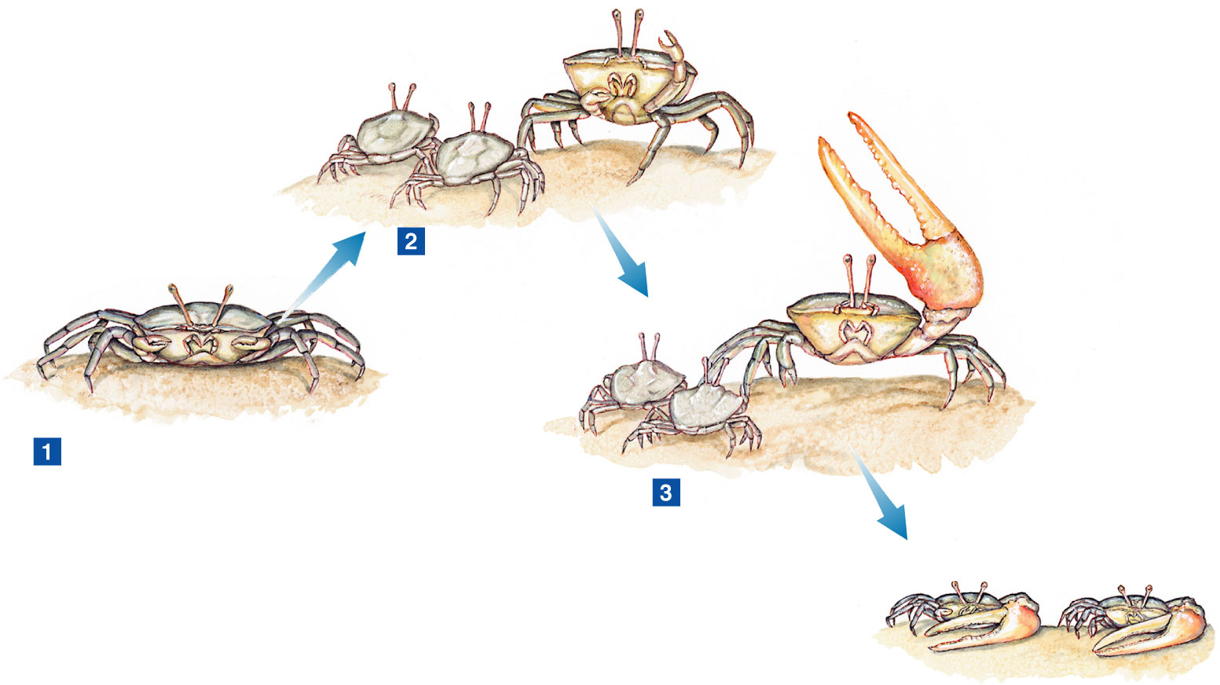
Figure 15–7 Lamarck’s Theory of Evolution
Section 15-2

Slide 14
Jean Baptist Lamarck- 1809
Realized that living things changed over time
Organisms of today were descended from past
However, the mechanism he described was wrong
Three principles
Organisms move toward a perfect state
Law of use and disuse
The more a particular part of an individual is used, the stronger it becomes
Inheritance of acquired characteristics
Characteristics acquired during life are passed to offspring

Slide 15
Figure 15–7 Lamarck’s Theory of Evolution
Section 15-2

Slide 16
Jean Baptist Lamarck- 1809
Realized that living things changed over time
Organisms of today were descended from past
However, the mechanism he described was wrong
Three principles
Organisms move toward a perfect state
Law of use and disuse
The more a particular part of an individual is used, the stronger it becomes
Inheritance of acquired characteristics
Characteristics acquired during life are passed to offspring
Ex. Giraffes

Slide 17
Thomas Malthus
Realized that populations grow quicker than their food source
What prevents this?
War, famine and disease.
Darwin realized that natural populations reproduce at even higher rates than humans

Slide 18
Chapter 15
Section 3:Natural Selection and Evidence

Slide 19
Darwin’s Mechanism of Evolution
Natural Selection
On the Origin of Species by Means of Natural Selection
Major points of Darwin’s theory
Overproduction
Variation
Differences between organisms of the same species
Must be able to inherit
Competition
Limited resources
Those who are more fit, get more resources

Slide 20
Darwin’s Mechanism of Evolution
Survival of the fittest
Organisms who are more fit live longer and reproduce more
Natural selection
Environment selects for those traits that make an organism a better fit
Adaptation
Population acquires those traits that make it better fit to live a particular environment
Descent with modification
Evolution/speciation

Slide 21
Evidence of Evolution
Fossils
Any object that provides evidence of organisms that once inhabited the Earth
Many different types
Comparative Anatomy
Study of structural similarities and differences
Some similarities offer evidence of evolution relationships
Common ancestry

Slide 22
Comparative Anatomy
Homologous structures
Similar internal structure and embryonic development, but different function
Ex. Bones in forelimbs of modern vertebrates

Slide 23
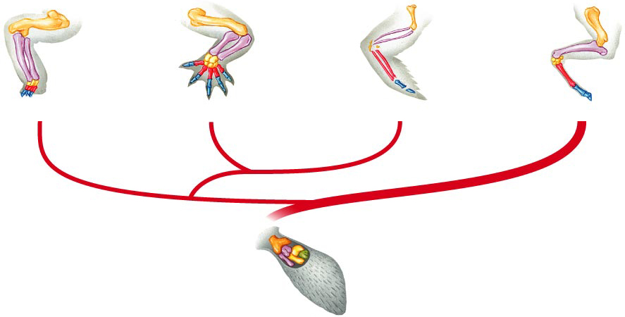
Figure 15–15 Homologous Body Structures
Section 15-3
Turtle
Alligator
Bird
Mammal
Ancient lobe-finned fish

Slide 24
Comparative Anatomy
Homologous structures
Similar internal structure and embryonic development, but different function
Ex. Bones in forelimbs of modern vertebrates
Vestigial structures
Remnants of structures that were once purposeful
Present day- have lost function
Ex. In humans
Ex. Snakes and whales

Slide 25
Comparative Anatomy
Embryological Development
The more closely related two organisms are, the longer they look like one another
Common ancestor more recent
Vertebrate embryos
Pharyngeal gill slits, tail, 2 chambered heart
As development proceeds certain traits are reduced or disappear

Slide 26
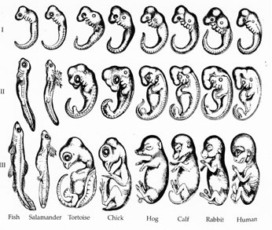

Slide 27
Biochemical Evidence
Universal genetic code
Similarities in protein structure

Slide 28
Analogous Structures
Similar external form and function, but different internal structure
Convergent evolution
Organisms are not related
Ex. Wings of birds and insects

