Slide 1
Chapter 14
Section 1 Human Heredity

Slide 2
Human Chromosomes
Human chromosomes
46 total, 23 pairs
22 pairs of autosomes
1 pair of sex chromosomes
Male vs. female

Slide 3
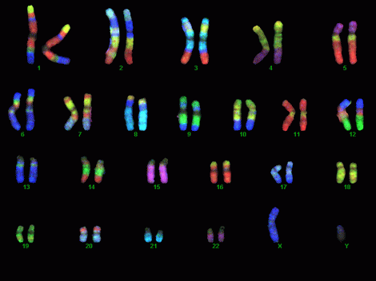

Slide 4
Human Chromosomes
Human chromosomes
46 total, 23 pairs
22 pairs of autosomes
1 pair of sex chromosomes
Male vs. female
Karyotype
Picture taken of chromosomes while they are condensed
Used to look for genetic problems

Slide 5
Tracking traits
Pedigree
Family tree that follows one particular trait

Slide 6
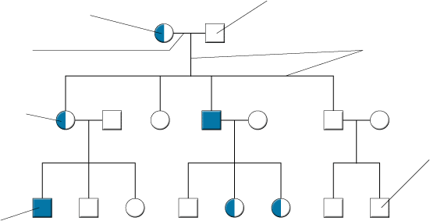
Figure 14-3 A Pedigree
Section 14-1
A circle represents a female.
A square represents a male.
A horizontal line connecting a male and female represents a marriage.
A vertical line and a bracket connect the parents to their children.
A half-shaded circle or square indicates that a person is a carrier of the trait.
A circle or square that is not shaded indicates that a person neither expresses the trait nor is a carrier of the trait.
A completely shaded circle or square indicates that a person expresses the trait.

Slide 7
Tracking traits
Pedigree
Family tree that follows one particular trait
Circle=female, square=male
Shading significance

Slide 8
Human genome
Our complete set of genetic information
Maps out the genes on each chromosome
Established in 2003

Slide 9
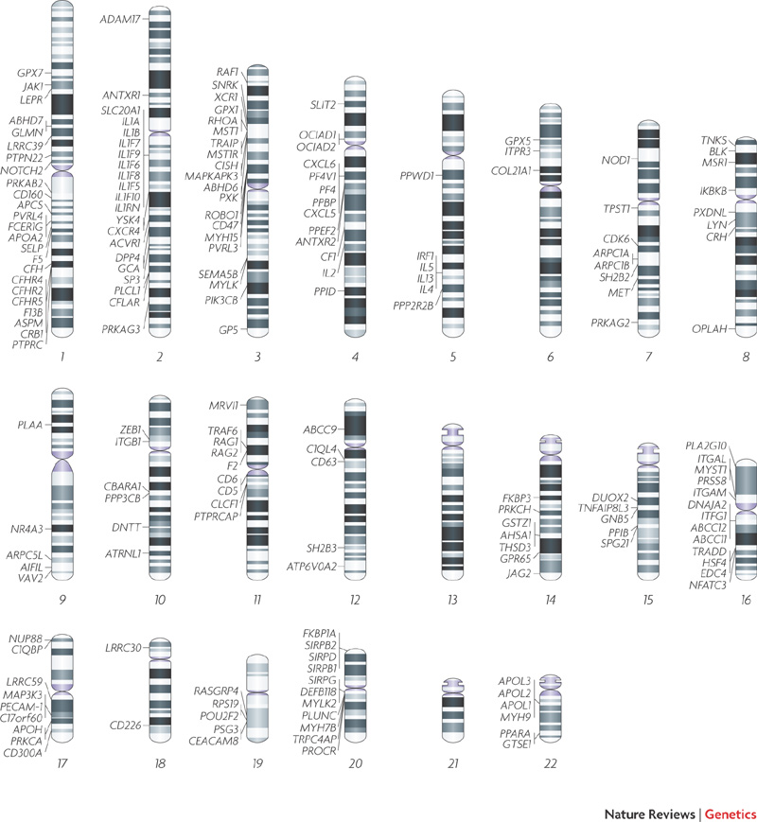

Slide 11
Recessive Genetic Disorders
PKU phenylketoneuria
Individuals lack an enzyme needed to breakdown phenylalanine
If have amino acid build up in brain tissue
Mental retardation
All babies in US are tested for defect on chromosome 12

Slide 12
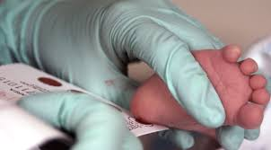

Slide 13
Recessive Genetic Disorders
PKU phenylketoneuria
Individuals lack an enzyme needed to breakdown phenylalanine
If have amino acid build up in brain tissue
Mental retardation
All babies in US are tested for defect on chromosome 12
Treatment-
Tay Sachs
Common in Jewish families of European descent
Causes nervous system to breakdown
Causes death in first few years of life
No treatment
Can be tested for presence of allele

Slide 14
Recessive Genetic Disorders
Cystic Fibrosis
Common among people of Northern Europe descent
Chromosome 7
Defect in Cl- protein channels causes mucus to become very thick

Slide 15
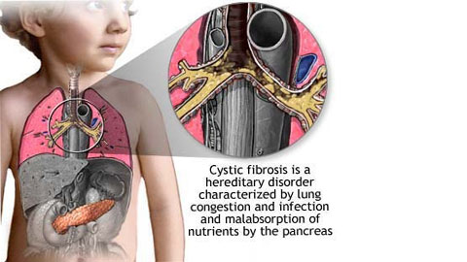

Slide 16
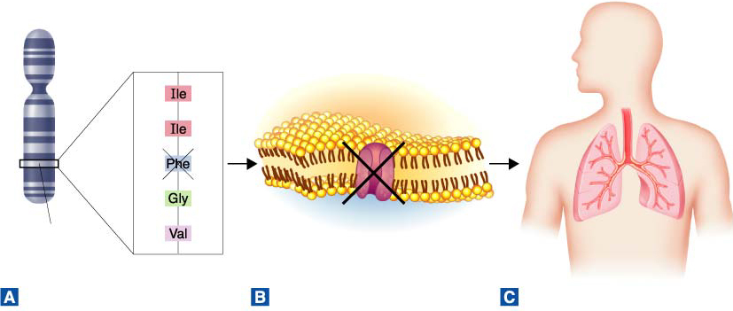
Figure 14-8 The Cause of Cystic Fibrosis
Section 14-1
Chromosome # 7
CFTR gene
The most common allele that causes cystic fibrosis is missing 3 DNA bases. As a result, the amino acid phenylalanine is missing from the CFTR protein.
Normal CFTR is a chloride ion channel in cell membranes. Abnormal CFTR cannot be transported to the cell membrane.
The cells in the person’s airways are unable to transport chloride ions. As a result, the airways become clogged with a thick mucus.

Slide 17
Recessive Genetic Disorders
Cystic Fibrosis
Common among people of Northern Europe descent
Chromosome 7
Defect in Cl- protein channels causes mucus to become very thick
Lungs and digestive tract effected
Treament-

Slide 18
Recessive Genetic Disorders
Sickle Cell disease
Prevalent among African Americans
Affects hemoglobin chain
Carries oxygen
Causes cell shape to change

Slide 19
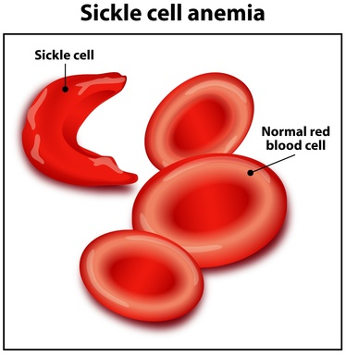

Slide 20
Recessive Genetic Disorders
Sickle Cell disease
Prevalent among African Americans
Affects hemoglobin chain
Carries oxygen
Causes cell shape to change
Causes damage due to blockage of capillaries
Brain, heart, spleen
Caused by single point mutation
Heterozygous advantage

Slide 21
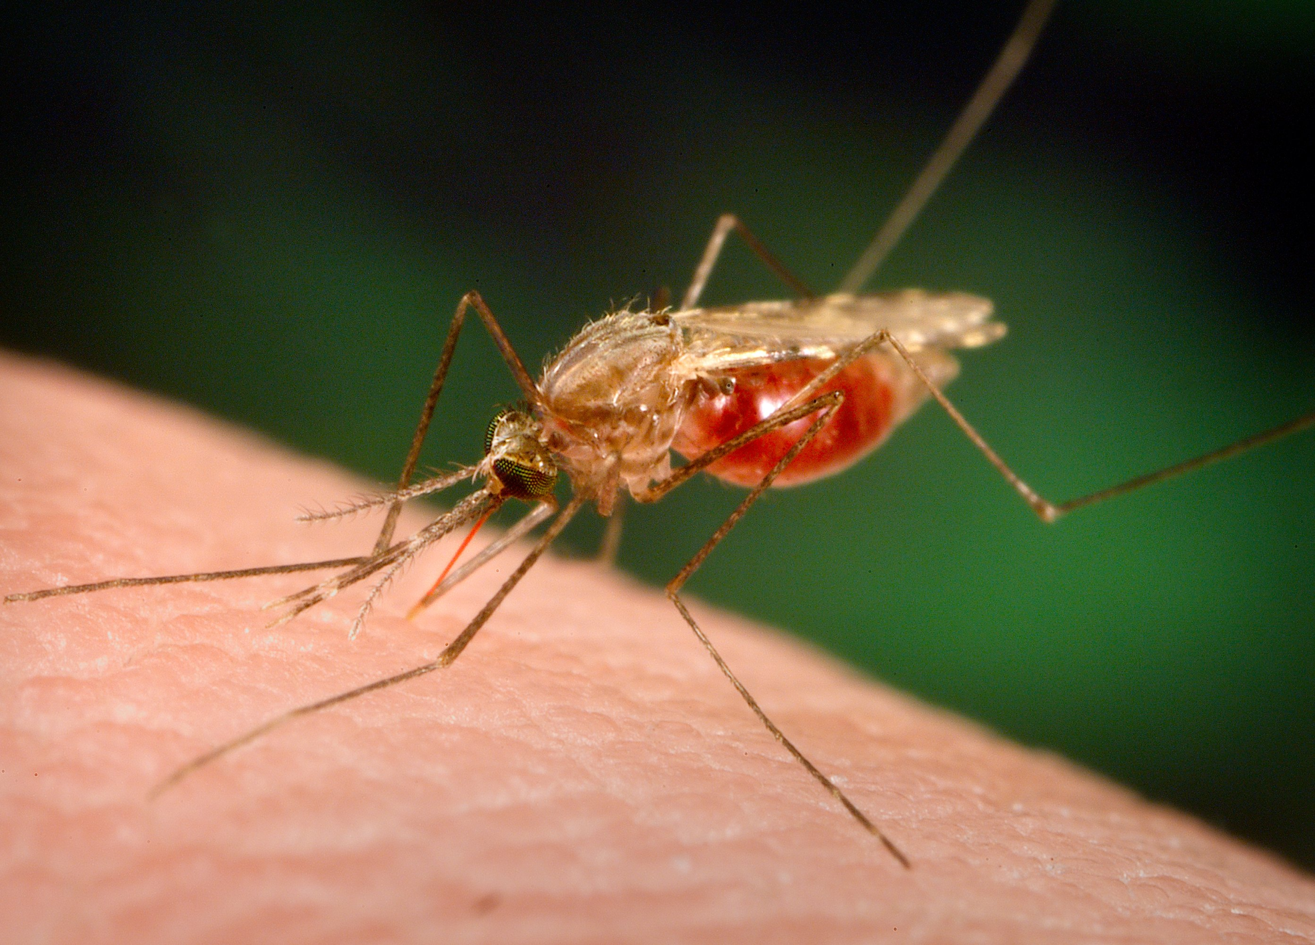

Slide 22
Dominant Genetic Disorders
Huntington’s Disease
Causes loss of muscle control and mental disease
Death
Symptoms do not occur until in 30’s
Achondroplasia dwarfism

Slide 23
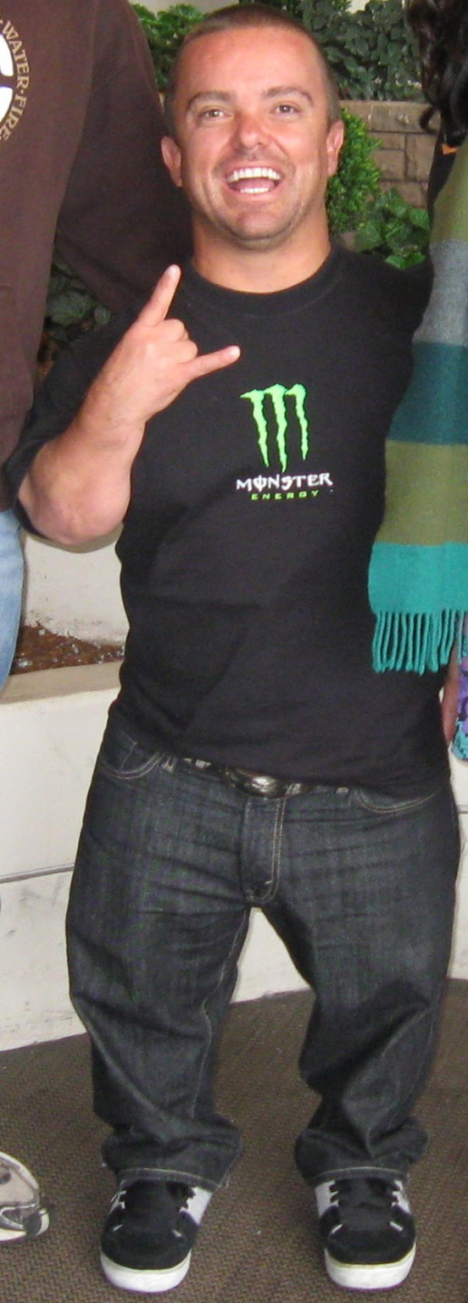
Jason Shannon Acuna
AKA
“WEE MAN”

Slide 24
Chapter 14
Section 2 Human Sex Chromosomes

Slide 25
Sex Linked Genes
Sex-linked genes
Genes that are located on the X or Y chromosome

Slide 26
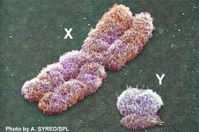
Comparison of X and Y chromosome in Humans

Slide 27
Sex Linked Genes
Sex-linked genes
Genes that are located on the X or Y chromosome
Y-few genes including hairy ears
X- 100 genes
Problem for males
Only carry one copy of X chromosome and it’s genes
Hemizygous

Slide 28
Sex-linked disorders
Colorblindness
Punnet square ex.

Slide 29
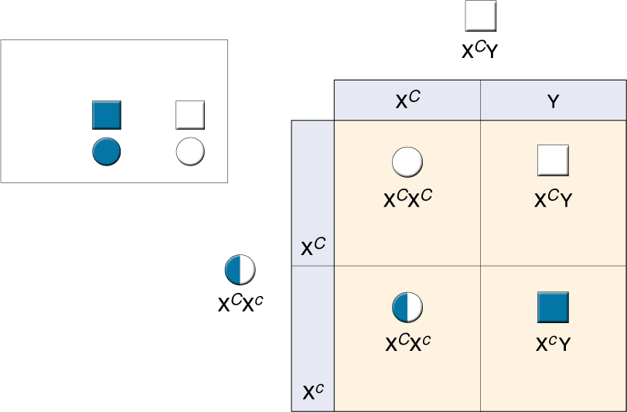
Figure 14-13 Colorblindness
Section 14-2
Father
(normal vision)
Normal vision
Colorblind
Male
Female
Daughter
(normal vision)
Son
(normal vision)
Mother (carrier)
Daughter
(carrier)
Son
(colorblind)

Slide 30
Sex Linked Disorders
Sex-linked disorders
Colorblindness
Punnet square ex.
Hemophilia
2 genes on X chromosome for blood clotting
Can bleed to death
Suffer internal bleeding, bruising
Treatment
Prior to 1980’s
Now
Duchenne Muscular Dystrophy
Progressive weakening and loss of skeletal muscle
Treatment with gene therapy someday?

Slide 31
X- chromosome inactivation
Females do not need both X chromosomes
One is switched off
Barr body
The same X chromosome is NOT turned off in every cell

Slide 32
Human Chromosomal Disorders
Chromosomal disorder
Caused by nondisjunction during meiosis

Slide 33
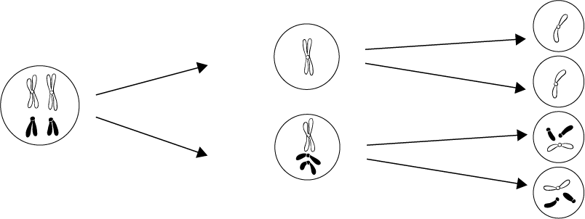
Nondisjunction
Section 14-2
Homologous chromosomes fail to separate
Meiosis I:
Nondisjunction
Meiosis II

Slide 34
Human Chromosomal Disorders
Chromosomal disorder
Caused by nondisjunction during meiosis
Monsomy = short one chromosome
Trisomy = one chromosome too many
Down syndrome
Trisomy 21

Slide 35
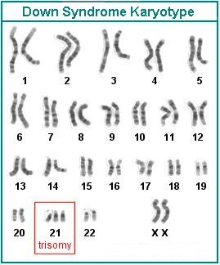

Slide 36
Human Chromosomal Disorders
Chromosomal disorder
Caused by nondisjunction during meiosis
Monsomy = short one chromosome
Trisomy = one chromosome too many
Down syndrome
Trisomy 21
1 in 700 births
Facial characteristics

Slide 37
Human Chromosomal Disorders
Chromosomal disorder
Caused by nondisjunction during meiosis
Monsomy = short one chromosome
Trisomy = one chromosome too many
Down syndrome
Trisomy 21
1 in 700 births
Facial characteristics
Mental retardation

Slide 38
Sex Chromosome Disorders
Turner’s syndrome
X_
Female who is sterile
Klinefelter’s
XXY
Male
Usually has reproductive problems

Slide 39
Chapter 14
Section 3 Biotechnology

Slide 40
DNA Fingerprinting
Gel electrophoresis

Slide 41
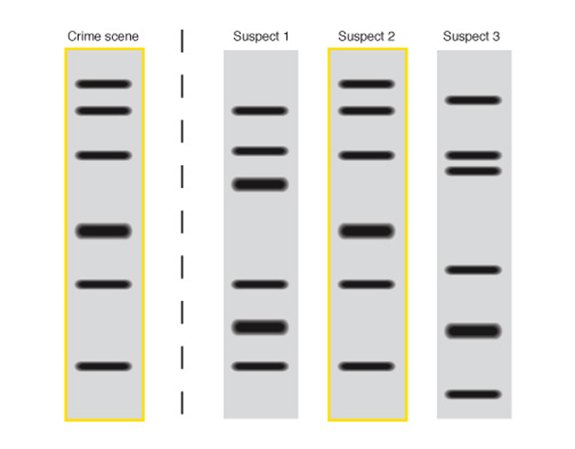
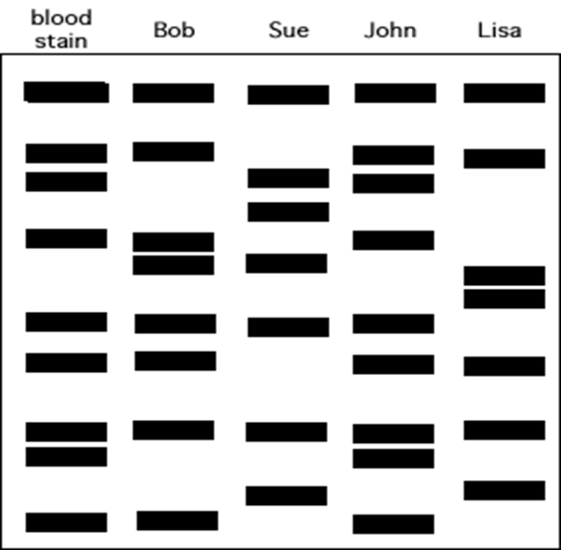

Slide 42
Figure 14-18 DNA Fingerprinting
Section 14-3
Restriction enzyme
Chromosomes contain large amounts of DNA called repeats that do not code for proteins. This DNA varies from person to person. Here, one sample has 12 repeats between genes A and B, while the second sample has 9 repeats.
Restriction enzymes are used to cut the DNA into fragments containing genes and repeats. Note that the repeat fragments from these two samples are of different lengths.
The DNA fragments are separated according to size using gel electrophoresis. The fragments containing repeats are then labeled using radioactive probes. This produces a series of bands—the DNA fingerprint.

Slide 43
DNA Fingerprinting
Gel electrophoresis
Gene Therapy
Absent or faulty gene is replace by working gene
Viral delivery mechanism

Slide 44
Figure 14-21 Gene Therapy
Section 14-3
Bone marrow cell
Normal hemoglobin gene
Nucleus
Chromosomes
Bone marrow
Genetically engineered virus

Slide 45
DNA Fingerprinting
Gel electrophoresis
Gene Therapy
Absent or faulty gene is replace by working gene
Viral delivery mechanism
Ethical issues

