Slide 1
Chapter 12
Section 1: Is the Genetic Material Protein or DNA?

Slide 2
Frederick Griffith- 1928
Vaccine for pneumonia
Caused by bacteria
Discovered that two strains exist
S strain
R strain

Slide 3
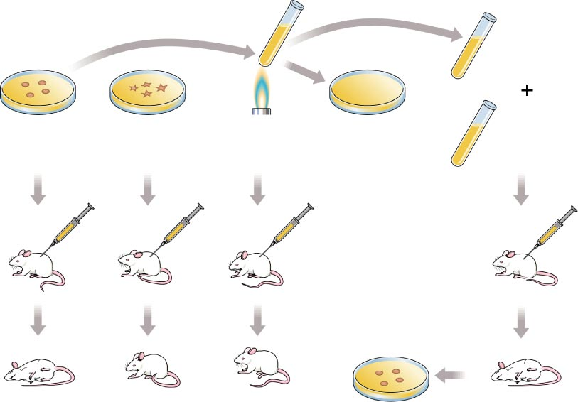
Figure 12–2 Griffith’s Experiment
Section 12-1
Heat-killed, disease-causing bacteria (smooth colonies)
Harmless bacteria (rough colonies)
Heat-killed, disease-causing bacteria (smooth colonies)
Control (no growth)
Harmless bacteria (rough colonies)
Disease-causing bacteria (smooth colonies)
Dies of pneumonia
Lives
Dies of pneumonia
Lives
Live, disease-causing bacteria (smooth colonies)

Slide 4
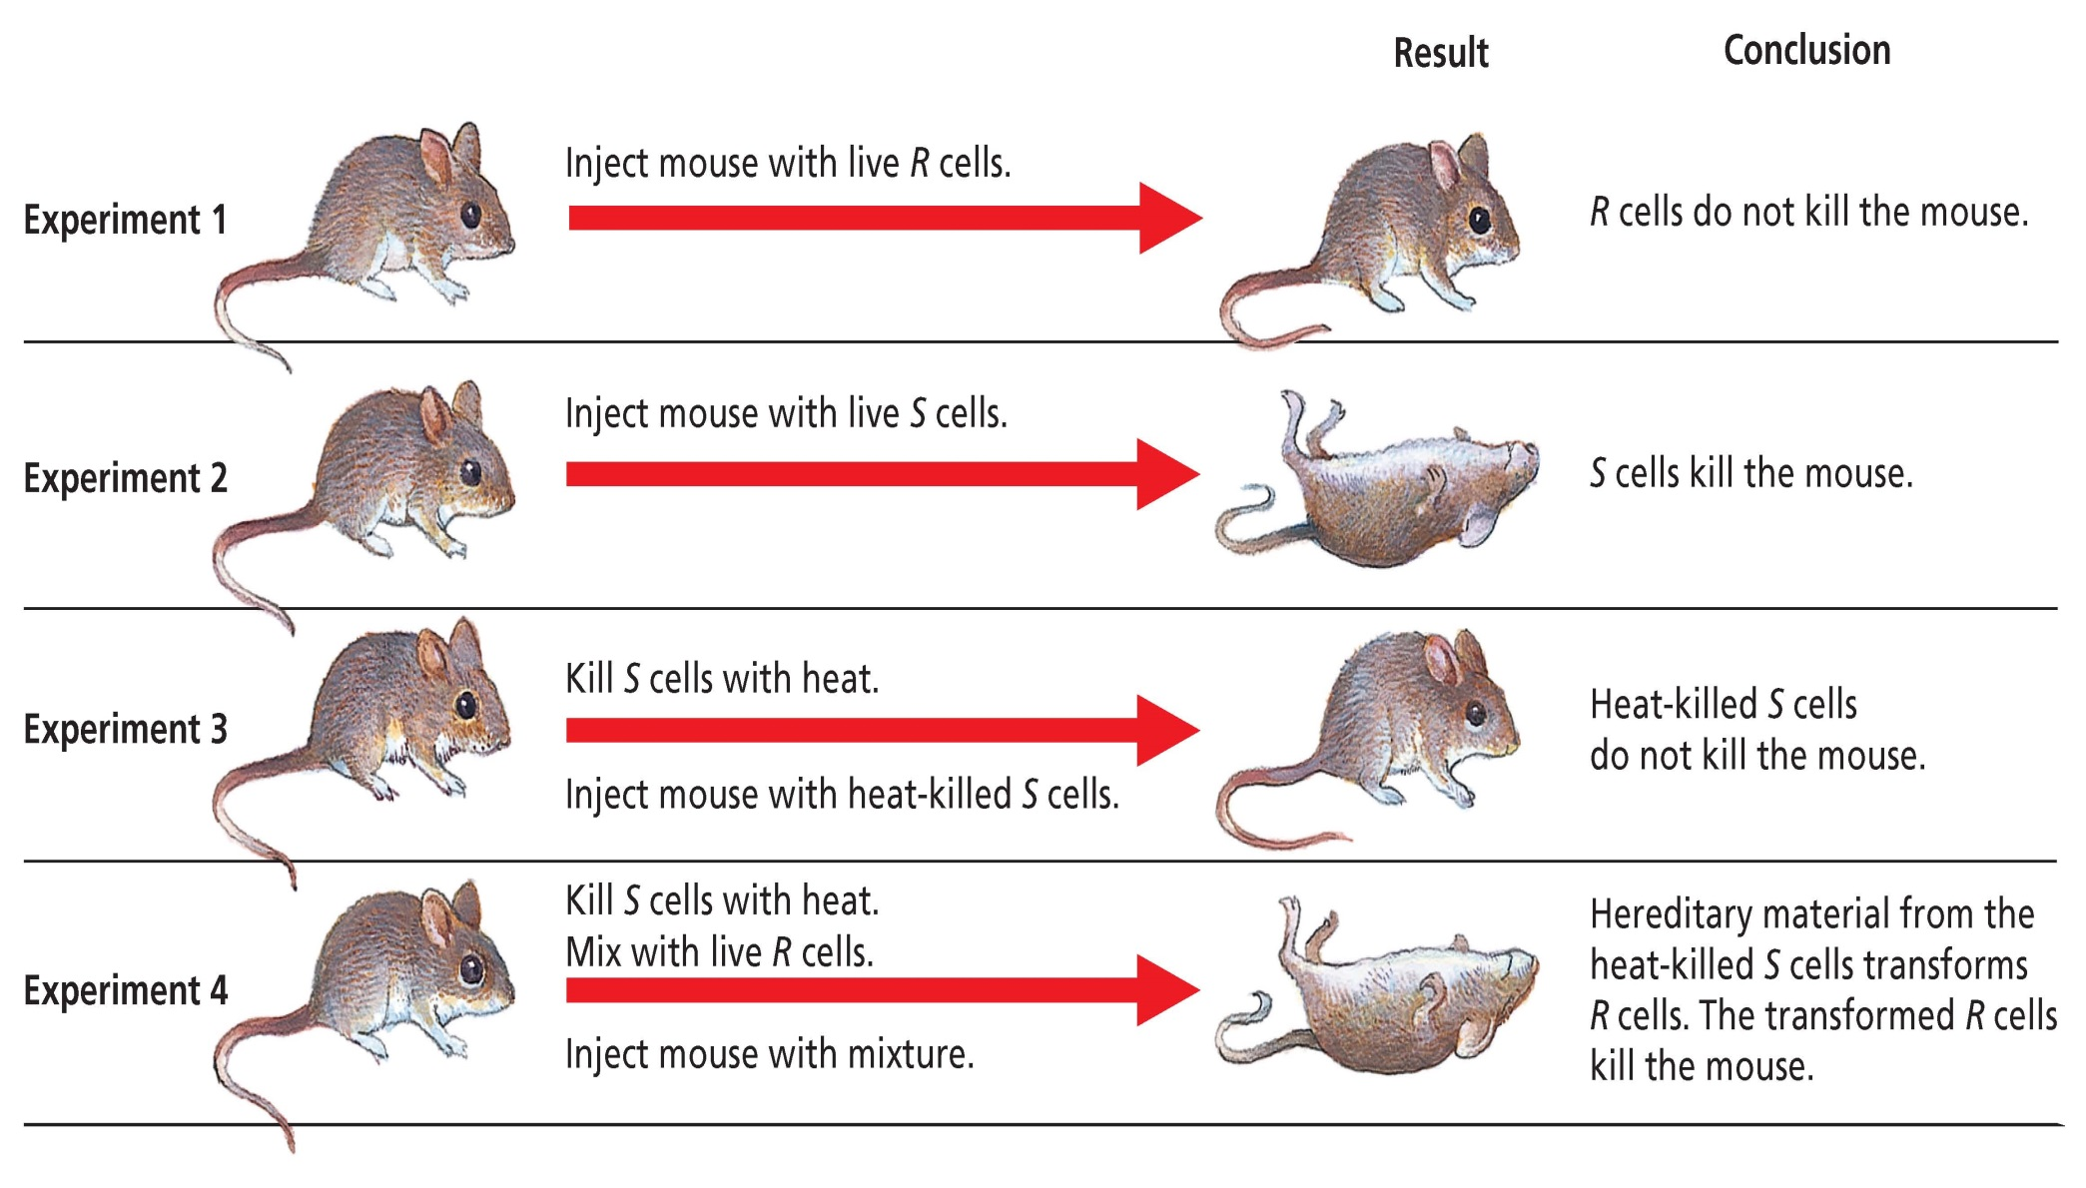

Slide 5
Frederick Griffith- 1928
Vaccine for pneumonia
Caused by bacteria
Discovered that two strains exist
S strain
R strain
Transformation took place when R mixed with heat killed S strain
Passing of genetic material from one organism to another

Slide 6
Oswald Avery - 1944
Created extract from heat killed bacteria
Destroyed different parts of extract using enzymes
Proved that DNA had to be the transformation agent in Griffith’s experiment

Slide 7
Alfred Hershey and Martha Chase -1952
Used T₂ Bacteriophage and E. coli
Virus that infects bacteria
Used radioactively labeled parts
Protein was labeled with sulfur
DNA was labeled with phosphorous

Slide 8
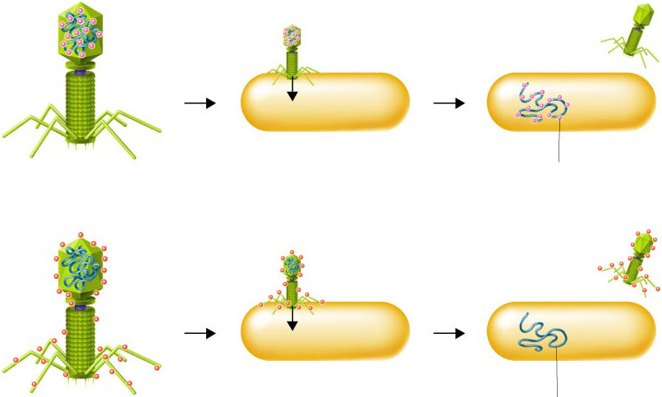
Figure 12–4 Hershey-Chase Experiment
Section 12-1
Bacteriophage with phosphorus-32 in DNA
Phage infects bacterium
Radioactivity inside bacterium
Bacteriophage with sulfur-35 in protein coat
Phage infects bacterium
No radioactivity inside bacterium

Slide 9
Figure 12–4 Hershey-Chase Experiment
Section 12-1
Bacteriophage with phosphorus-32 in DNA
Phage infects bacterium
Radioactivity inside bacterium
Bacteriophage with sulfur-35 in protein coat
Phage infects bacterium
No radioactivity inside bacterium

Slide 10
Figure 12–4 Hershey-Chase Experiment
Section 12-1
Bacteriophage with phosphorus-32 in DNA
Phage infects bacterium
Radioactivity inside bacterium
Bacteriophage with sulfur-35 in protein coat
Phage infects bacterium
No radioactivity inside bacterium

Slide 11
Alfred Hershey and Martha Chase -1952
Used T₂ Bacteriophage and E. coli
Virus that infects bacteria
Used radioactively labeled parts
Protein was labeled with sulfur
DNA was labeled with phosphorous
Found DNA inside E. coli
Genetic material had to be DNA

Slide 12
Rosalind Franklin
X- Ray diffraction
Discovered basic structure of DNA was a helix

Slide 13
Erwin Chargraff
Chargraff’s base pairing rules
Adenine = Thymine
Cytosine= Guanine

Slide 14
Francis Crick and James Watson-1953
Built three dimensional model of DNA
Sides are alternating sugar and phosphate molecules
Rungs are nitrogen bases held together by hydrogen bonds

Slide 15
Review of DNA Structure
Subunits= nucleotides
Deoxyribose sugar
Phosphate group which has a negative charge
Nitrogenous bases

Slide 16
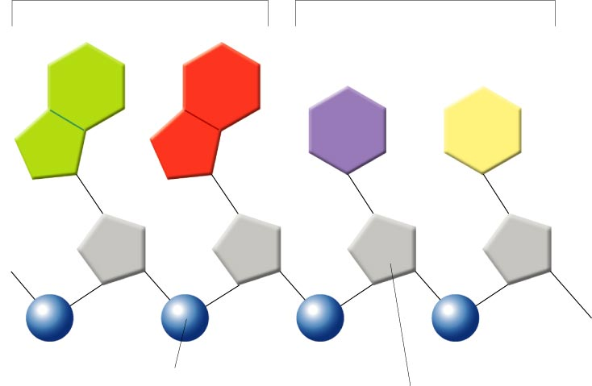
DNA Nucleotides
Purines
Pyrimidines
Adenine
Guanine
Cytosine
Thymine
Phosphate group
Deoxyribose

Slide 17
Review of DNA Structure
Subunits= nucleotides
Deoxyribose sugar
Phosphate group which has a negative charge
Nitrogenous bases
Pyrimidines
Thymine and cytosine
Purines
Adenine and guanine
Looks like a twisted ladder

Slide 18
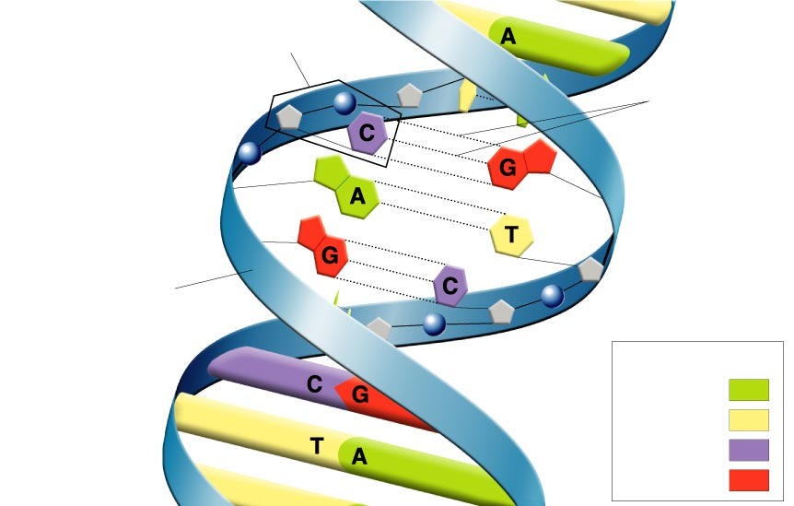
Structure of DNA
Nucleotide
Hydrogen bonds
Sugar-phosphate backbone
Key
Adenine (A)
Thymine (T)
Cytosine (C)
Guanine (G)

Slide 19
Chapter 12
Section 2: Chromosomes and DNA Replication

Slide 20
Pro vs. Eukaryotic Chromosomes
Prokaryotic
Circular strands or pieces
Plasmids

Slide 21
Prokaryotic Chromosome Structure
Chromosome
E. coli bacterium
Bases on the chromosome

Slide 22
Pro vs. Eukaryotic Chromosomes
Prokaryotic
Circular strands or pieces
Plasmids
Eukaryotic
Located in nucleus
Linear strands
1000 X more complex

Slide 23
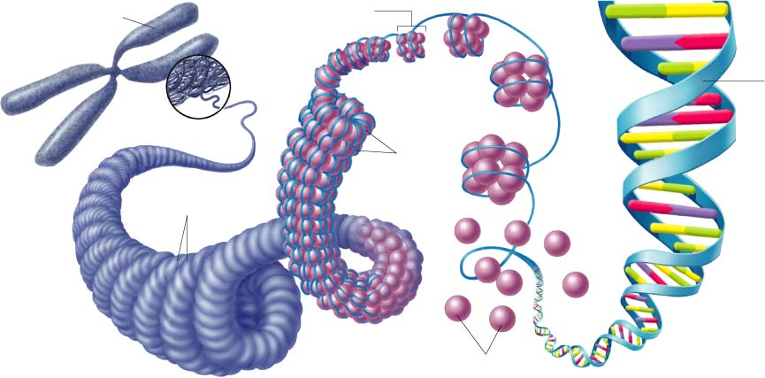
Chromosome Structure of Eukaryotes
Chromosome
Nucleosome
DNA
double
helix
Coils
Supercoils
Histones

Slide 24
Eukaryotic Chromosomes Elaborated
DNA is wound around proteins called histones
Creates loops called nucleosomes
Normally spread out
Prior to cell division, DNA begins to condense and coil

Slide 25
Chromosome Structure of Eukaryotes
Chromosome
Nucleosome
DNA
double
helix
Coils
Supercoils
Histones

Slide 26
DNA Replication
Begins at one of many starting points
Helicase enzyme breaks hydrogen bonds between nitrogen bases
DNA unzips

Slide 27
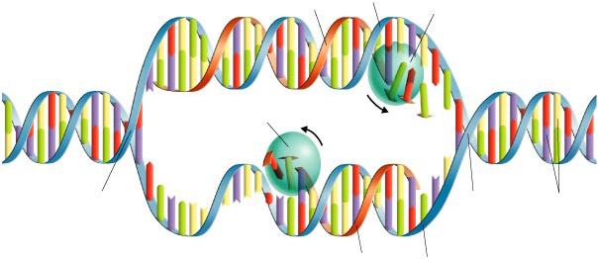
Figure 12–11 DNA Replication
Section 12-2
Original strand
DNA polymerase
New strand
Growth
DNA polymerase
Growth
Replication fork
Replication fork
Nitrogenous bases
New strand
Original strand

Slide 28
DNA Replication
Begins at one of many starting points
Helicase enzyme breaks hydrogen bonds between nitrogen bases
DNA unzips
Creates Replication fork/bubble
Exposed nitrogen bases are paired with complementary bases by DNA polymerase
Anti-parallel growth 3’-5’ and 5’-3’
Once end point is reached, replication stops
Semiconservative replication- half new, half old

Slide 29
Figure 12–11 DNA Replication
Section 12-2
Original strand
DNA polymerase
New strand
Growth
DNA polymerase
Growth
Replication fork
Replication fork
Nitrogenous bases
New strand
Original strand

Slide 30
Chapter 12
Section 3: Protein Synthesis

Slide 31
RNA: A Review
Basic subunit=nucleotide
Ribose sugar
Phosphate group
Nitrogen bases
Adenine, uracil, cytosine and guanine
Single stranded molecule
Three types exist

Slide 32
3 Types of RNA
Messenger RNA (mRNA)
Contains instructions for making a protein
Message is sent in three letter sequences called codon
Each codon codes for a specific amino acid start or stop.
Codon chart pg. 303

Slide 33
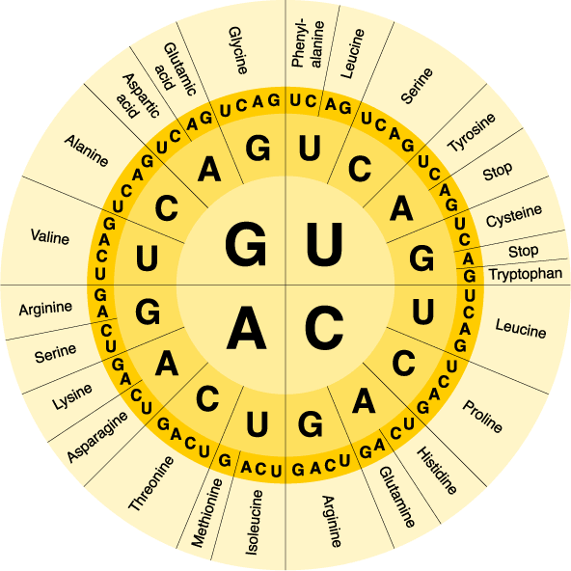
The Genetic Code

Slide 34
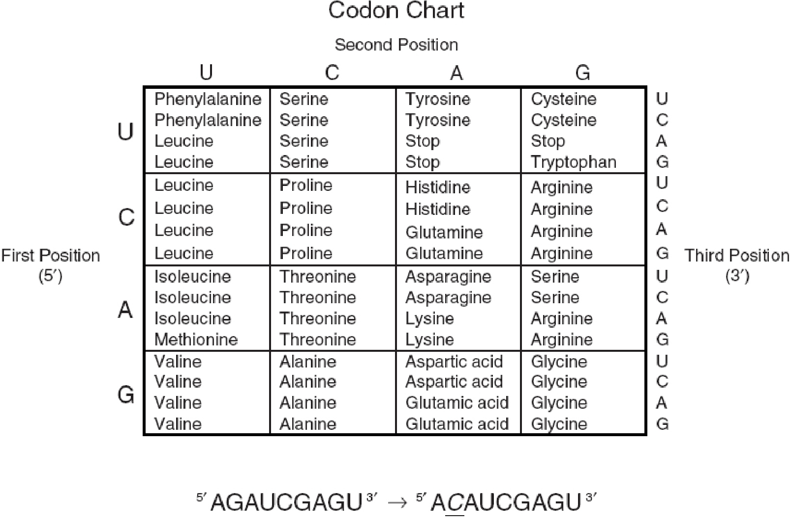

Slide 35
3 Types of RNA
Messenger RNA (mRNA)
Contains instructions for making a protein
Message is sent in three letter sequences called codon
Each codon codes for a specific amino acid start or stop.
Codon chart pg. 303
Transfer RNA (tRNA)
Approximately 80 nucleotides in length
Shape determines function
Anticodon complementary to codon in mRNA
Creates hydrogen bond
Translates from RNA language to amino acid language
Ribosomal RNA (rRNA)
Structural function in ribosomes

Slide 36
Transcription
DNA is found in nucleus
Protein synthesis takes place in cytoplasm at ribosomes
RNA is created from DNA by transcription
Very similar to DNA replication with a few important exceptions

Slide 37
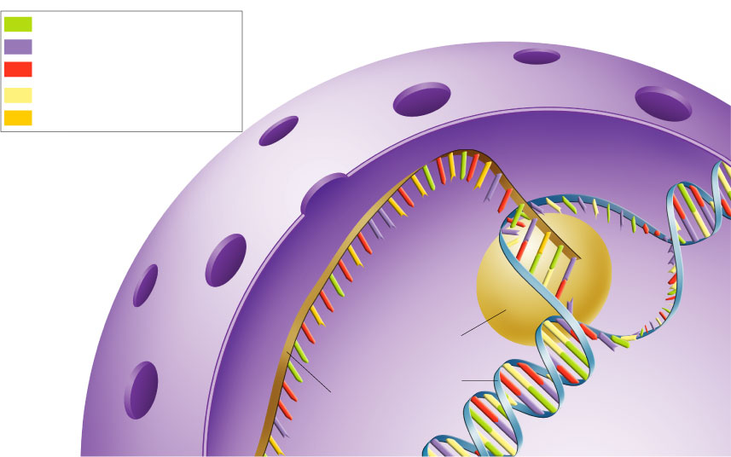
Figure 12–14 Transcription
Section 12-3
Adenine (DNA and RNA)
Cystosine (DNA and RNA)
Guanine(DNA and RNA)
Thymine (DNA only)
Uracil (RNA only)
RNA polymerase
DNA
RNA

Slide 38
Transcription
DNA is found in nucleus
Protein synthesis takes place in cytoplasm at ribosomes
RNA is created from DNA by transcription
Very similar to DNA replication with a few important exceptions
Promoter region is where transcription starts
RNA polymerase binds to promoter
Unzips DNA

Slide 39
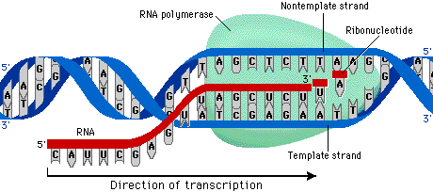

Slide 40
Transcription
DNA is found in nucleus
Protein synthesis takes place in cytoplasm at ribosomes
RNA is created from DNA by transcription
Very similar to DNA replication with a few important exceptions
Promoter region is where transcription starts
RNA polymerase binds to promoter
Unzips DNA
Binds complementary RNA nucleotides to one side of DNA
Coding strand

Slide 41
RNA Processing in Eukaryotic cells
mRNA contains segments called introns and exons
Introns-garbage segments
Exons- coding segments
While in nucleus, introns are cut out

Slide 42
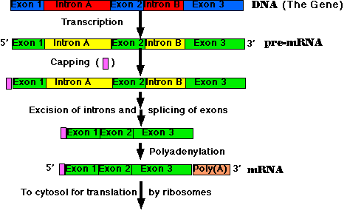
RNA Processing

Slide 43
RNA Processing in Eukaryotic cells
mRNA contains segments called introns and exons
Introns-garbage segments
Exons- coding segments
While in nucleus, introns are cut out
Exons are spliced together by enzymes
Add cap and tail before mRNA can leave nucleus

Slide 44
Translation
Assembly of protein according to mRNA instructions
All amino acids are found in cytoplasm
tRNA binds to its specific amino acid
Ribosomes are made up of two parts
Bind to mRNA
Start codon
Complementary tRNA binds to mRNA
Charged with amino acid

Slide 45
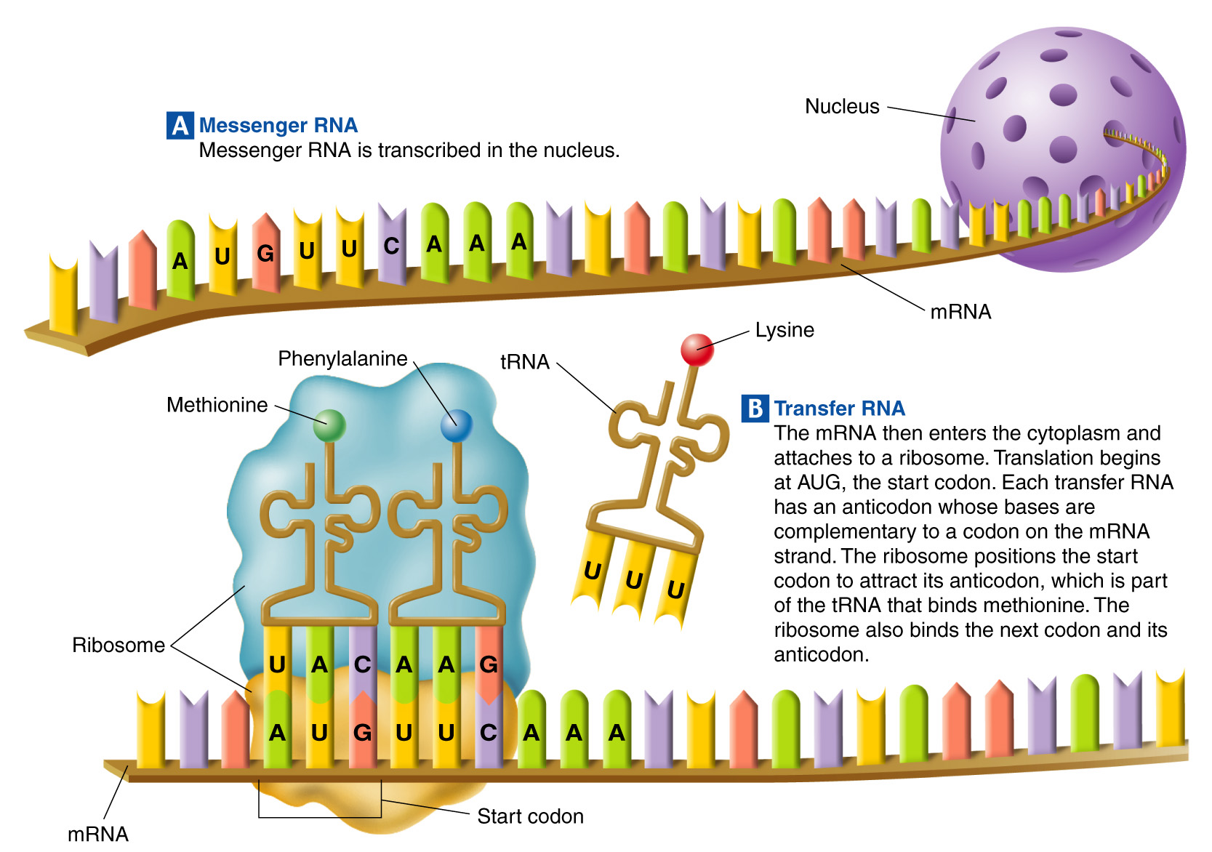
Figure 12–18 Translation
Section 12-3

Slide 46
Translation
Assembly of protein according to mRNA instructions
All amino acids are found in cytoplasm
tRNA binds to its specific amino acid
Ribosomes are made up of two parts
Bind to mRNA
Start codon
Complementary tRNA binds to mRNA
Charged with amino acid
Amino acids create a peptide bond
Ribosome shifts
tRNA releases
Process repeats until a stop codon is reached

Slide 47
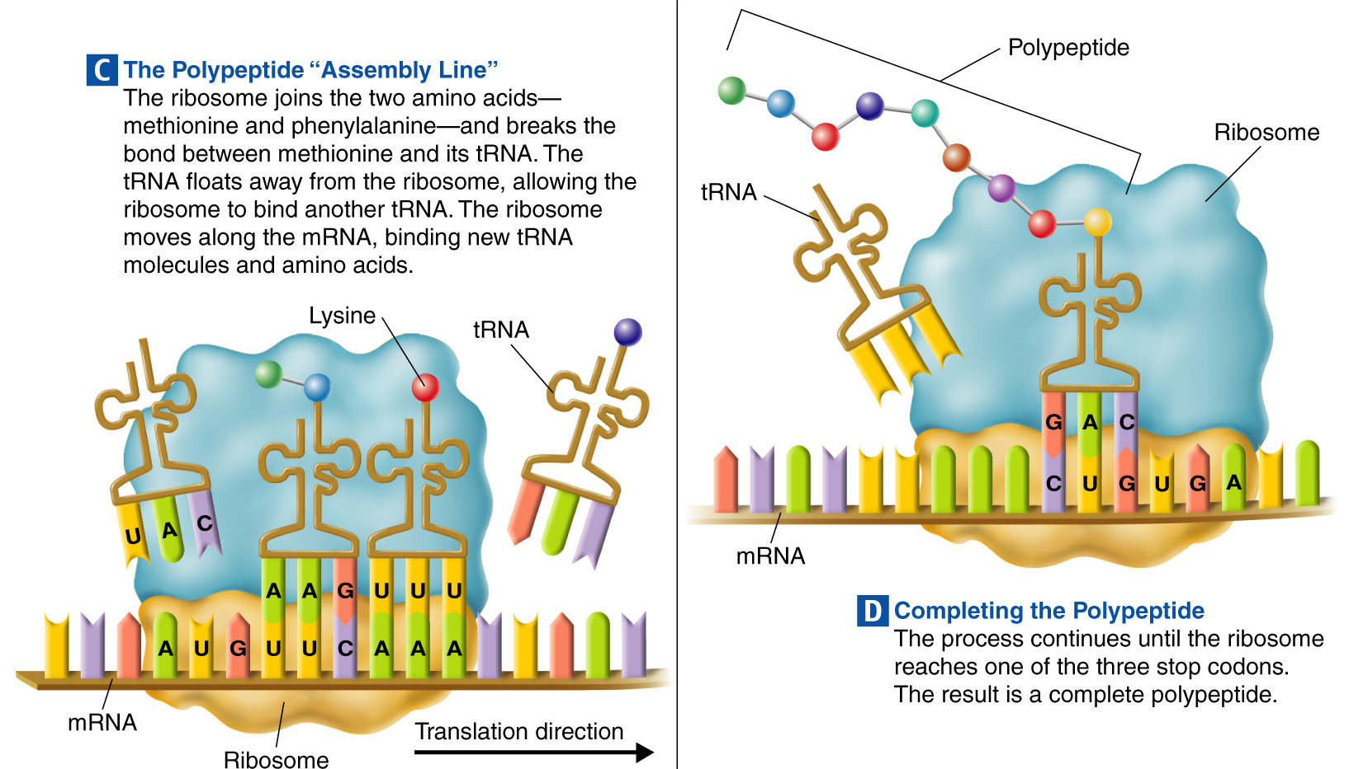
Figure 12–18 Translation (continued)
Section 12-3

Slide 48
Translation
Assembly of protein according to mRNA instructions
All amino acids are found in cytoplasm
tRNA binds to its specific amino acid
Ribosomes are made up of two parts
Bind to mRNA
Start codon
Complementary tRNA binds to mRNA
Charged with amino acid
Amino acids create a peptide bond
Ribosome shifts
tRNA releases
Process repeats until a stop codon is reached
Result is a protein

Slide 49
Chapter 12
Section 4: Mutations

Slide 50
Mutations
Random changes in the genetic material
Types of mutations-Gene mutations and chromosomal mutations
Gene mutations
Point mutations-changes in one nucleotide
Substitution

Slide 51
Mutations
Random changes in the genetic material
Types of mutations-Gene mutations and chromosomal mutations
Gene mutations
Point mutations-changes in one nucleotide
Substitution
Frameshift mutation
Insertion
Deletion

Slide 52
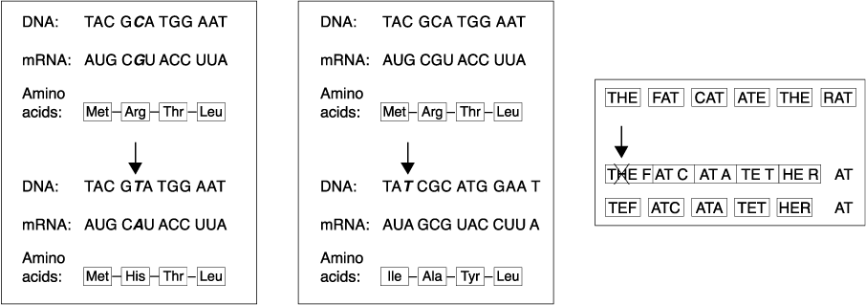
Gene Mutations: Substitution, Insertion, and Deletion
Deletion
Substitution
Insertion

Slide 53
Mutations Cont.
Chromosome mutations- change in number or structure of the chromosomes
Deletion
Duplication
Inversion
Translocation

Slide 54
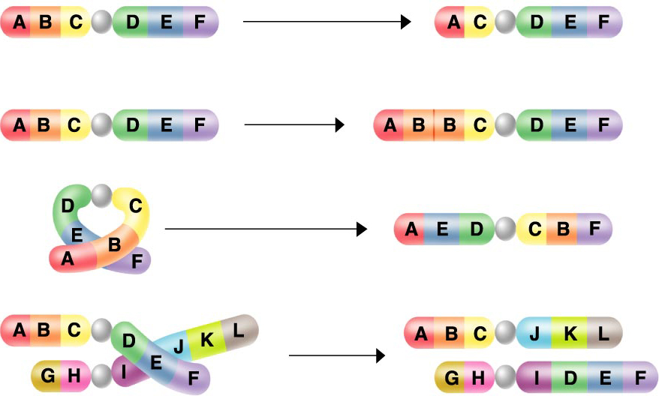
Chromosomal Mutations
Deletion
Duplication
Inversion
Translocation

Slide 55
Significance of Mutations
Neutral
Harmful-ex. Sickle cell disease
Beneficial-creates variety upon which natural selection acts
Does it matter if it is in a body or sex cell?

Slide 56
Chapter 12
Section 5: Gene Regulation

Slide 57
What is Gene regulation?
Only a fraction of your genes are being expressed at any given time.
How does an organism know whether to turn a gene on or off?
Regulatory sites, promotors and transcription regulation
Operon-a group of genes that operate together
Gene regulation example- E.coli :
genes called the lac operon must be expressed in order for E.coli to use lactose as a food

Slide 58
Prokaryotic Gene Regulation
Found that bacteria only produce the enzymes needed to breakdown lactose when it is present
Controlled by an operon
Series of genes that are all related to one function
Composed of :
Structural genes
Code for polypeptides
Operator
On/off switch
When repressor protein is bound “off”
Regulator gene
Produces repressor protein
Promoter site
Site where RNA polymerase binds
Example of what happens when lactose present

Slide 59
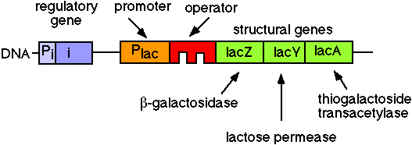
Lac Operon Model-Video

Slide 60
Eukaryotic Gene Regulation
Thought it would be similar to prokaryotes
NOT!!!!!!!
Not well understood
TATA box acts as promoter
Enhancer sequences
Uncoil DNA from nucleosomes to allow transcription
Attract RNA polymerase
Some cause DNA to bend to bring regions closer together
Repressors

Slide 61
Development and differentiation
Embryonic cells
All genes are turned on
Differentiation
Cells become specialized, only certain genes are turned on
Transcribed
Hox genes
Master genes

