Slide 1
Chapter 11 Honors Biology
Section 4- Meiosis

Slide 2
Meiosis
Used for the purpose of making gametes for sexual reproduction
Diploid v. Haploid
Somatic Cells
Diploid (2N)
46 chromosomes in humans
23 homologous pairs
Similar length, centromere location and genetic information
Gametes
Sperm or egg
Haploid (N)
23 chromosomes in humans
No pairs
Made by process of meiosis

Slide 3
Overview of Meiosis
Two divisions instead of one
Reduction Division
Start with one diploid cell, end with 4 haploid cells
Each is genetically unique
Increases variety

Slide 4
Stages of Meiosis I
Interphase
Similar to what happens prior to mitosis
Prophase I
Chromosomes align with homologous pair.

Slide 5
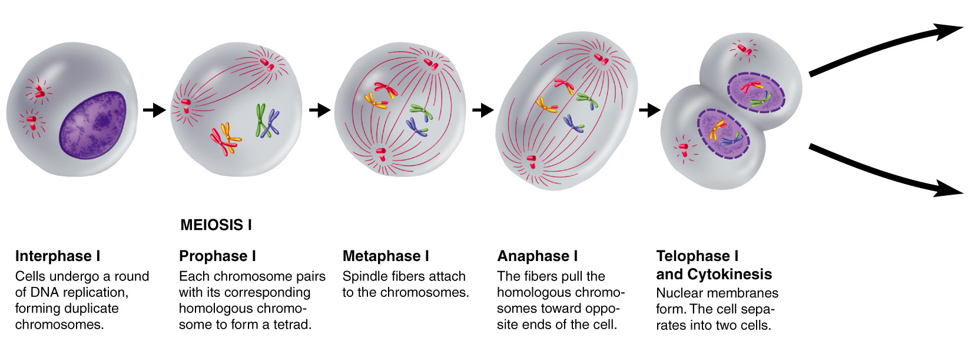
Figure 11-15 Meiosis
Section 11-4
Meiosis I
Meiosis I

Slide 6
Stages of Meiosis I
Interphase
Similar to what happens prior to mitosis
Prophase I
Chromosomes align with homologous pair.
Synapsis
Creates a tetrad
Crossing over occurs

Slide 7
Crossing-Over
Crossing over taking place
Section 11-4

Slide 8
Crossing-Over
Crossing over taking place

Slide 9
Crossing-Over
Crossing over taking place

Slide 10
Stages of Meiosis I
Interphase
Similar to what happens prior to mitosis
Prophase I
Chromosomes align with homologous pair.
Synapsis
Creates a tetrad
Crossing over occurs
Exchange of genetic material from dad and mom
Increases variety

Slide 11
Stages of Meiosis I cont.
Metaphase I
Homologous pairs line up in middle

Slide 12
Figure 11-15 Meiosis
Section 11-4
Meiosis I
Meiosis I

Slide 13
Stages of Meiosis I cont.
Metaphase I
Homologous pairs line up in middle
Anaphase I
Homologous pairs separate
Disjunction
Move to opposite ends of cell
Still replicated chromosome

Slide 14
Figure 11-15 Meiosis
Section 11-4
Meiosis I

Slide 15
Stages of Meiosis I cont.
Metaphase I
Homologous pairs line up in middle
Anaphase I
Homologous pairs separate
Disjunction
Move to opposite ends of cell
Still replicated chromosome
Telophase I
Nuclear membrane reforms
Cytokinesis
Cell divides
Creates two new daughter cells
Haploid (N)

Slide 16
Figure 11-15 Meiosis
Section 11-4
Meiosis I

Slide 17
Stages of Meiosis II
Similar to mitosis except 2 cells that are haploid to start
Prophase II
Nuclear membrane breaks down
Spindle fiber attach to centromeres

Slide 18
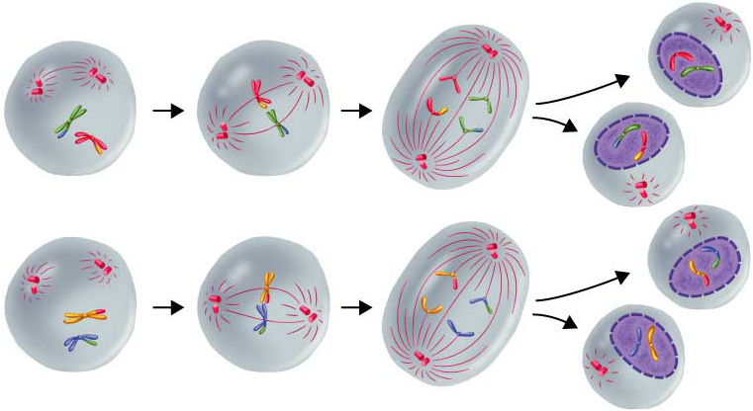
Figure 11-17 Meiosis II
Section 11-4
Meiosis II
Prophase II
Metaphase II
Anaphase II
Telophase II
Meiosis I results in two haploid (N) daughter cells, each with half the number of chromosomes as the original.
The chromosomes line up in a similar way to the metaphase stage of mitosis.
The sister chromatids separate and move toward opposite ends of the cell.
Meiosis II results in four haploid (N) daughter cells.

Slide 19
Stages of Meiosis II
Similar to mitosis except 2 cells that are haploid to start
Prophase II
Nuclear membrane breaks down
Spindle fiber attach to centromeres
Metaphase II
Chromosomes line up in the middle

Slide 20
Figure 11-17 Meiosis II
Section 11-4
Meiosis II
Prophase II
Metaphase II
Anaphase II
Telophase II
Meiosis I results in two haploid (N) daughter cells, each with half the number of chromosomes as the original.
The chromosomes line up in a similar way to the metaphase stage of mitosis.
The sister chromatids separate and move toward opposite ends of the cell.
Meiosis II results in four haploid (N) daughter cells.

Slide 21
Stages of Meiosis II
Similar to mitosis except 2 cells that are haploid to start
Prophase II
Nuclear membrane breaks down
Spindle fiber attach to centromeres
Metaphase II
Chromosomes line up in the middle
Anaphase II
Centromeres divide
Chromatids separate and move to opposite poles
Now called chromosomes

Slide 22
Figure 11-17 Meiosis II
Section 11-4
Meiosis II
Prophase II
Metaphase II
Anaphase II
Telophase II
Meiosis I results in two haploid (N) daughter cells, each with half the number of chromosomes as the original.
The chromosomes line up in a similar way to the metaphase stage of mitosis.
The sister chromatids separate and move toward opposite ends of the cell.
Meiosis II results in four haploid (N) daughter cells.

Slide 23
Stages of Meiosis II cont.
Telophase II
Nuclear envelope forms
Cytokinesis
Cells divide
End up with 4 haploid cells
Each genetically unique
Return to interphase

Slide 24
Figure 11-17 Meiosis II
Section 11-4
Meiosis II
Prophase II
Metaphase II
Anaphase II
Telophase II
Meiosis I results in two haploid (N) daughter cells, each with half the number of chromosomes as the original.
The chromosomes line up in a similar way to the metaphase stage of mitosis.
The sister chromatids separate and move toward opposite ends of the cell.
Meiosis II results in four haploid (N) daughter cells.

Slide 25
Gametogenesis
Spermatogenesis
Creates of total of 4 equal cells that eventually differentiate into 4 sperm

Slide 26
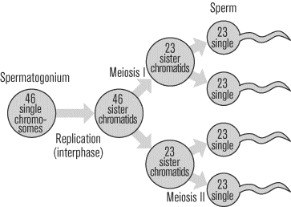

Slide 27
Gametogenesis
Spermatogenesis
Creates of total of 4 equal cells that eventually differentiate into 4 sperm
Happens throughout male’s life
Oogensis
Creates 1 large cell and 3 smaller cells

Slide 28
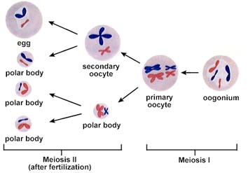

Slide 29
Gametogenesis
Spermatogenesis
Creates of total of 4 equal cells that eventually differentiate into 4 sperm
Happens throughout male’s life
Oogensis
Creates 1 large cell and 3 smaller cells
Larger cells becomes an egg
Smaller cells become polar bodies that are discarded
Majority of process takes place before female is ever born

Slide 30
Chapter 11
Section 1 The Study of Genetics

Slide 31
Genetics
The scientific study of heredity
Gregor Mendel
Father of Genetics
Performed experiments with pea plants
Why
Self-pollinating
True breeding plants
Only 2 varieties of any given trait
Large numbers of offspring

Slide 32
Gregor Mendel cont.
Mendel’s experiments
Parental (P) generation-true breeding plants

Slide 33
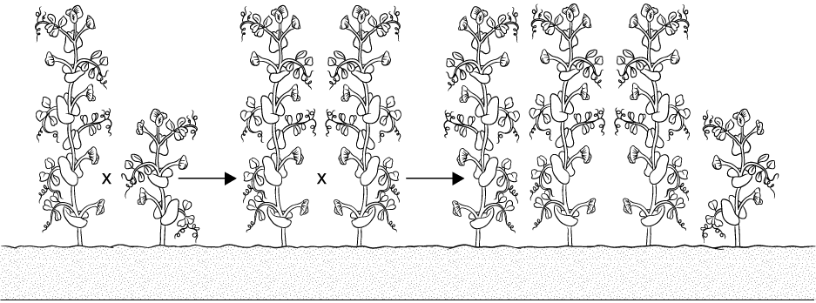
Principles of Dominance
Section 11-1
P Generation
F1 Generation
F2 Generation
Tall
Short
Tall
Tall
Tall
Tall
Tall
Short

Slide 34
Gregor Mendel cont.
Mendel’s experiments
Parental (P) generation-true breeding plants
Filial (F₁) generation- cross pollinated
Hybrids

Slide 35
Principles of Dominance
Section 11-1
P Generation
F1 Generation
F2 Generation
Tall
Short
Tall
Tall
Tall
Tall
Tall
Short

Slide 36
Gregor Mendel cont.
Mendel’s experiments
Parental (P) generation-true breeding plants
Filial (F₁) generation- cross pollinated
Hybrids
F₂ generation- self-pollinated hybrids

Slide 37
Principles of Dominance
Section 11-1
P Generation
F1 Generation
F2 Generation
Tall
Short
Tall
Tall
Tall
Tall
Tall
Short

Slide 38
Gregor Mendel cont.
Mendel’s experiments
Parental (P) generation-true breeding plants
Filial (F₁) generation- cross pollinated
Hybrids
F₂ generation- self-pollinated hybrids
Mendel’s conclusions
Realized that inheritance controlled by “factors” that are passed on.
Different forms of inheritable factors.
Principle of dominance

Slide 39
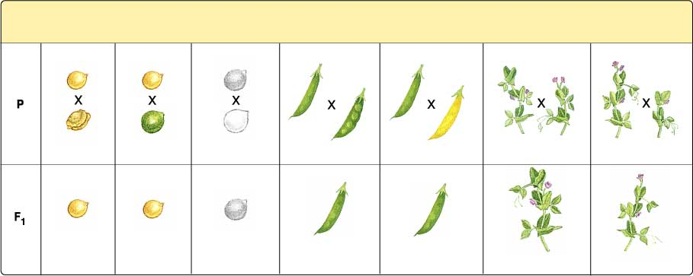
Figure 11-3 Mendel’s Seven F₁ Crosses on Pea Plants
Mendel’s Crosses and their Results
Section 11-1
Seed Shape
Seed Color
Seed Coat
Color
Pod
Shape
Pod Color
Flower Position
Plant Height
Round
Yellow
Gray
Smooth
Green
Axial
Tall
Wrinkled
Green
White
Constricted
Yellow
Terminal
Short
Round
Yellow
Gray
Smooth
Green
Axial
Tall

Slide 40
Gregor Mendel cont.
Mendel’s experiments
Parental (P) generation-true breeding plants
Filial (F₁) generation- cross pollinated
Hybrids
F₂ generation- self-pollinated hybrids
Mendel’s conclusions
Realized that inheritance controlled by “factors” that are passed on.
Different forms of inheritable factors.
Principle of dominance
Law of segregation
Alleles segregate from one another during meiosis I

Slide 41
Chapter 11
Section 2-Genetics and Probability

Slide 42
Probability
The likelihood that a particular event will occur.
Punnet squares
Used to predict outcomes of genetic events
Terms to know
Homozygous
Heterozygous
Phenotype
Genotype
Capital letters vs. lower case
Typically use letter of dominant trait
Monohybrid cross

Slide 43
Monohybrid Punnet Square

Slide 44
Chapter 11
Section 3- Probability with two traits

Slide 45
Law of Independent Assortment
During meiosis, genes separate independently of one another.
Only completely true for genes that are found on different chromosomes
Dihybrid cross
Cross involving two different traits

Slide 46
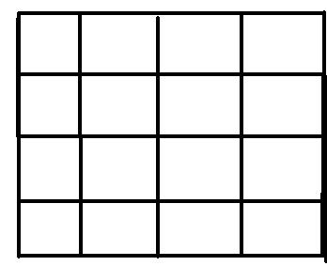
Dihybrid Punnet Square

Slide 47
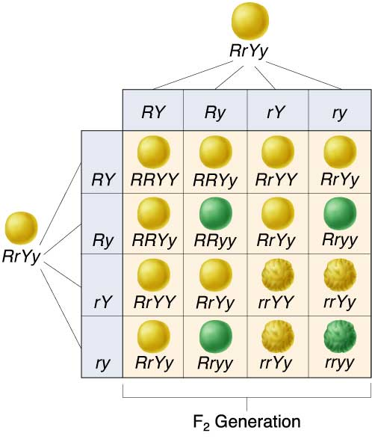
Figure 11-10 Independent Assortment in Peas
Section 11-3

Slide 48
Genetics can be complicated
Non-Mendelian patterns of inheritance
Incomplete dominance
Results in heterozygous individuals producing a third new phenotype
Genotypic ratio=phenotypic ratio
Ex.large, med, small ears on elephant

Slide 49
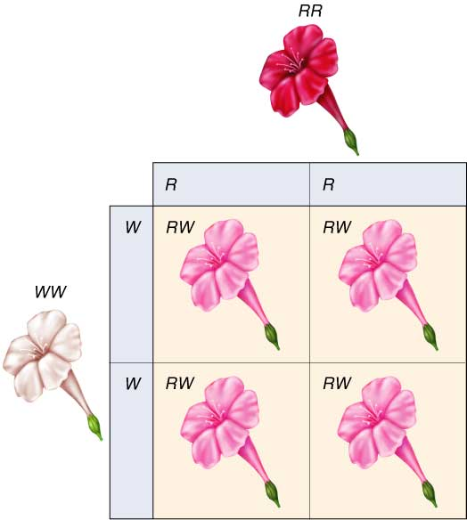
Figure 11-11 Incomplete Dominance in Four O’Clock Flowers
Section 11-3

Slide 50
Figure 11-11 Incomplete Dominance in Four O’Clock Flowers
Section 11-3

Slide 51
Genetics can be complicated
Non-Mendelian patterns of inheritance
Incomplete dominance
Results in heterozygous individuals producing a third new phenotype
Genotypic ratio=phenotypic ratio
Ex. Large, medium, small ears on elephant
Codominace
Both alleles expressed equally at same time
Ex. Long pine needles, short pine needles, long and short
Multiple Alleles
More than 2 alleles exist for a certain gene
Any one individual can only receive 2
Ex. Human blood types

Slide 52
Polygenic traits
Phenotypic trait is controlled by several genes
Quantitative control
Ex.eye color
Environmental influence
Nature vs. nurture

Slide 53
Chapter 11
Section 5-Gene Linkage

Slide 54
Gene Linkage
Thomas Hunt Morgan
Studied Drosophila melanogaster
Discovered that some genes on same chromosome are inherited together
Gene linkage
Gene Map
Shows the relative location of genes on a chromosome
Locus-a particular place or location
The farther apart genes are, the greater the chance of crossing over.

