Slide 1
5.3 Shaping Communities
I. Carving a Niche
A. Niche- the unique position occupied by a species in an ecological community
1. aka-the role an organism plays in a community
2. affects many other organisms
II. Competing for resources
A. Fundamental Niche
1. the entire range of conditions where a species could survive
B. Realized Niche
1. the actual niche a species occupies

Slide 2
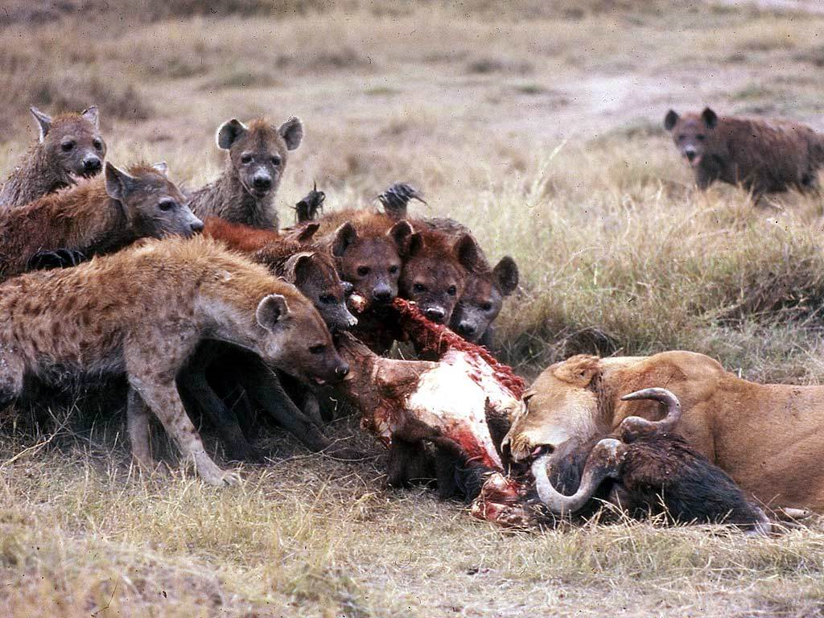
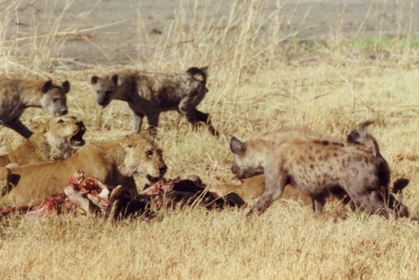
C. Competition for Resources
1. shapes a species' fundamental niche
2. Kleptoparasitism – stealing of food
a. Hyenas stealing food from lions

Slide 3
3. Plants complete for light
4. Outcomes
a. one species wins and one loses
1. loser is eliminated from the habitat
b. competitors survive together splitting resources

Slide 4
D. Competitive Exclusion
1. one species eliminating another through competition
2. no two species that are too similar can coexist
a. one species will be better at getting the resources they share
b. the less successful species will either die off or move ecosystems
E. Dividing Resources
1. Competitors eat same kinds of food from same place
2. divide the resources by feeding in slightly different way or in slightly different places

Slide 5
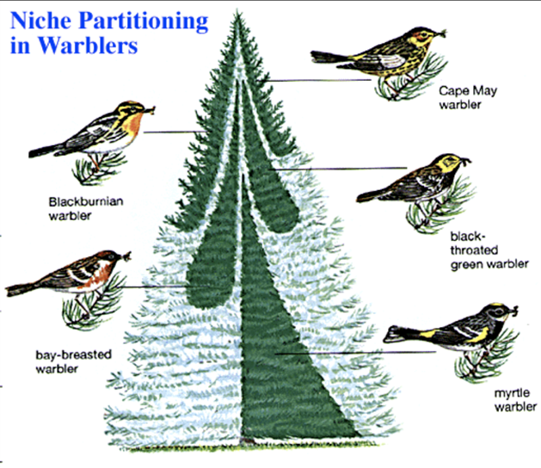
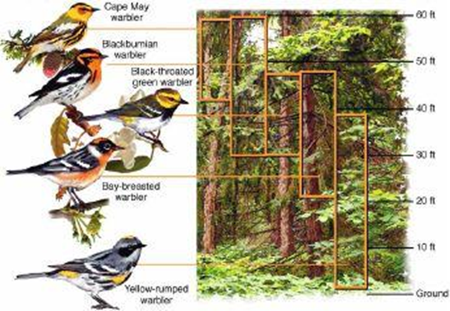
3. Warbler bird species have same fundamental niche
4. They divide the spruce tree up for smaller realized niches for each type of warbler

Slide 6
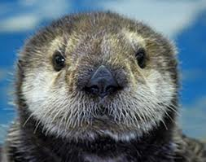
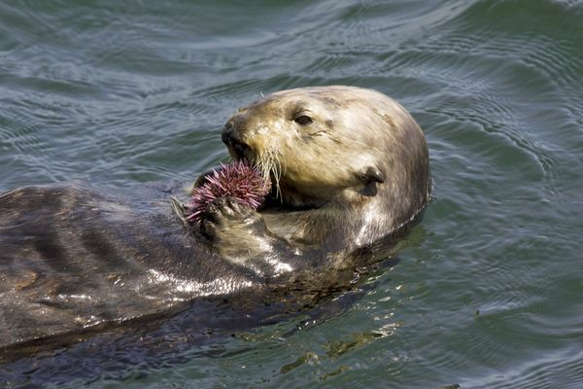
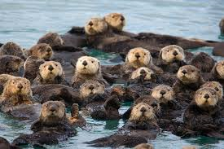
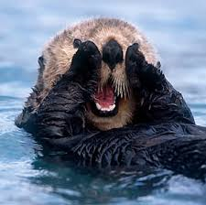
III. Ecosystem Resiliency
A. Interactions between species & the number of species add to ecosystem resiliency
B. Keystone species
1. a species that is critical to an ecosystem
a. the species affects the survival and number of many other species in a community

Slide 7
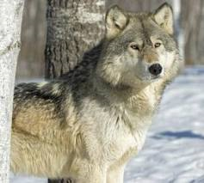
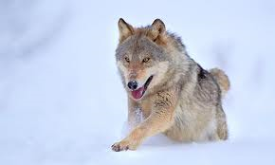
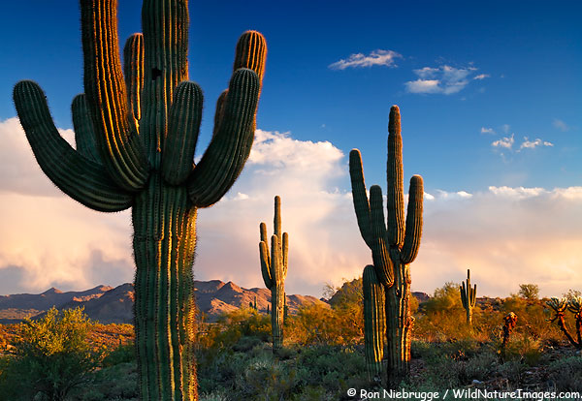
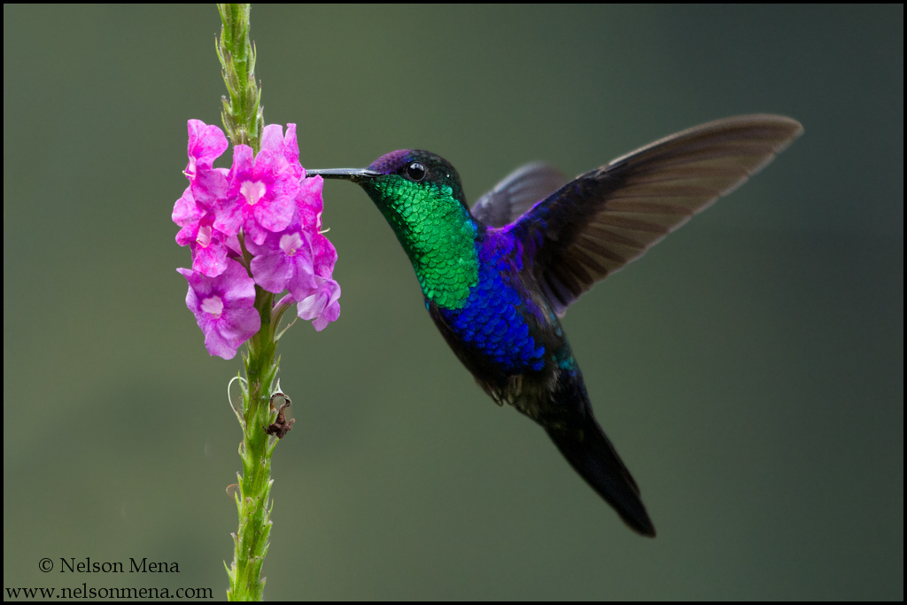
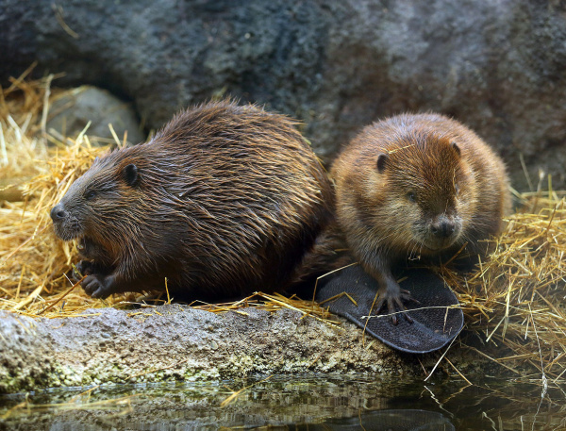
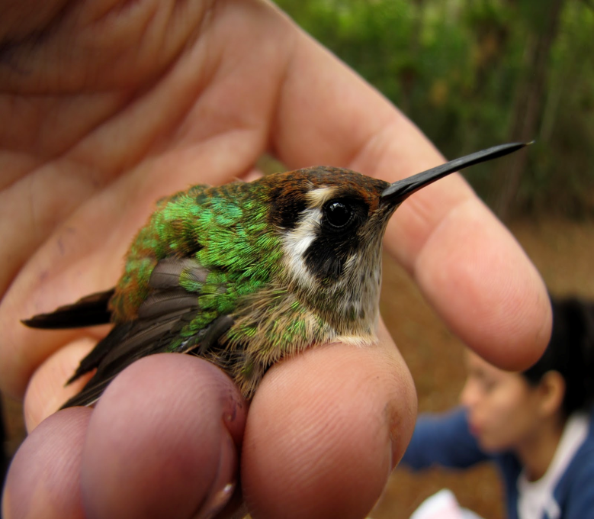
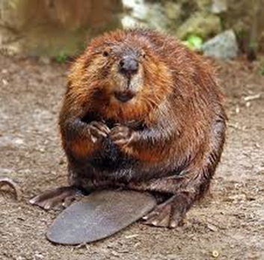

Slide 8
C. Higher biodiversity helps make an ecosystem more resilient
1. Predation increases biodiversity

