Slide 1
Chapter 9
Cellular Respiration
Honors Biology Section 1

Slide 2
Chemical energy
Glucose=3,811 calories in one gram
Kcal
All energy cannot be released at once. Why?

Slide 3
Cellular Respiration: Two Major Types
Process that releases energy by breaking down food molecules

Slide 4
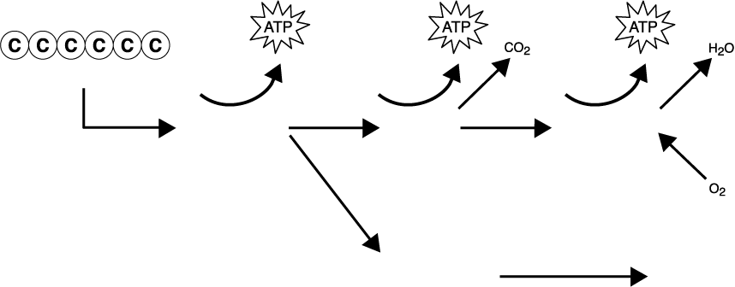
Chemical Pathways
Section 9-1
Glucose
Requires the presence of oxygen
Glycolysis
Krebs cycle
Electron transport
Fermentation (without oxygen)
Alcohol or lactic acid

Slide 5
Cellular Respiration: Two Major Types
Process that releases energy by breaking down food molecules
Aerobic
36 ATP
Anaerobic
2 ATP

Slide 6
Aerobic Cellular RSS
6 O₂ + C₆H₁₂O₆ → 6 CO₂ + 6H₂O + Energy
Redox Reactions
LEO the lion says GER
Involves transfer of energy associated with electrons
In living systems, Hydrogen atom
E-/H carriers
Used to store small amount of energy
Intermediate
NAD+
Nicotinamide adenine dinucleotide
FAD+
Flavin adenine dinucleotide

Slide 7
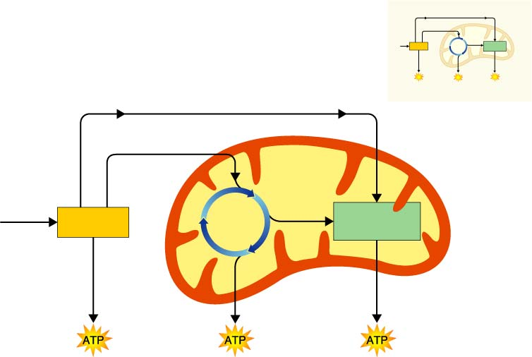
Figure 9–2 Cellular Respiration: An Overview
Section 9-1
Mitochondrion
Electrons carried in NADH
Pyruvic acid
Electrons carried in NADH and FADH₂
Glucose
Krebs Cycle
Electron Transport Chain
Glycolysis
Mitochondrion
Cytoplasm

Slide 8
Stages of Respiration
Glycolysis
Occurs in cytoplasm of cells
With/without oxygen
Diagram-
When oxygen present in eukaryotes, products enter mitochondria

Slide 9
Figure 9–3 Glycolysis
Section 9-1
Glucose
2 Pyruvic acid
To the electron transport chain

Slide 10
Figure 9–3 Glycolysis
Section 9-1
Glucose
2 Pyruvic acid
To the electron transport chain

Slide 11
Figure 9–3 Glycolysis
Section 9-1
Glucose
2 Pyruvic acid
To the electron transport chain

Slide 12
Stages of Respiration- Glycolysis cont.
Under anaerobic conditions
Fermentation
Two types
Alcoholic fermentation
Occurs in yeast and other microorganisms
Lactic acid fermentation

Slide 13
Figure 9–4 Lactic Acid Fermentation
Section 9-1
Glucose
Lactic acid
Pyruvic acid

Slide 14
Figure 9–4 Lactic Acid Fermentation
Section 9-1
Glucose
Lactic acid
Pyruvic acid

Slide 15
Figure 9–4 Lactic Acid Fermentation
Section 9-1
Glucose
Lactic acid
Pyruvic acid

Slide 16
Stages of Respiration- Glycolysis cont.
Under anaerobic conditions
Fermentation
Two types
Alcoholic fermentation
Occurs in yeast and other microorganisms
Lactic acid fermentation
Occurs in us when oxygen is depleted
Some bacteria
Causes muscle soreness?

Slide 17
Chapter 9
Cellular Respiration Section 2

Slide 18
Flowchart
Section 9-2
Cellular Respiration
Glucose (C₆H₁₂0₆)
+
Oxygen (0₂)
Glycolysis
Krebs Cycle
Electron Transport Chain
Chemiosmosis

Slide 19
Krebs Cycle
Takes place in matrix of mitochondria
Products of glycolysis enter by active transport
Purpose is to remove energy a little at a time
Diagram

Slide 20
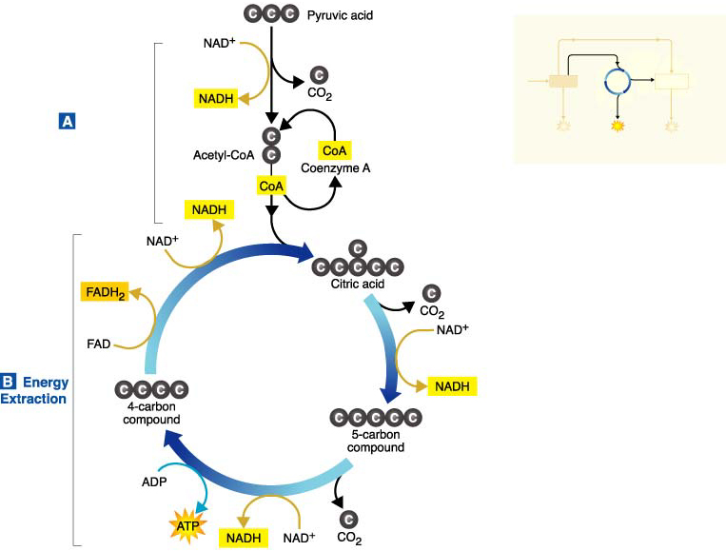
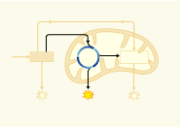
Figure 9–6 The Krebs Cycle
Section 9-2
Citric Acid Production
Mitochondrion

Slide 21
Figure 9–6 The Krebs Cycle
Section 9-2
Citric Acid Production
Mitochondrion

Slide 22
Electron Transport Chain
Takes place on mitochondria’s inner membrane
Releases energy that has been temporarily stored in e- of FADH₂ and NADH
Coupled with chemiosmosis
Diagram

Slide 23
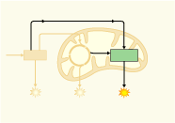
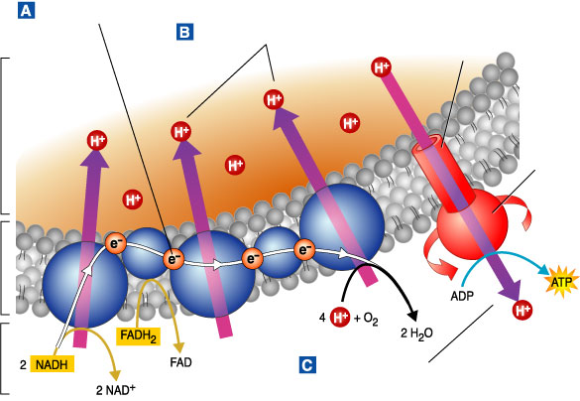
Figure 9–7 Electron Transport Chain
Section 9-2
Electron Transport
Hydrogen Ion Movement
Channel
Mitochondrion
Intermembrane
Space
ATP synthase
Inner
Membrane
Matrix
ATP Production

Slide 24
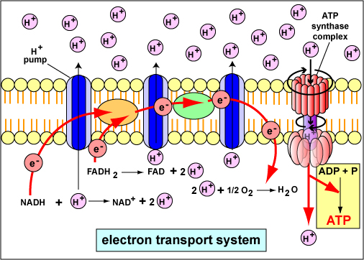
Chemiosmosis
Uses energy released by ETC to move protons to inner membrane space by active transport
Creates proton gradient
Diagram

Slide 25
Summary of ATP production
Make only 4 ATP directly 2 glycolysis, 2 Krebs
Rest of ATP comes from electron carriers that release energy in ETC, which is coupled to chemiosmosis
Glycolysis
2 NADH=4 ATP*
Pyruvic Acid formation
2 NADH= 6 ATP
Krebs
6 NADH= 18 ATP
2 FADH₂= 4 ATP
Total 36 ATP

