Slide 1
Chapter 17
Section 1: THE FOSSIL RECORD

Slide 2
Fossil Record
Provides history of life on Earth
99% of all living things are now extinct
Incomplete record due to gaps
Fossil formation

Slide 3
Formation of a Fossil
Section 17-1
Water carries small rock particles to lakes and seas.
Dead organisms are buried by layers of sediment, which forms new rock.
The preserved remains may later be discovered and studied.

Slide 4
Fossil Record
Provides history of life on Earth
99% of all living things are now extinct
Incomplete record due to gaps
Fossil formation
Organism dies
Buried in sedimentary rock or volcanic ash, sand
Layers build on top causing:
Compaction and chemical changes
Geologic processes bring back to light
Weathering

Slide 5
Interpreting Fossil Evidence
Relative dating
Determines age of fossil by comparison of the surrounding layers
Older on bottom
Results in a time frame
Cannot be used over wide distances
Index fossils
Can be used to create time frame over greater distances
Criteria
Easy to identify
Short life span
Wide geographic distribution
Ex. Trilobite

Slide 6
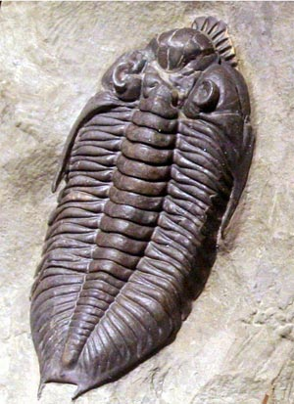
One example of a trilobite fossil

Slide 7
Interpreting Fossil Evidence
Radioactive dating
Based on idea of radioactive decay of unstable isotopes
Results in radiation
Happens at a constant rate
Can only be used in certain rock formations
Provides more accurate age in years
Half life
Time it takes for half of the radioactive isotopes to break down
Carbon –14 decays into Nitrogen –14 (5,730 years)
Potassium 40- (1.26 billion years)

Slide 8
Section 17-1
Knowledge Checkpoint: Take out half sheet of paper!
Comparing Relative and Absolute Dating of Fossils
Can determine
Is performed by
Drawbacks
Relative Dating
Absolute Dating
Age of fossil with respect to another rock or fossil (that is, older or younger)
Age of a fossil in years
Comparing depth of a fossil’s source stratum to the position of a reference fossil or rock
Determining the relative amounts of a radioactive isotope and nonradioactive isotope in a specimen
Imprecision and limitations of age data
Difficulty of radioassay laboratory methods

Slide 9
Geologic Time Scale
No standard lengths
Divisions were created based on major changes in biodiversity
Era is subdivided into Periods or Epochs

Slide 10
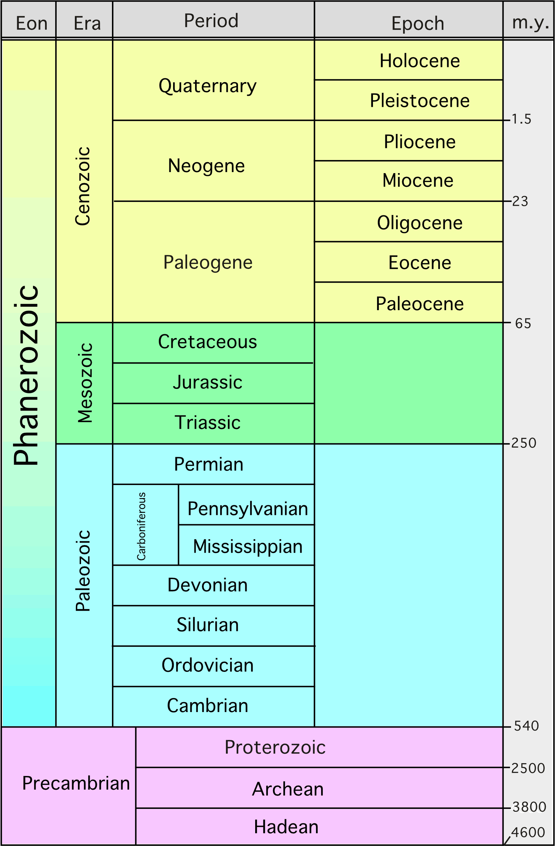
Simplified Version of the Geologic Time Scale

Slide 11
Chapter 17
Section 2: HOW IT ALL BEGAN?

Slide 12
How did life first start?
Biogenesis- theory that all living things originate from other living things
Problem?

Slide 13
Early Earth
4.6 billion years ago
Took 100 million years to fully form
No water in liquid form or Oxygen
Little atmosphere
Composed of hydrogen cyanide, carbon dioxide, carbon monoxide, nitrogen, hydrogen sulfide and water vapor
Extremely hot
4 billion year ago
Began to cool
3.8 bya
Oceans formed with intense thunderstorms

Slide 14
First Organic Molecules
Oparin- Russian biochemist
Created Primordial Soup Model
Synthesis of organic molecules form inorganic substances
Never tested
Tested in 1953 by Stanley Miller and Harold Urey
Designed experiment to simulate primitive Earth and ran it for one week

Slide 15
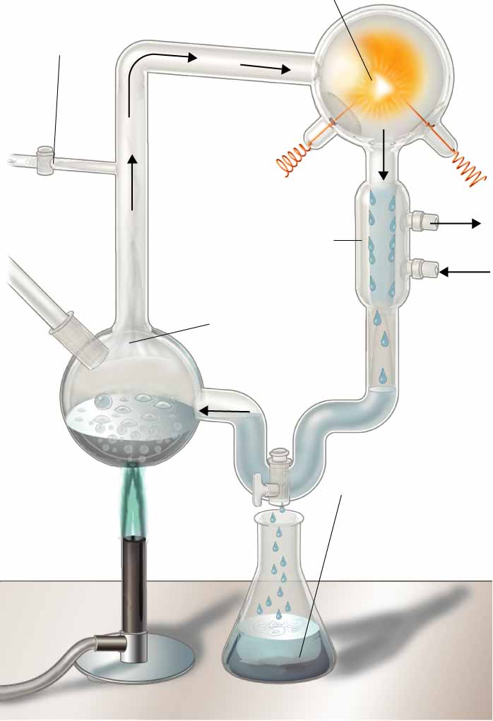
Miller-Urey Experiment
Section 17-2
Mixture of gases simulating atmospheres of early Earth
Spark simulating lightning storms
Cold water cools chamber, causing droplets to form
Condensation chamber
Water vapor
Liquid containing amino acids and other organic compounds

Slide 16
First Organic Molecules
Oparin- Russian biochemist
Created Primordial Soup Model
Synthesis of organic molecules form inorganic substances
Never tested
Tested in 1953 by Stanley Miller and Harold Urey
Designed experiment to simulate primitive Earth and ran it for one week
Found various amino acids and some bases of cytosine and uracil
Since then, test has been refined, but similar results
Problems?

Slide 17
Problems Fixed?
Microspores
Large molecules that form bubbles
Made of protein
Selectively permeable
Simple means of storing and releasing energy
Genetic Material required
Which came first RNA or DNA?
Not sure
Current belief is RNA
Simpler
Can form spontaneously in water
Able to duplicate itself

Slide 18
Earth Continues to Change
3.5 billion years ago
First fossils of living things
Bacteria that evolved before oxygen
Anaerobic cellular respiration

Slide 19
Earth Continues to Change
2.2 billion years ago
Photosynthetic bacteria were plentiful
Advantage over ancestors?
Produced oxygen in large quantities
Changed Earth forever
Caused iron to rust in water
Oxygen eventually reached atmosphere
Creates ozone layer
Decreases UV radiation
As oxygen concentration increased, bacteria evolved to perform cellular respiration.

Slide 20
Earth Continues to Change
2 billion years ago
Bacteria evolve to have internal membranes
Ex. Ribosomes
Eventually give rise to Eukaryotic cells
Endosymbiotic theory

Slide 21
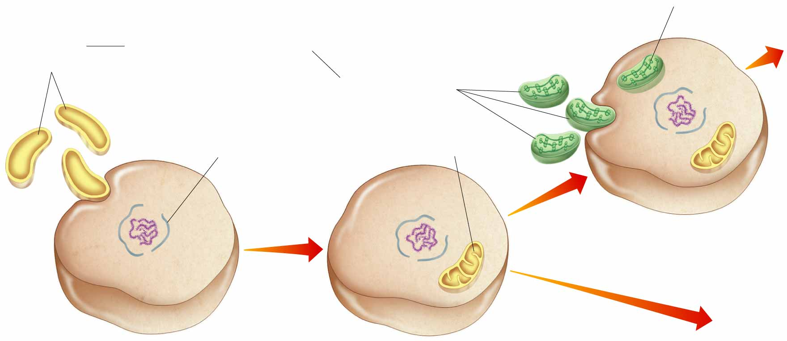
Endosymbiotic Theory
Section 17-2
Chloroplast
Aerobic bacteria
Ancient Prokaryotes
Plants and plantlike protists
Nuclear envelope evolving
Photosynthetic bacteria
Mitochondrion
Primitive Photosynthetic Eukaryote
Animals, fungi, and non-plantlike protists
Ancient Anaerobic Prokaryote
Primitive Aerobic Eukaryote

Slide 22
Earth Continues to Change
2 billion years ago
Bacteria evolve to have internal membranes
Ex. Ribosomes
Eventually give rise to Eukaryotic cells
Endosymbiotic theory
Evidence
Own DNA
Have own ribosomes
Double membrane
Reproduce by binary fission

Slide 23
Chapter 17
Section 3: Changes in Biodiversity

Slide 24
Paleozoic Era
Cambrian Period
Evolution of hard parts and shells
Invertebrates like jellyfish, worms and sponges are common
Trilobites are common
Ordovician and Silurian Periods
Arthropods increase in numbers
Vertebrates as jawless fish first appear
Plants invade land from green algae ancestors
Devonian Period
Ferns arise on land
Insects move onto land
Bony fish and sharks appear for first time in water
Late in period, amphibians are the first vertebrates on land

Slide 25
Paleozoic Era
Carboniferous and Permian Periods
Plants and insect continue to adaptively radiate
Reptiles make it to land
Adaptations for land
Plant material deposited at high rate in swampy environments
Coal and gas
End of Paleozoic
Mass extinction
95% of all life gone from Earth
Fish and reptiles survive

Slide 26
Mesozoic-Age of Reptiles
Triassic Period
First dinosaurs and mammals appear
Gymnosperm plants appear (naked seed plants)
Jurassic Period
Dinosaurs dominate the land
Ruled for 150 million years
Archaeopteryx

Slide 27
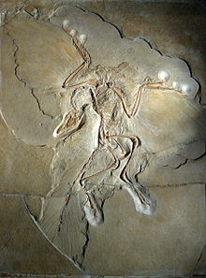
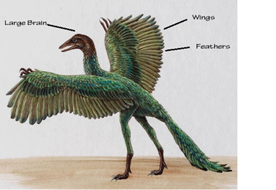
Archaeopteryx

Slide 28
Mesozoic-Age of Reptiles
Triassic Period
First dinosaurs and mammals appear
Gymnosperm plants appear (naked seed plants)
Jurassic Period
Dinosaurs dominate the land
Ruled for 150 million years
Archaeopteryx
First bird
Evolved from dinos?

Slide 29
Mesozoic-Age of Reptiles
Cretaceous Period
Tyrannosaurus Rex common
Turtles and crocodiles appear
Angiosperms (flowering plants)
At end, mass extinction 65 mya
50% of all plants and animals gone including all the dinos?

Slide 30
Cenozoic Era- Age of Mammals
Tertiary Period
Warm mild climate
Whales and dolphins flourish
Grasses evolve
Grazing animals
Quaternary Period
Climate cooled
Series of ice ages challenge life
4.5 mya
Human ancestors appear in Africa
20,000 ya
Warming trend begins

Slide 31
Chapter 17
Section 4

Slide 32
Patterns of Macroevolution
Extinction
Small scale
Mass
Originally thought it was caused by 1 event
Now, it is believed to be a combination of a bunch of events
Adaptive Radiation
One species evolves into several different species

Slide 33
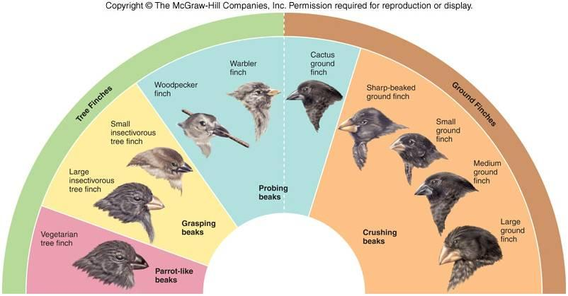

Slide 34
Patterns of Macroevolution
Extinction
Small scale
Mass
Originally thought it was caused by 1 event
Now, it is believed to be a combination of a bunch of events
Adaptive Radiation
One species evolves into several different species
Convergent evolution
Unrelated species resemble each other
Experience similar selection pressures

Slide 35
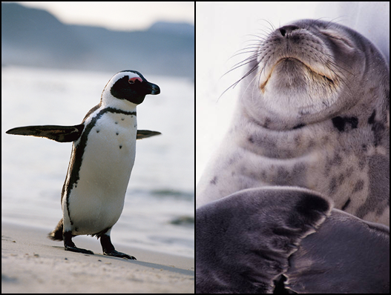

Slide 36
Patterns of Macroevolution
Extinction
Small scale
Mass
Originally thought it was caused by 1 event
Now, it is believed to be a combination of a bunch of events
Adaptive Radiation
One species evolves into several different species
Convergent evolution
Unrelated species resemble each other
Experience similar selection pressures
Ex. Shark, penguin and dolphins, sea lions

Slide 37
Patterns of Macroevolution
Coevolution
Two species evolve in response to one another
Ex. Flowering plants and insects
Punctuated equilibrium
Rapid evolutional spurts followed by periods of long stability
Developmental Genes and Body Plans
Hox genes

