Slide 1
Honors Biology Chapter 10
Section 1

Slide 2
Cell Growth
To get bigger or make more cells that is the question?
Limit to cell growth
DNA overload
DNA’s function
Protein synthesis, everything is made of proteins
Transport of materials
As cell gets larger, what would happen to rate of diffusion of materials?
Consider a plant cell

Slide 3
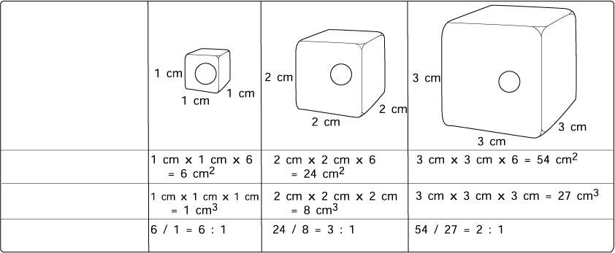
Ratio of Surface Area to Volume in Cells
Cell Size
Surface Area (length x width x 6)
Volume
(length x width x height)
Ratio of Surface Area to Volume

Slide 4
Cell Growth
To get bigger or make more cells that is the question?
Limit to cell growth
DNA overload
DNA’s function
Protein synthesis, everything is made of proteins
Transport of materials
As cell gets larger, what would happen to rate of diffusion of materials?
Consider a plant cell
Surface area L X W X # of sides
Volume L X W X H
Ratio

Slide 5
Cell Division
Process of creating two new daughter cells from one
Genetically identical
Purpose
Regulates the size of a cell
Repair of damaged cells
Replace old cells
Asexual Reproduction

Slide 6
Honors Biology Chapter 10
Section 2

Slide 7
Prokaryotes v. Eukaryotes Cell Division
Prokaryotes
Cell division is a two step process
Copy DNA
Divide cytoplasm
Eukaryotes
Much more complex
Cell division includes two main processes
Mitosis-
Cytokinesis

Slide 8
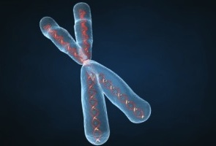
Chromosomes
Become visible in the cell only prior to cell division
DNA becomes tightly coiled
Structure

Slide 9
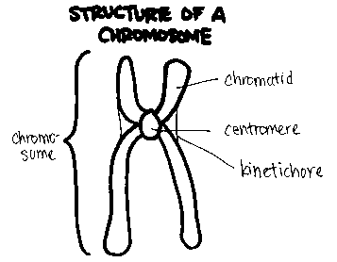

Slide 10
Chromosomes
Become visible in the cell only prior to cell division
DNA becomes tightly coiled
Structure
Chromosome number

Slide 11
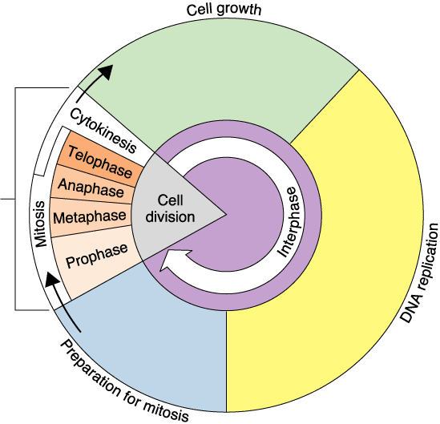
Figure 10–4 The Cell Cycle
G₁ phase
M phase
S phase
G₂ phase

Slide 12
Cell Cycle
Interphase
Preparation for mitosis
Normal cell activities
3 sub phases
G₁ Phase(first gap)
Cell growth
Raw materials created for DNA synthesis
S Phase (synthesis)
DNA is replicated
G₂ Phase
New organelles are created
Proteins needed for spindle fibers are created
M phase
Composed of two parts
Mitosis
Cytokinesis

Slide 13
Mitosis Explained
4 phases
Prophase
Chromosomes condense and become visible
Spindle fibers are created
Centriole
From microtubules
Nuclear envelope breaks down
Spindle fibers attach to chromatids within centromere

Slide 14
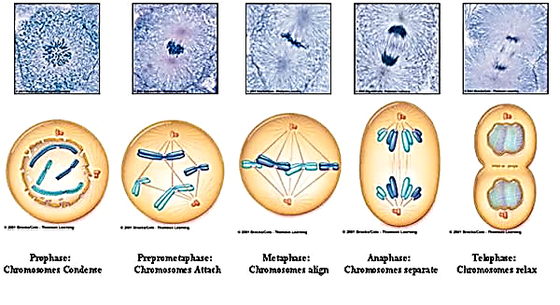

Slide 15
Mitosis Explained
4 phases
Prophase
Chromosomes condense and become visible
Spindle fibers are created
Centriole
From microtubules
Nuclear envelope breaks down
Spindle fibers attach to chromatids within centromere
Metaphase
Chromosomes line up across middle

Slide 17
Mitosis Explained
4 phases continued
Anaphase
Centromeres break down
Sister chromatids separate
Daughter chromosomes
Pulled by spindle fibers
At end, chromosomes are at opposite poles

Slide 19
Mitosis Explained
4 phases continued
Anaphase
Centromeres break down
Sister chromatids separate
Daughter chromosomes
Pulled by spindle fibers
At end, chromosomes are at opposite poles
Telophase
Chromosomes begin to uncoil
Spindle fibers break down
Nuclei reform

Slide 21
Cytokinesis Explained
Animal cell
Cytoplasm is pinched inward by proteins
Actin and myosin

Slide 22
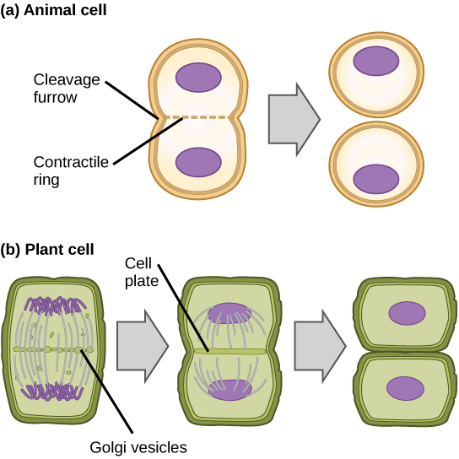

Slide 23
Cytokinesis Explained
Animal cell
Cytoplasm is pinched inward by proteins
Actin and myosin
Plant cells
Create a cell plate
Vacuoles are created by golgi apparatus

Slide 25
Honors Biology Chapter 10
Section 3

Slide 26
Regulating cell cycle
Cyclins
Protein family that when produced regulate passage of cell through cell cycle
Two major types of regulation
Internal
Checkpoints
G_{1,} G₂, and M
Stop signals
External
Growth factors
Proteins produced by cells that cause other cells to divide
Ex. MPF (maturation promoting factor)
Wound healing
Speeds up process of cell division
Density dependent
Slows down

Slide 27
Cancer
Uncontrolled cell growth
Divide to form masses of cells called tumors

Slide 28
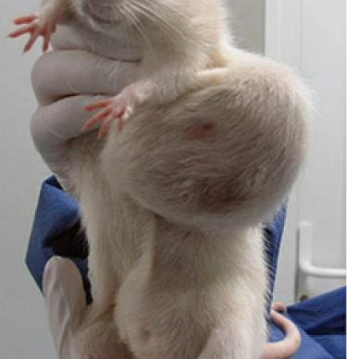

Slide 29
Cancer
Uncontrolled cell growth
Divide to form masses of cells called tumors
Benign
Malignant

Slide 30
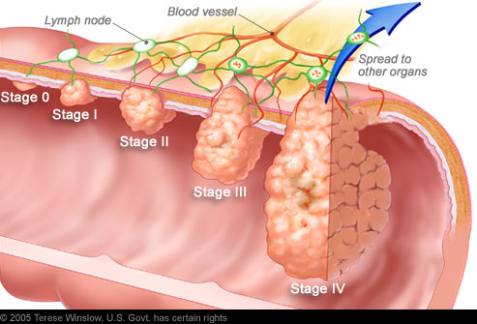

Slide 31
Cancer
Uncontrolled cell growth
Divide to form masses of cells called tumors
Benign
Malignant
Environmental triggers
Carcinogens
Genetic influence
p53 gene- oncogene
Normally does not allow cell to divide until it has the proper number of chromosomes

