Slide 1
CH 3 notes part 2

Slide 2
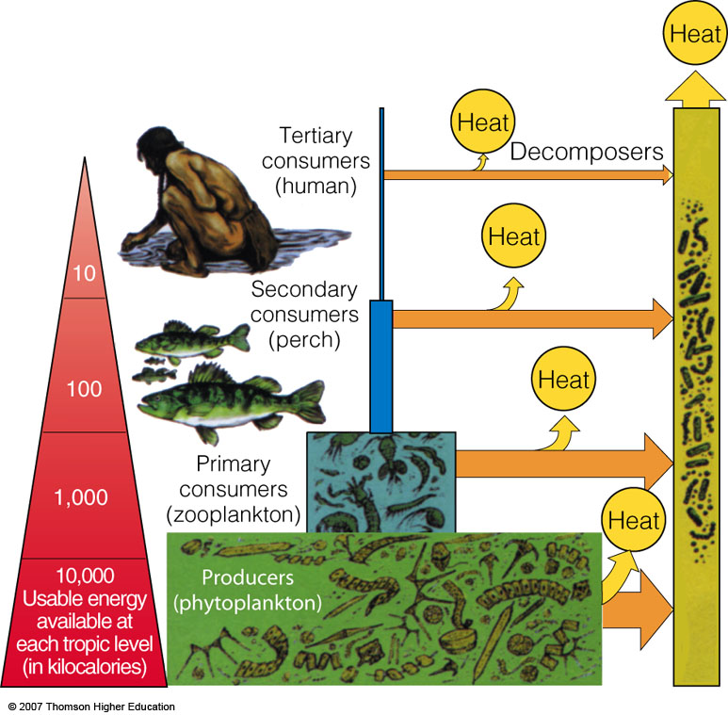
Energy Flow in an Ecosystem: Losing Energy in Food Chains and Webs
Ecological efficiency: percentage of useable energy transferred as biomass from one trophic level to the next.
Figure 3-19

Slide 3
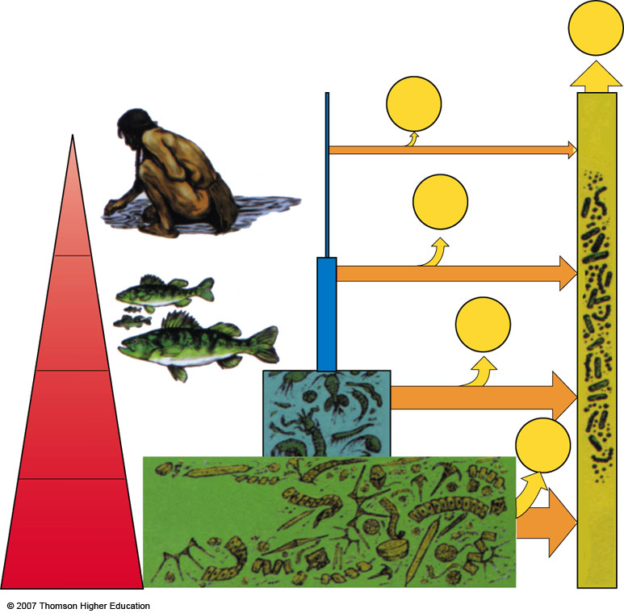
Heat
Tertiary
consumers
(human)
Heat
Decomposers
Heat
10
Secondary
consumers
(perch)
100
Heat
Primary
consumers
(zooplankton)
1,000
Heat
10,000
Usable energy
Available at
Each tropic level
(in kilocalories)
Producers
(phytoplankton)
Fig. 3-19, p. 66
Notes:
Figure 3.19
Natural capital: generalized pyramid of energy flow showing the decrease in usable energy available at each succeeding trophic level in a food chain or web. In nature, ecological efficiency varies from 2% to 40%, with 10% efficiency being common. This model assumes a 10% ecological efficiency (90% loss in usable energy to the environment, in the form of low-quality heat) with each transfer from one trophic level to another. QUESTION: Why is it a scientific error to call this a pyramid of energy?

Slide 4
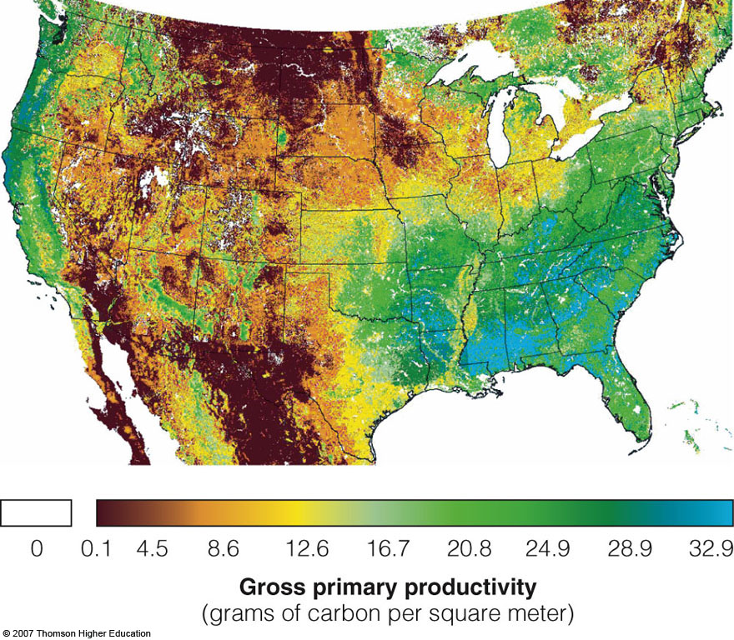
Productivity of Producers: The Rate Is Crucial
Gross primary production (GPP)
Rate at which an ecosystem’s producers convert solar energy into chemical energy as biomass.
Figure 3-20

Slide 5
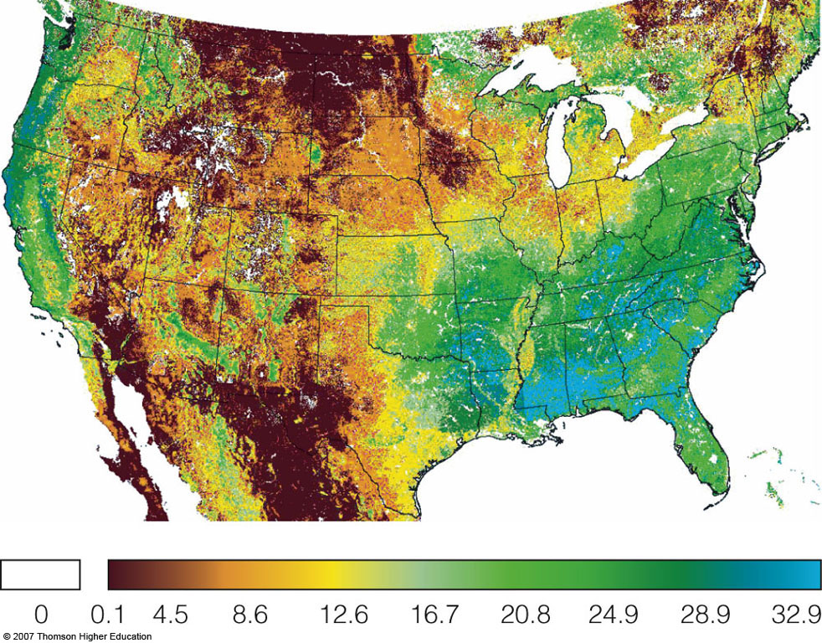
Gross primary productivity
(grams of carbon per square meter)
Fig. 3-20, p. 66
Notes:
Figure 3.20
Natural capital: gross primary productivity across the continental United States based on remote satellite data. The differences roughly correlate with variations in moisture and soil types. (NASA’s Earth Observatory)

Slide 6
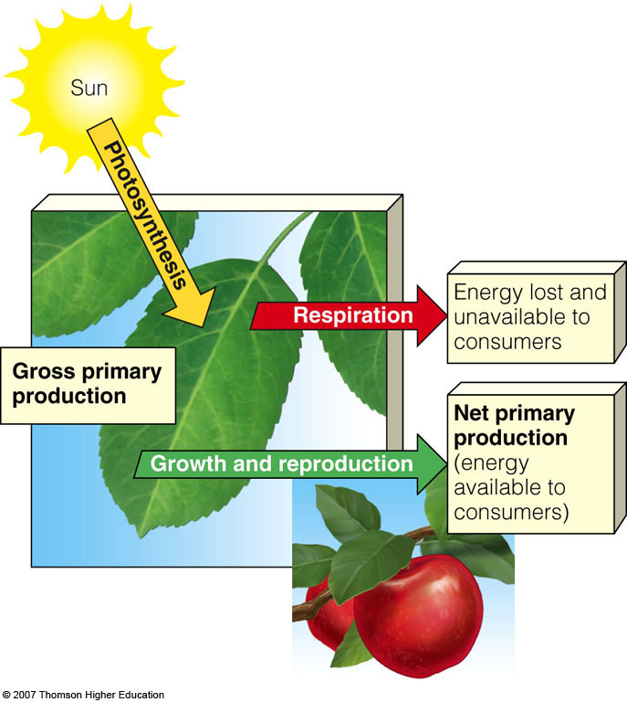
Net Primary Production (NPP)
NPP = GPP – R
Rate at which producers use photosynthesis to store energy minus the rate at which they use some of this energy through respiration (R).
Figure 3-21

Slide 7
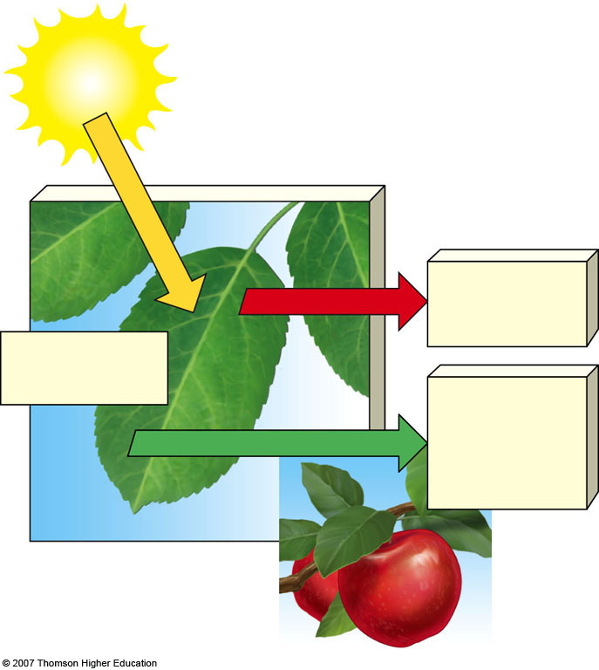
Sun
Photosynthesis
Energy lost
and unavailable to consumers
Respiration
Gross primary production
Net primary production (energy available to consumers)
Growth and reproduction
Fig. 3-21, p. 66
Notes:
Figure 3.21
Natural capital: distinction between gross primary productivity and net primary productivity. A plant uses some of its gross primary productivity to survive through respiration. The remaining energy is available to consumers.

Slide 8
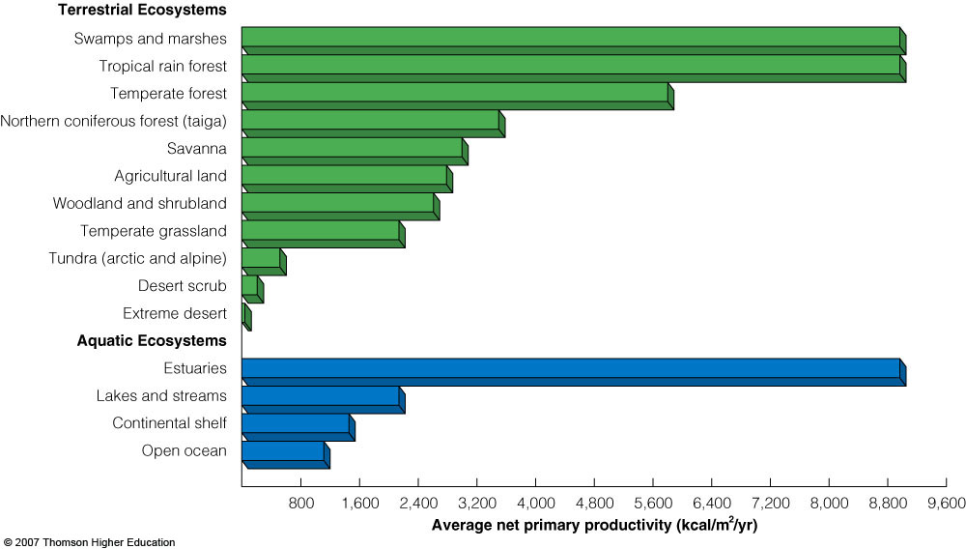
What are nature’s three most productive and three least productive systems?
Figure 3-22

Slide 9
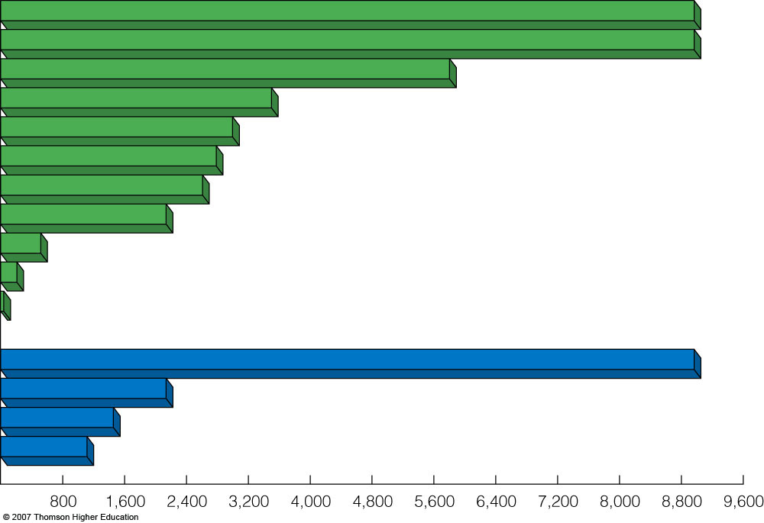
Terrestrial Ecosystems
Swamps and marshes
Tropical rain forest
Temperate forest
North. coniferous forest
Savanna
Agricultural land
Woodland and shrubland
Temperate grassland
Tundra (arctic and alpine)
Desert scrub
Extreme desert
Aquatic Ecosystems
Estuaries
Lakes and streams
Continental shelf
Open ocean
Average net primary productivity (kcal/m² /yr)
Fig. 3-22, p. 67
Notes:
Figure 3.22
Natural capital: estimated annual average net primary productivity per unit of area in major life zones and ecosystems, expressed as kilocalories of energy produced per square meter per year (kcal/m²/yr). QUESTION: What are nature’s three most productive and three least productive systems? (Data from Communities and Ecosystems, 2nd ed., by R. H. Whittaker, 1975. New York: Macmillan)

Slide 10
SOIL: A RENEWABLE RESOURCE
Soil is a slowly renewed resource that provides most of the nutrients needed for plant growth and also helps purify water.
Soil formation begins when bedrock is broken down by physical, chemical and biological processes called weathering.
Mature soils, or soils that have developed over a long time are arranged in a series of horizontal layers called soil horizons.

Slide 11
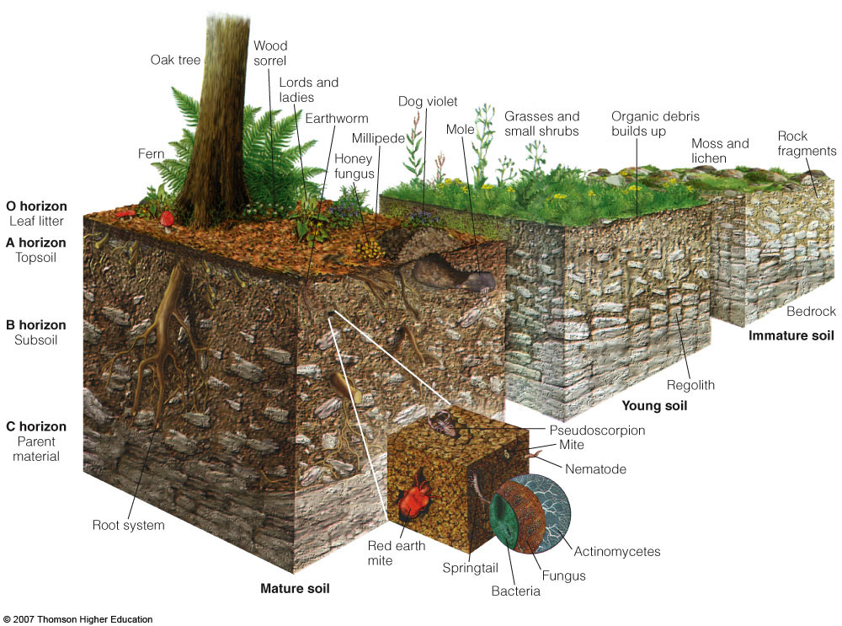
SOIL: A RENEWABLE RESOURCE
Figure 3-23

Slide 12
Wood
sorrel
Oak tree
Lords and
ladies
Dog violet
Organic debris
builds up
Grasses and
small shrubs
Rock
fragments
Earthworm
Millipede
Fern
Moss and
lichen
Honey
fungus
O horizon
Mole
Leaf litter
A horizon
Topsoil
B horizon
Bedrock
Subsoil
Immature soil
Regolith
C horizon
Young soil
Pseudoscorpion
Parent
material
Mite
Nematode
Root system
Red Earth
Mite
Actinomycetes
Fungus
Mature soil
Bacteria
Springtail
Fig. 3-23, p. 68
Notes:
Figure 3.23
Natural capital: soil formation and generalized soil profile. Horizons, or layers, vary in number, composition, and thickness, depending on the type of soil. (Used by permission of Macmillan Publishing Company from Derek Elsom, Earth, New York: Macmillan, 1992. Copyright © 1992 by Marshall Editions Developments Limited)

Slide 13
Layers in Mature Soils
Infiltration: the downward movement of water through soil.
Leaching: dissolving of minerals and organic matter in upper layers carrying them to lower layers.
The soil type determines the degree of infiltration and leaching.

Slide 14
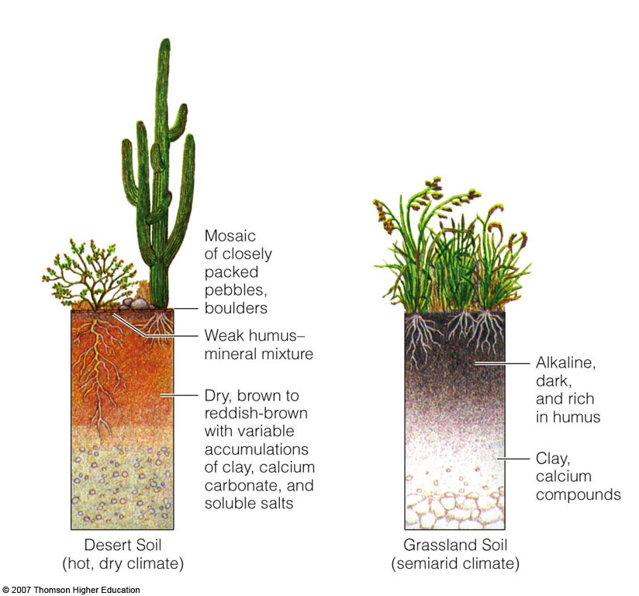
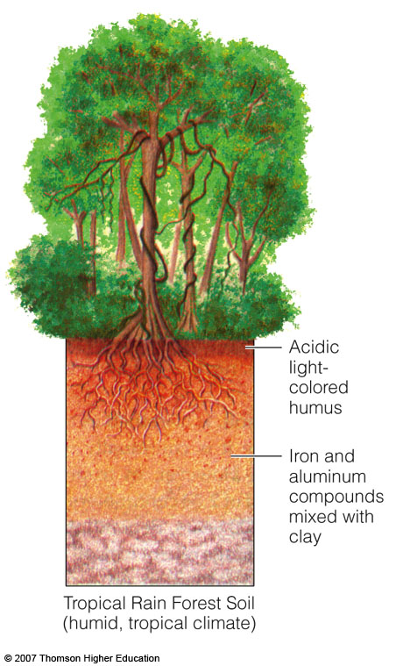
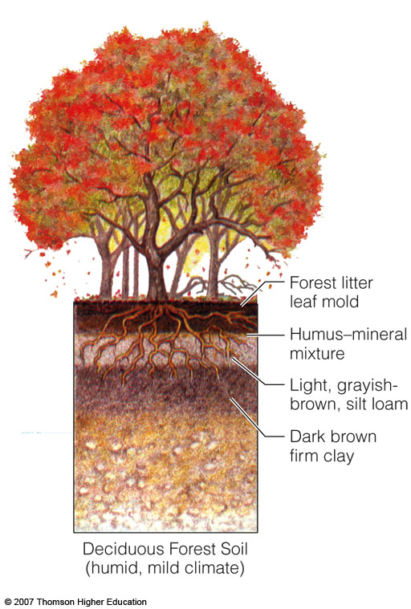
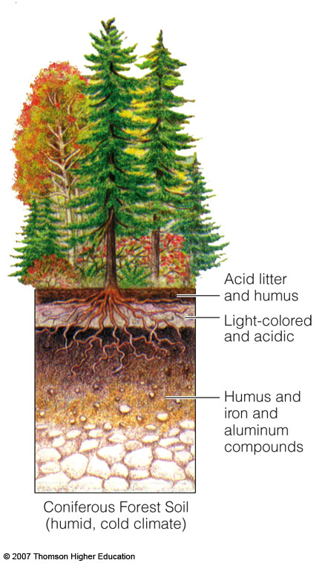
Soil Profiles of the Principal Terrestrial Soil Types
Figure 3-24

Slide 15
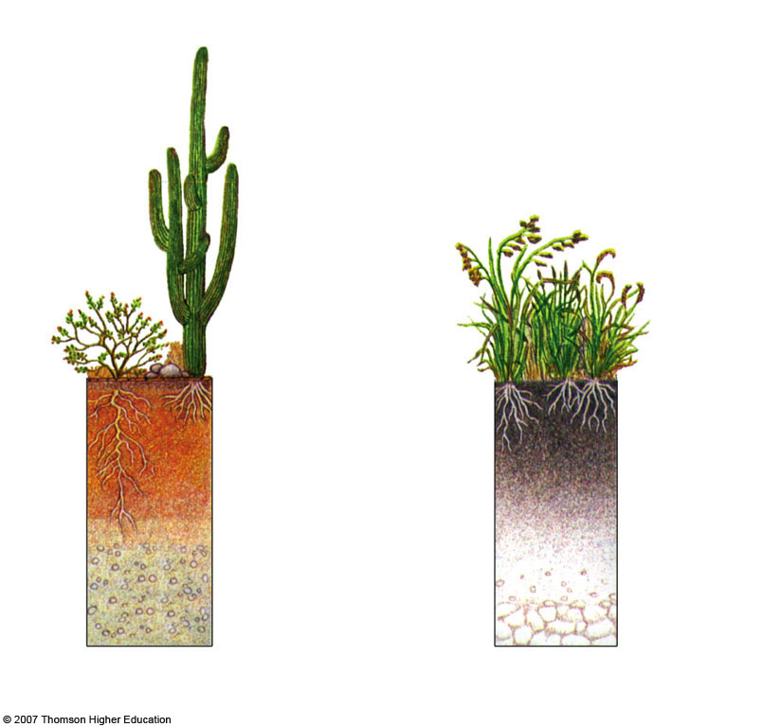
Mosaic of closely packed pebbles, boulders
Weak humus-mineral mixture
Alkaline,
dark,
and rich
in humus
Dry, brown to reddish-brown with variable accumulations of clay, calcium and carbonate, and soluble salts
Clay, calcium compounds
Desert Soil
(hot, dry climate)
Grassland Soil
semiarid climate)
Fig. 3-24a, p. 69
Notes:
Figure 3.24
Natural capital: soil profiles of the principal soil types typically found in five types of terrestrial ecosystems.

Slide 16
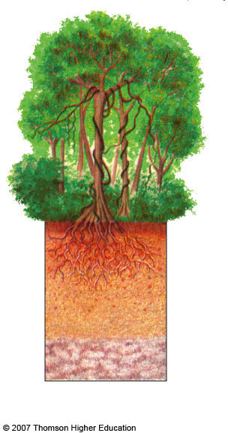
Acidic
light-colored humus
Iron and aluminum compounds mixed with clay
Tropical Rain Forest Soil
(humid, tropical climate)
Fig. 3-24b, p. 69
Notes:
Figure 3.24
Natural capital: soil profiles of the principal soil types typically found in five types of terrestrial ecosystems.

Slide 17
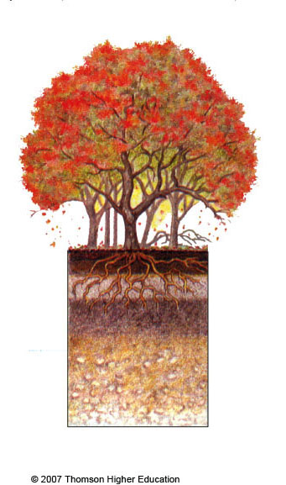
Forest litter leaf mold
Humus-mineral mixture
Light, grayish-brown, silt loam
Dark brown firm clay
Deciduous Forest Soil
(humid, mild climate)
Fig. 3-24b, p. 69
Notes:
Figure 3.24
Natural capital: soil profiles of the principal soil types typically found in five types of terrestrial ecosystems.

Slide 18
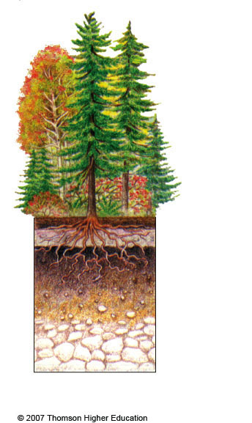
Acid litter and humus
Light-colored and acidic
Humus and iron and aluminum compounds
Coniferous Forest Soil
(humid, cold climate)
Fig. 3-24b, p. 69
Notes:
Figure 3.24
Natural capital: soil profiles of the principal soil types typically found in five types of terrestrial ecosystems.

Slide 19
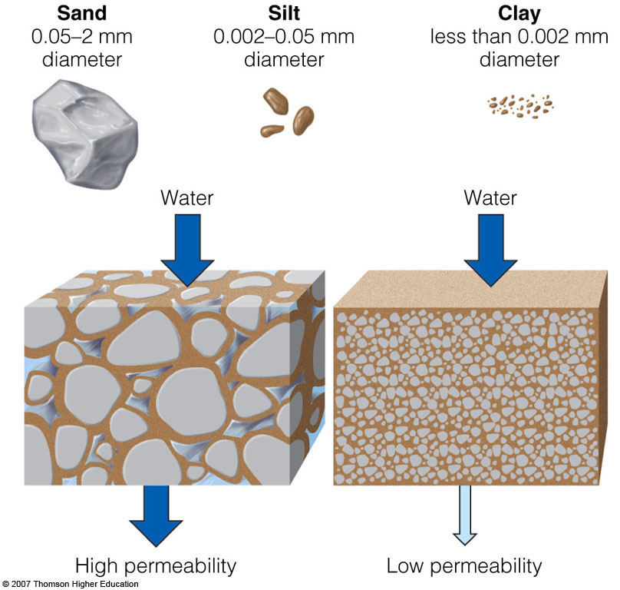
Some Soil Properties
Soils vary in the size of the particles they contain, the amount of space between these particles, and how rapidly water flows through them.
Figure 3-25

Slide 20
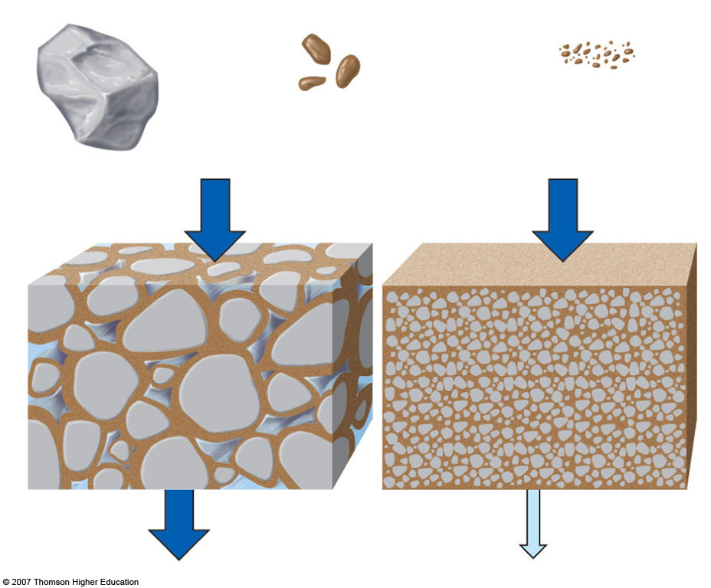
Sand
Silt
Clay
0.05–2 mm
diameter
0.002–0.05 mm
diameter
less than 0.002 mm
Diameter
Water
Water
High permeability
Low permeability
Fig. 3-25, p. 70
Notes:
Figure 3.25
Natural capital: the size, shape, and degree of clumping of soil particles determine the number and volume of spaces for air and water within a soil. Soils with more pore spaces (left) contain more air and are more permeable to water than soils with fewer pores (right).

Slide 21
MATTER CYCLING IN ECOSYSTEMS
Nutrient Cycles: Global Recycling
Global Cycles recycle nutrients through the earth’s air, land, water, and living organisms.
Nutrients are the elements and compounds that organisms need to live, grow, and reproduce.
Biogeochemical cycles move these substances through air, water, soil, rock and living organisms.

Slide 22
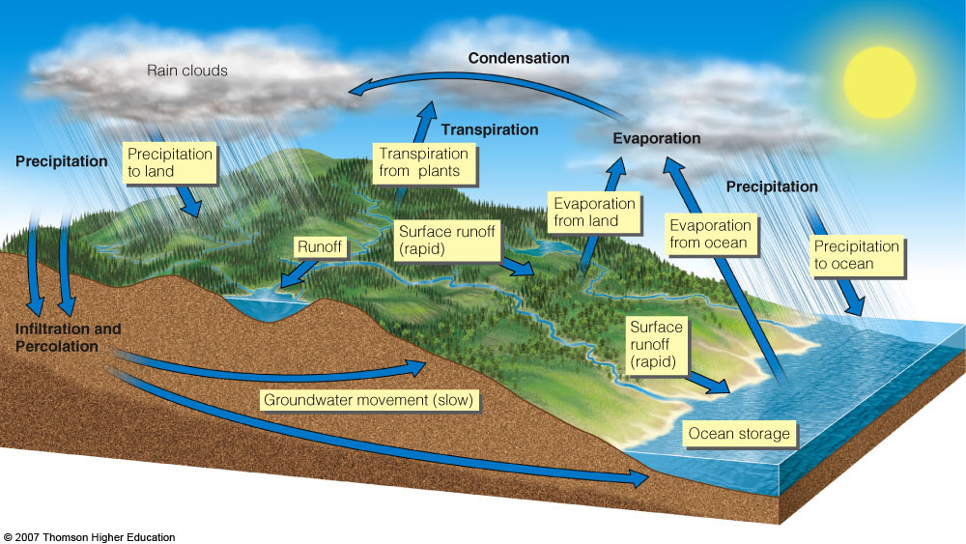
The Water Cycle
Figure 3-26

Slide 23
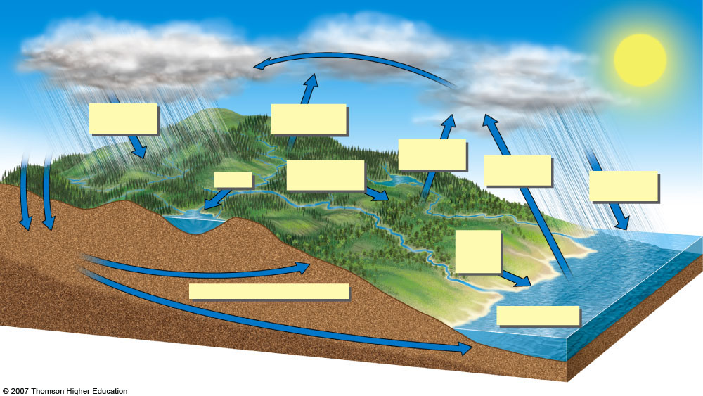
Condensation
Rain clouds
Transpiration
Evaporation
Precipitation to land
Transpiration from plants
Precipitation
Precipitation
Evaporation from land
Surface runoff (rapid)
Evaporation from ocean
Runoff
Precipitation to ocean
Infiltration and Percolation
Surface runoff (rapid)
Groundwater movement (slow)
Ocean storage
Fig. 3-26, p. 72
Notes:
Figure 3.26
Natural capital: simplified model of the hydrologic cycle.

Slide 24
Water’ Unique Properties
There are strong forces of attraction between molecules of water.
Water exists as a liquid over a wide temperature range.
Liquid water changes temperature slowly.
It takes a large amount of energy for water to evaporate.
Liquid water can dissolve a variety of compounds.
Water expands when it freezes.

Slide 25
Effects of Human Activities on Water Cycle
We alter the water cycle by:
Withdrawing large amounts of freshwater.
Clearing vegetation and eroding soils.
Polluting surface and underground water.
Contributing to climate change.

Slide 26
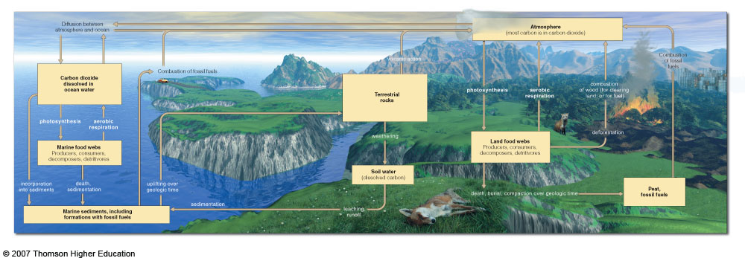
The Carbon Cycle: Part of Nature’s Thermostat
Figure 3-27

Slide 27
Fig. 3-27, pp. 72-73
Notes:
Figure 3.27
Natural capital: simplified model of the global carbon cycle. Carbon moves through both marine ecosystems (left side) and terrestrial ecosystems (right side). Carbon reservoirs are shown as boxes; processes that change one form of carbon to another are shown in unboxed print. QUESTION: What are three ways in which your lifestyle directly or indirectly affects the carbon cycle? (From Cecie Starr, Biology: Concepts and Applications, 4th ed., Pacific Grove, Calif.: Brooks/Cole, © 2000)

Slide 28
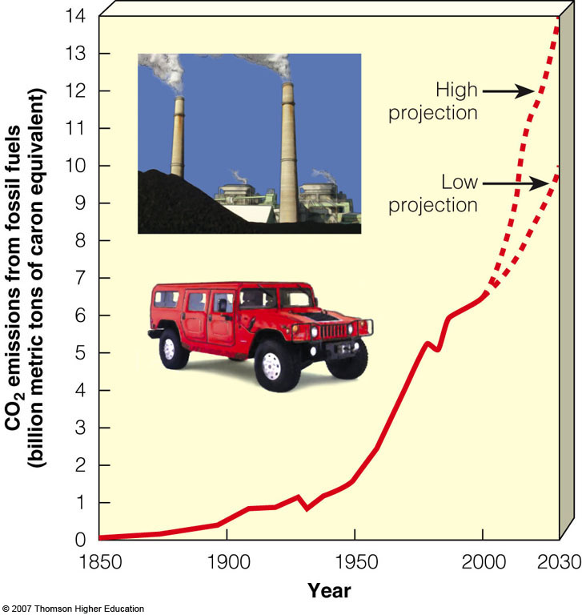
Effects of Human Activities on Carbon Cycle
We alter the carbon cycle by adding excess CO₂ to the atmosphere through:
Burning fossil fuels.
Clearing vegetation faster than it is replaced.
Figure 3-28

Slide 29
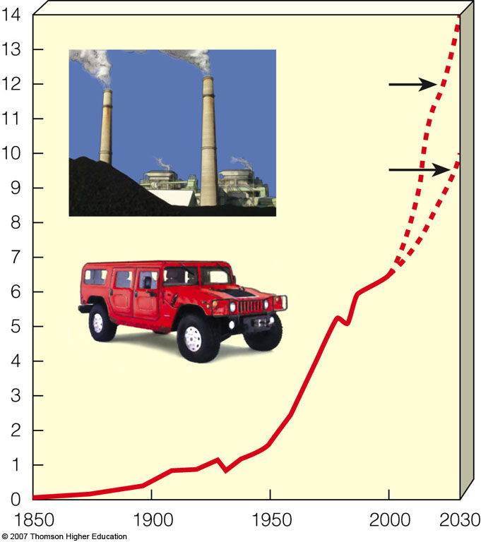
High
projection
Low
projection
CO₂ emissions from fossil fuels
(billion metric tons of carbon equivalent)
Year
Fig. 3-28, p. 74
Notes:
Figure 3.28
Natural capital degradation: human interference in the global carbon cycle from carbon dioxide emissions when fossil fuels are burned and forests are cleared, 1850 to 2006 and projections to 2030 (dashed lines). (Data from UN Environment Programme, British Petroleum, International Energy Agency, and U.S. Department of Energy)

Slide 30
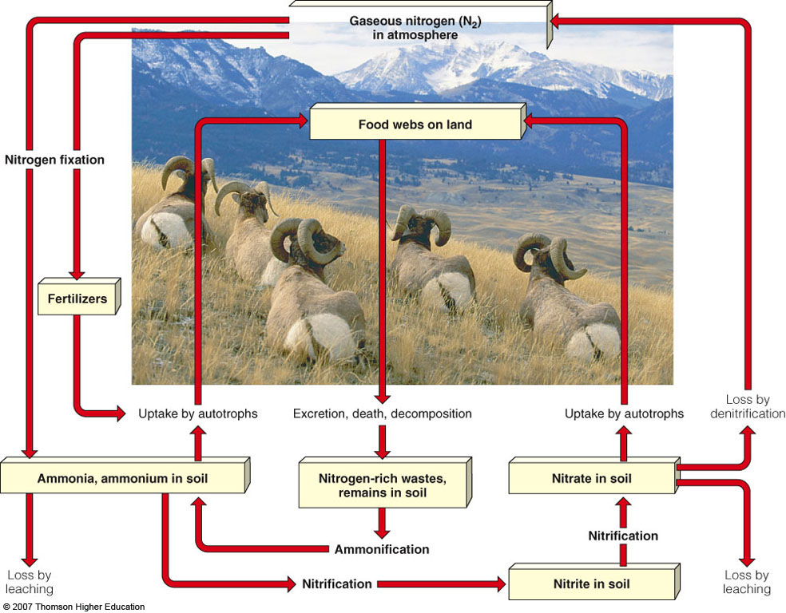
The Nitrogen Cycle: Bacteria in Action
Figure 3-29

Slide 31
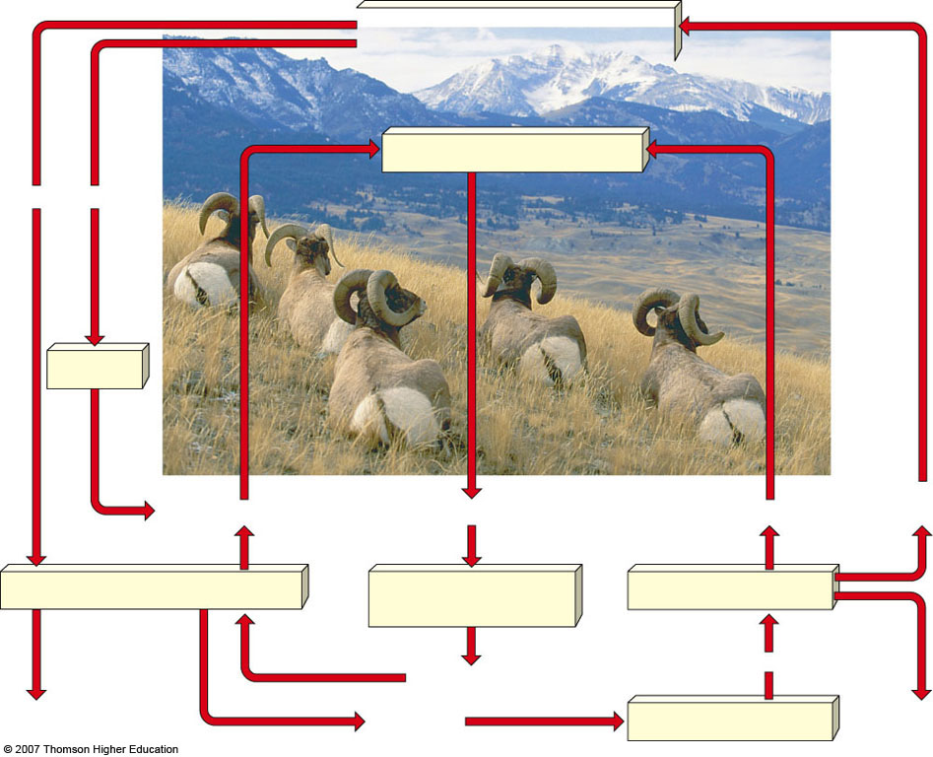
Gaseous nitrogen (N₂)
in atmosphere
Food webs on land
Nitrogen fixation
Fertilizers
Excretion, death, decomposition
Uptake by autotrophs
Loss by
denitrification
Uptake by autotrophs
Ammonia, ammonium in soil
Nitrogen-rich wastes,
remains in soil
Nitrate in soil
Ammonification
Nitrification
Loss by
leaching
Loss by
leaching
Nitrite in soil
Nitrification
Fig. 3-29, p. 75
Notes:
Figure 3.29
Natural capital: simplified model of the nitrogen cycle in a terrestrial ecosystem. Nitrogen reservoirs are shown as boxes; processes changing one form of nitrogen to another are shown in unboxed print. QUESTION: What are three ways in which your lifestyle directly or indirectly affects the nitrogen cycle? (Adapted from Cecie Starr, Biology: Today and Tomorrow, Brooks/Cole © 2005)

Slide 32
Effects of Human Activities on the Nitrogen Cycle
We alter the nitrogen cycle by:
Adding gases that contribute to acid rain.
Adding nitrous oxide to the atmosphere through farming practices which can warm the atmosphere and deplete ozone.
Contaminating ground water from nitrate ions in inorganic fertilizers.
Releasing nitrogen into the troposphere through deforestation.

Slide 33
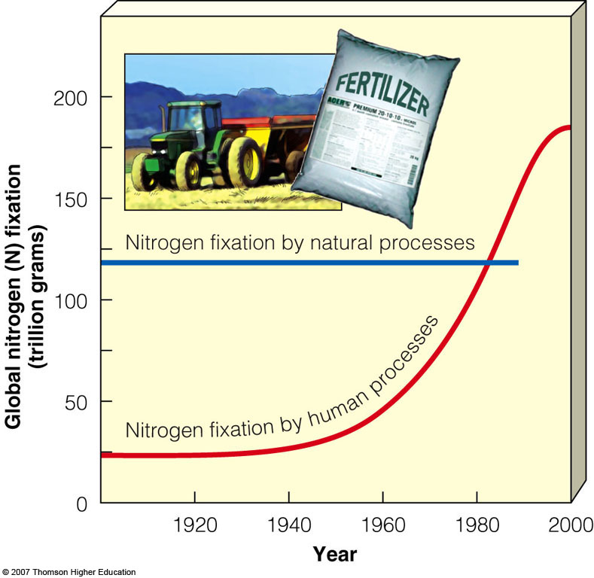
Effects of Human Activities on the Nitrogen Cycle
Human activities such as production of fertilizers now fix more nitrogen than all natural sources combined.
Figure 3-30

Slide 34
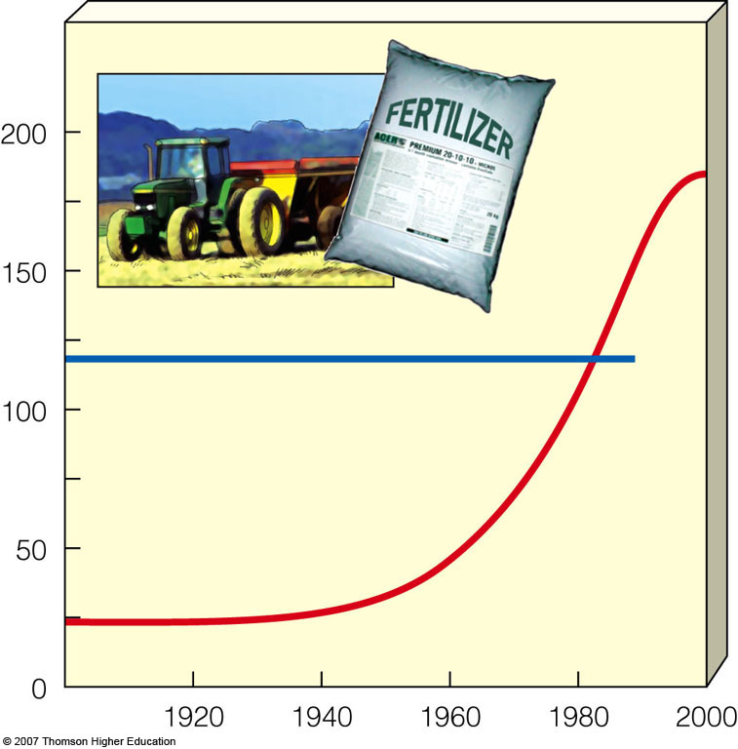
Nitrogen fixation by natural processes
Global nitrogen (N) fixation
(trillion grams)
Nitrogen fixation by human processes
Year
Fig. 3-30, p. 76
Notes:
Figure 3.30
Natural capital degradation: human interference in the global nitrogen cycle. Human activities such as production of fertilizers now fix more nitrogen than all natural sources combined. (Data from UN Environment Programme, UN Food and Agriculture Organization, and U.S. Department of Agriculture)

Slide 35
The Phosphorous Cycle
Figure 3-31

Slide 36
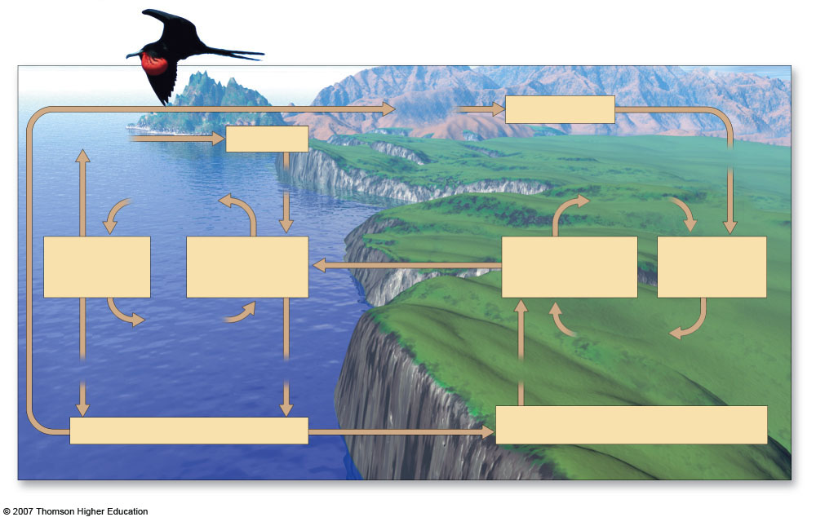
mining
Fertilizer
excretion
Guano
agriculture
uptake by
autotrophs
weathering
uptake by
autotrophs
Marine
Food
Webs
Dissolved
in Ocean
Water
leaching, runoff
Dissolved
in Soil Water,
Lakes, Rivers
Land
Food
Webs
death,
decomposition
death,
decomposition
sedimentation
settling out
weathering
uplifting over
geologic time
Marine Sediments
Rocks
Fig. 3-31, p. 77
Notes:
Figure 3.31
Natural capital: simplified model of the phosphorus cycle. Phosphorus reservoirs are shown as boxes; processes that change one form of phosphorus to another are shown in unboxed print. QUESTION: What are three ways in which your lifestyle directly or indirectly affects the phosphorus cycle? (From Cecie Starr and Ralph Taggart, Biology: The Unity and Diversity of Life, 9th ed., Belmont, Calif.: Wadsworth © 2001)

Slide 37
Effects of Human Activities on the Phosphorous Cycle
We remove large amounts of phosphate from the earth to make fertilizer.
We reduce phosphorous in tropical soils by clearing forests.
We add excess phosphates to aquatic systems from runoff of animal wastes and fertilizers.

Slide 38
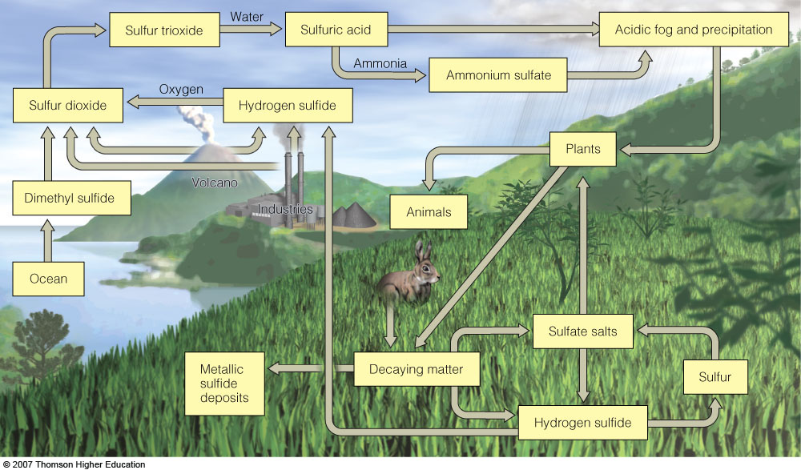
The Sulfur Cycle
Figure 3-32

Slide 39
Sulfur
trioxide
Water
Acidic fog and precipitation
Sulfuric acid
Ammonia
Ammonium
sulfate
Oxygen
Sulfur dioxide
Hydrogen sulfide
Plants
Dimethyl sulfide
Volcano
Industries
Animals
Ocean
Sulfate salts
Metallic
sulfide
deposits
Decaying matter
Sulfur
Hydrogen sulfide
Fig. 3-32, p. 78
Notes:
Figure 3.32
Natural capital: simplified model of the sulfur cycle. The movement of sulfur compounds in living organisms is shown in green, blue in aquatic systems, and orange in the atmosphere. QUESTION: What are three ways in which your lifestyle directly or indirectly affects the sulfur cycle?

Slide 40
Effects of Human Activities on the Sulfur Cycle
We add sulfur dioxide to the atmosphere by:
Burning coal and oil
Refining sulfur containing petroleum.
Convert sulfur-containing metallic ores into free metals such as copper, lead, and zinc releasing sulfur dioxide into the environment.

Slide 41
The Gaia Hypothesis: Is the Earth Alive?
Some have proposed that the earth’s various forms of life control or at least influence its chemical cycles and other earth-sustaining processes.
The strong Gaia hypothesis: life controls the earth’s life-sustaining processes.
The weak Gaia hypothesis: life influences the earth’s life-sustaining processes.

Slide 42
HOW DO ECOLOGISTS LEARN ABOUT ECOSYSTEMS?
Ecologist go into ecosystems to observe, but also use remote sensors on aircraft and satellites to collect data and analyze geographic data in large databases.
Geographic Information Systems
Remote Sensing
Ecologists also use controlled indoor and outdoor chambers to study ecosystems

Slide 43
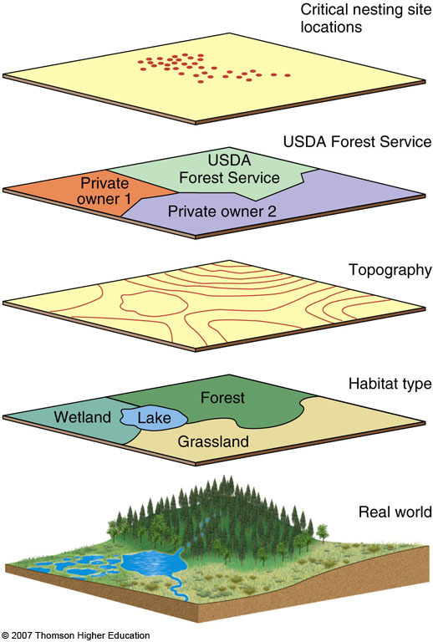
Geographic Information Systems (GIS)
A GIS organizes, stores, and analyzes complex data collected over broad geographic areas.
Allows the simultaneous overlay of many layers of data.
Figure 3-33

Slide 44
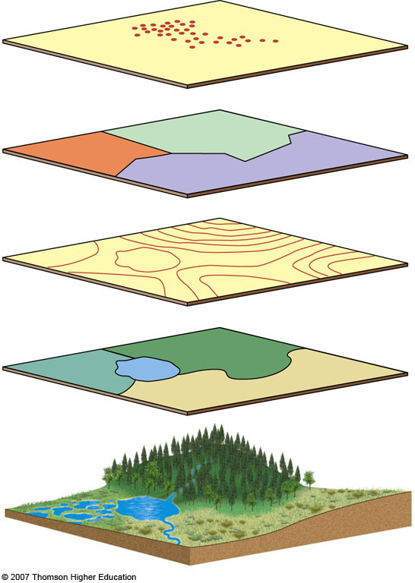
Critical nesting site locations
USDA Forest Service
USDA
Forest Service
Private
owner 1
Private owner 2
Topography
Habitat type
Forest
Wetland
Lake
Grassland
Real world
Fig. 3-33, p. 79
Notes:
Figure 3.33
Geographic information systems (GISs) provide the computer technology for organizing, storing, and analyzing complex data collected over broad geographic areas. They enable scientists to overlay many layers of data (such as soils, topography, distribution of endangered populations, and land protection status).

Slide 45
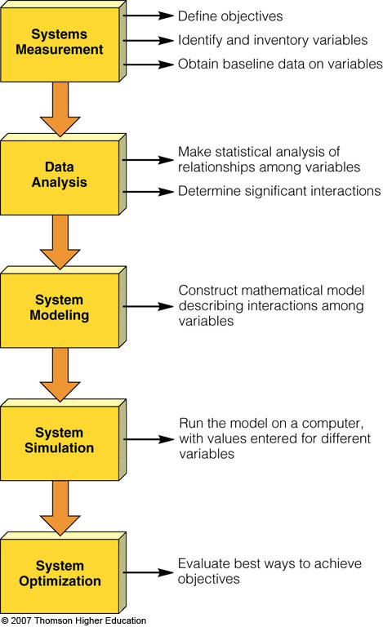
Systems Analysis
Ecologists develop mathematical and other models to simulate the behavior of ecosystems.
Figure 3-34

Slide 46
Define objectives
Systems
Measurement
Identify and inventory variables
Obtain baseline data on variables
Make statistical analysis of
relationships among variables
Data
Analysis
Determine significant interactions
System
Modeling
Objectives Construct mathematical model
describing interactions among
variables
System
Simulation
Run the model on a computer,
with values entered for different
Variables
System
Optimization
Evaluate best ways to achieve
objectives
Fig. 3-34, p. 80
Notes:
Figure 3.34
Major stages of systems analysis. (Modified data from Charles Southwick)

Slide 47
Importance of Baseline Ecological Data
We need baseline data on the world’s ecosystems so we can see how they are changing and develop effective strategies for preventing or slowing their degradation.
Scientists have less than half of the basic ecological data needed to evaluate the status of ecosystems in the United Sates (Heinz Foundation 2002; Millennium Assessment 2005).

