Slide 1
Chapter 16
Section 1: Genetics of Populations

Slide 2
Population
Group of individuals of the same species in the same area at the same time that can interbreed and produce fertile offspring
Gene pool
Representation of all the alleles of all the genes within a population
Relative frequency- How often something happens divided by all outcomes.
Example: Your team has won 9 games from a total of 12 games played: the Frequency of winning is 9. the Relative Frequency of winning is 9/12 = 75%
Evolution is therefore considered to be the change in allele frequency over time

Slide 3
Sources of Variety
Mutations
Although rare, mutations happen at a regular rate in all organisms
Mutations are not evil
Natural selection will determine if the mutation is good, bad or neutral
Sexual Reproduction
Gene shuffling- result of mating between 2 individuals and events of meiosis
The gene shuffling of 23 pairs of chromosomes can produce 8.4 million different combinations of genes!

Slide 4
One gene, two genes or more?
Single gene trait
Only one gene determines the phenotype
Only two distinct phenotypes possible

Slide 5
Phenotypes for Single-Gene Trait
100
80
60
40
20
0
Frequency of Phenotype
(%)
Widow’s peak
No widow’s peak
Phenotype

Slide 6
One gene, two genes or more?
Single gene trait
Only one gene determines the phenotype
Only two distinct phenotypes possible
Polygenic trait
Traits are controlled by more than one gene
Numerous genotypes and phenotypes
Ex.
Population graph= bell curve

Slide 7
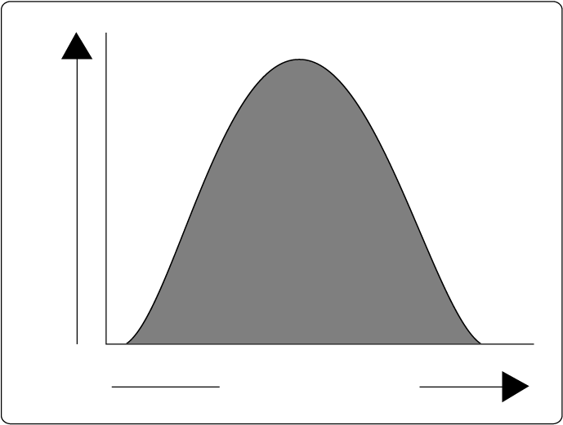
Generic Bell Curve for Polygenic Trait
Frequency of Phenotype
Phenotype (height)

Slide 8
Chapter 16
Section 2

Slide 9
Natural Selection
Can effect allele frequency in three main ways:
Directional selection
One extreme phenotype is favored over the others

Slide 10
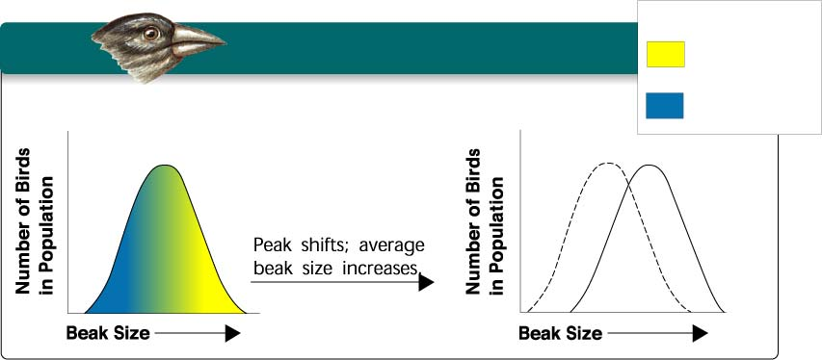
Figure 16–6 Graph of Directional Selection
Section 16-2
Key
Directional Selection
Low mortality, high fitness
Food becomes scarce.
High mortality, low fitness

Slide 11
Natural Selection
Can effect allele frequency in three main ways:
Directional selection
One extreme phenotype is favored over the others
Ex. Small seed shortage among darwins finches
Stabilizing selection
Average or mean phenotype is favored, extremes are selected against
Most common type in nature
Ex. Baby size-small vs. medium vs. large

Slide 12
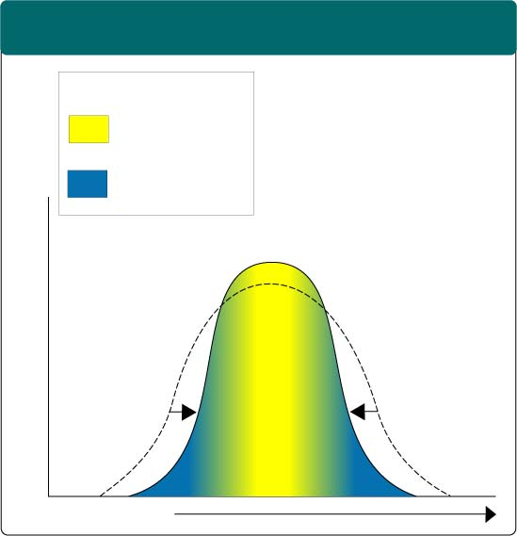
Figure 16–7 Graph of Stabilizing Selection
Section 16-2
Stabilizing Selection
Key
Low mortality, high fitness
High mortality, low fitness
Selection against both extremes keep curve narrow and in same place.
Percentage of Population
Birth Weight

Slide 13
Natural Selection
Can effect allele frequency in three main ways:
Directional selection
One extreme phenotype is favored over the others
Ex. Small seed shortage among darwins finches
Stabilizing selection
Average or mean phenotype is favored, extremes are selected against
Most common type in nature
Ex. Baby size-small vs. medium vs. large
Disruptive selection
Both extreme phenotypes are favored, being average is selected against

Slide 14
Figure 16–8 Graph of Disruptive Selection
Section 16-2
Disruptive Selection
Largest and smallest seeds become more common.
Key
Low mortality, high fitness
Population splits into two subgroups specializing in different seeds.
Number of Birds in Population
Number of Birds in Population
High mortality, low fitness
Beak Size
Beak Size

Slide 15
Natural Selection
Can effect allele frequency in three main ways:
Directional selection
One extreme phenotype is favored over the others
Ex. Small seed shortage among darwins finches
Stabilizing selection
Average or mean phenotype is favored, extremes are selected against
Most common type in nature
Ex. Baby size-small vs. medium vs. large
Disruptive selection
Both extreme phenotypes are favored, being average is selected against
Ex. Medium sized seeds among darwins finches

Slide 16
Genetic Drift
Changes in allele frequencies that take place by random chance events
Only happens in very small populations
Has nothing to do with organisms fitness
Specific type of
Founder effect
When subset of population colonizes a new habitat

Slide 17
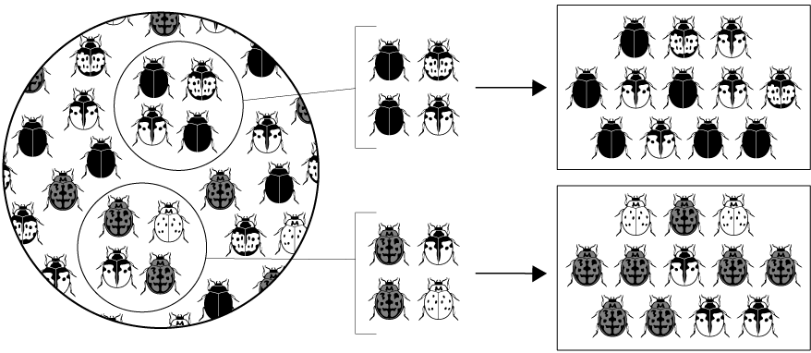
Genetic Drift
Section 16-2
Sample of
Original Population
Descendants
Founding Population A
Founding Population B

Slide 18
Genetic Drift
Section 16-2
Sample of
Original Population
Descendants
Founding Population A
Founding Population B

Slide 19
Genetic Drift
Section 16-2
Sample of
Original Population
Descendants
Founding Population A
Founding Population B

Slide 20
Genetic Equilibrium
This is what happens when no evolution is taking place.
Hardy-Weinberg Principle
Math principle
Allele frequencies will remain the same
Very rare in “real world”
Five conditions:
Random mating
Large population
No migration
No mutation
No natural selection

Slide 21
Hardy-Weinberg Principle
The Hardy–Weinberg principle, also known as the Hardy–Weinberg equilibrium, model, theorem, or law, states that allele and genotype frequencies in a population will remain constant from generation to generation in the absence of other evolutionary influences.

Slide 22
Hardy-Weinberg Equation
p²+2pq+q²=1
p+q=1
p=frequency of the dominant allele
q=frequency of the recessive allele
p²=(AA)% of homozygous dominant individuals
q²=(aa)% of homozygous recessive individuals
2pq=(Aa)% of heterozygous individuals

Slide 23
Chapter 16
Section 3: Speciation

Slide 24
Speciation
Any process that causes enough change between populations of the same species so that they can no longer interbreed.
New species
For this to happen, must be some type of isolation

Slide 25
Main Types of Isolation
Reproductive isolation
Behavioral
Courtship rituals
Temporal
Species reproduce at different times
Geographical
Two populations of a species are separated by a river, mountain or body of water

