Slide 1
10.1 Cell Reproduction
I. Why Cells Reproduce
A. Adult human body creates nearly 2 trillion cells a day
B. Necessary to help tissues/organs grow larger, to replace dead cells, & also replace damaged cells
C. Cell Size
1. as cells become larger substances must travel further to reach where they are needed
D. Cell Maintenance
1. If cells become too big DNA cannot be copied quickly enough to make necessary proteins
E. Making New Cells
1. Larger cells are harder to maintain, so cells divide when they grow to a certain size.

Slide 2
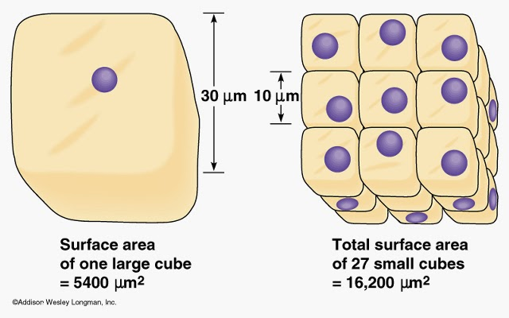

Slide 3
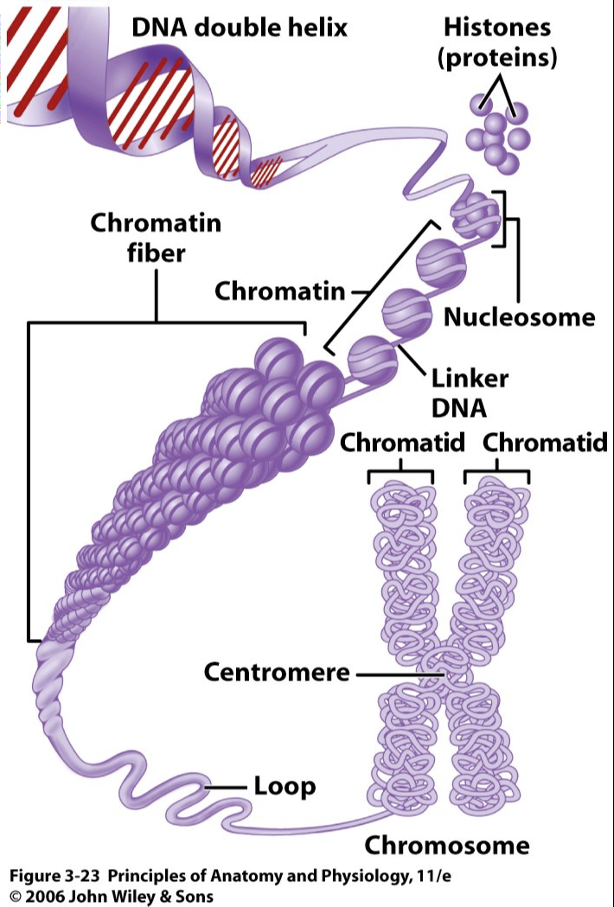
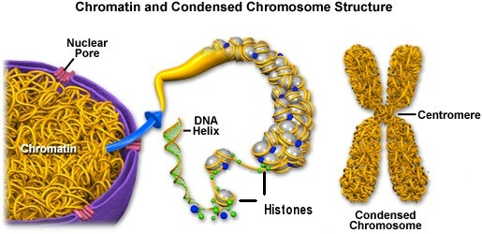
II. Chromosomes
A. Large molecules of DNA are organized into genes
1. the simplest organisms have thousands of genes
B. DNA/genes are organized & packaged into chromosomes

Slide 4
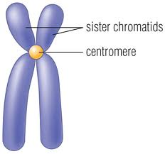
C. Prokaryotic Chromosome
1. single loop of DNA twisted upon itself many times
D. Eukaryotic Chromosome
1. DNA is highly condensed with the help of proteins
a. chromatin – DNA & proteins together
2. Histones - have DNA wrapped around them
3. Nucleosome – combination of DNA & histone core
4. Before a cell divides the chromosomes become even more condensed to ensure they do not get tangled
5. Each chromosome is made up of two sister chromatids held together in the center by a centromere

Slide 5
III. Preparing for Cell Division
A. Before a cell divides a copy of DNA must be made for each daughter cell
B. Prokaryotes
1. Binary Fission
C. Eukaryotes
1. in order to form two daughter cells each cell must contain enough of each organelle to carry out its functions

